Slide 1

Assessing Stormwater Reduction using Green Infrastructure: Gary City Hall (Gary, IN)
Dave Lampe, U.S. Geological Survey
Ohio-Kentucky-Indiana Water Science Center
Partnering with the Gary Sanitary District and
Funded through the Great Lakes Restoration Initiative

Slide 2
PROVISIONAL DATA
This information is preliminary and is subject to revision. It is being provided to meet the need for timely best science. The information is provided on the condition that neither the U.S. Geological Survey nor the U.S. Government may be held liable for any damages resulting from the authorized or unauthorized use of the information.

Slide 3
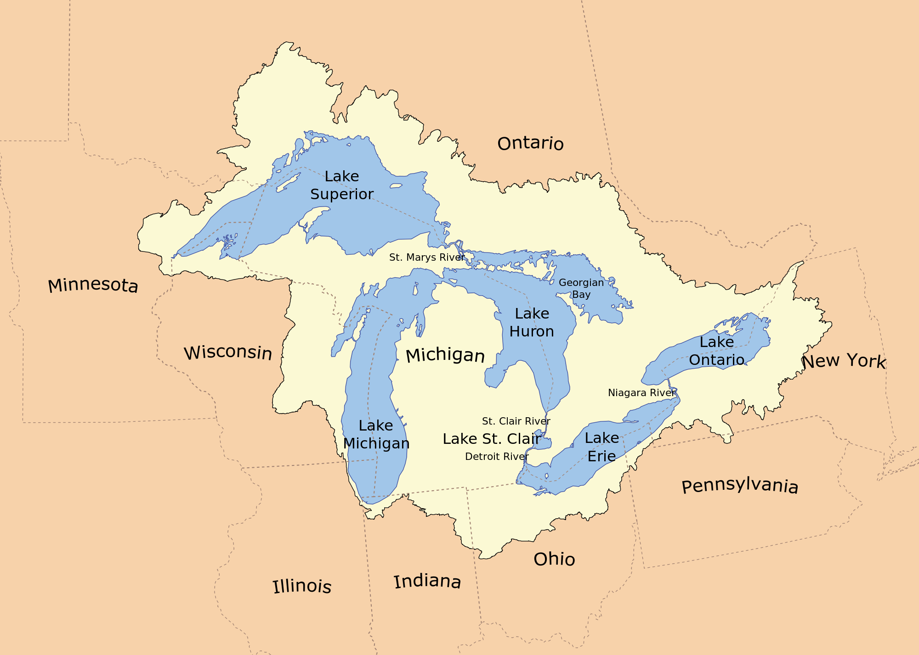
Gary City Hall - Gary, Indiana
https://www.usgs.gov/centers/umid-water/science/assessing-stormwater-reduction-using-green-infrastructure-gary-city-hall
https://blogs.umass.edu/hydrosystems/projects/upper-great-lakes/

Slide 4
Site Overview
The effectiveness of green infrastructure (rain gardens and decreased impervious surfaces) at reducing stormwater runoff is being assessed at a redevelopment project at Gary City Hall (Gary, Indiana). This study will evaluate pre- and post-construction hydrologic conditions using data collected by monitoring storm-sewer flow, groundwater levels, soil moisture, and meteorological conditions.
.
Photographs of Gary City Hall parking lot before and after installation of green infrastructure (rain garden)

Slide 5
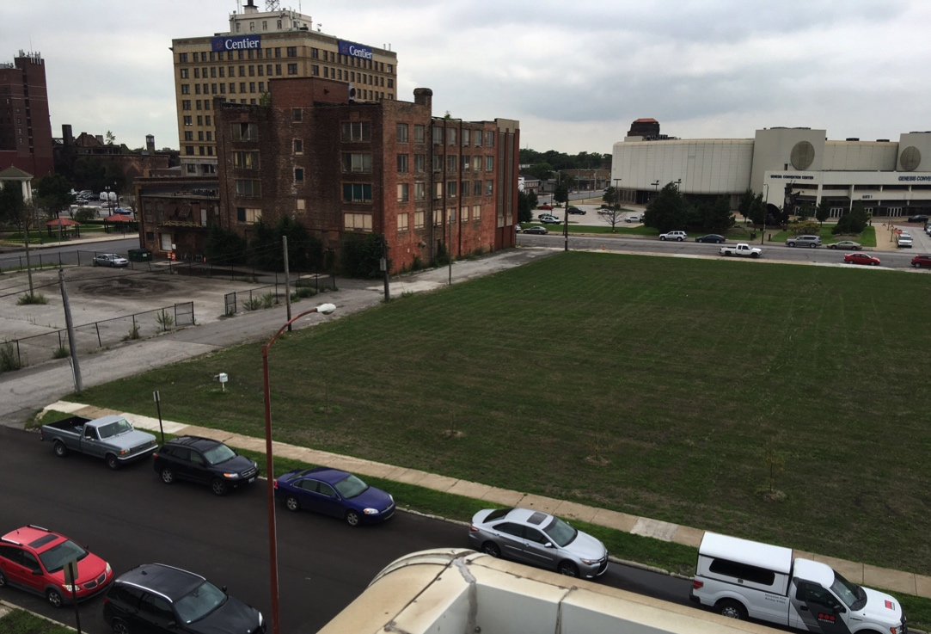
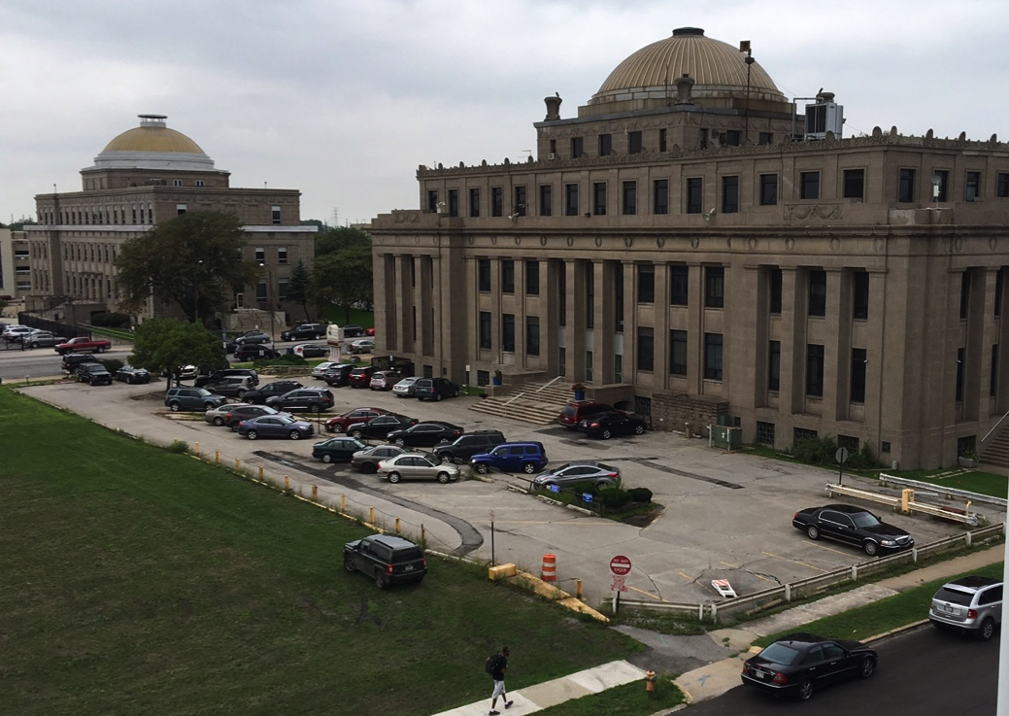
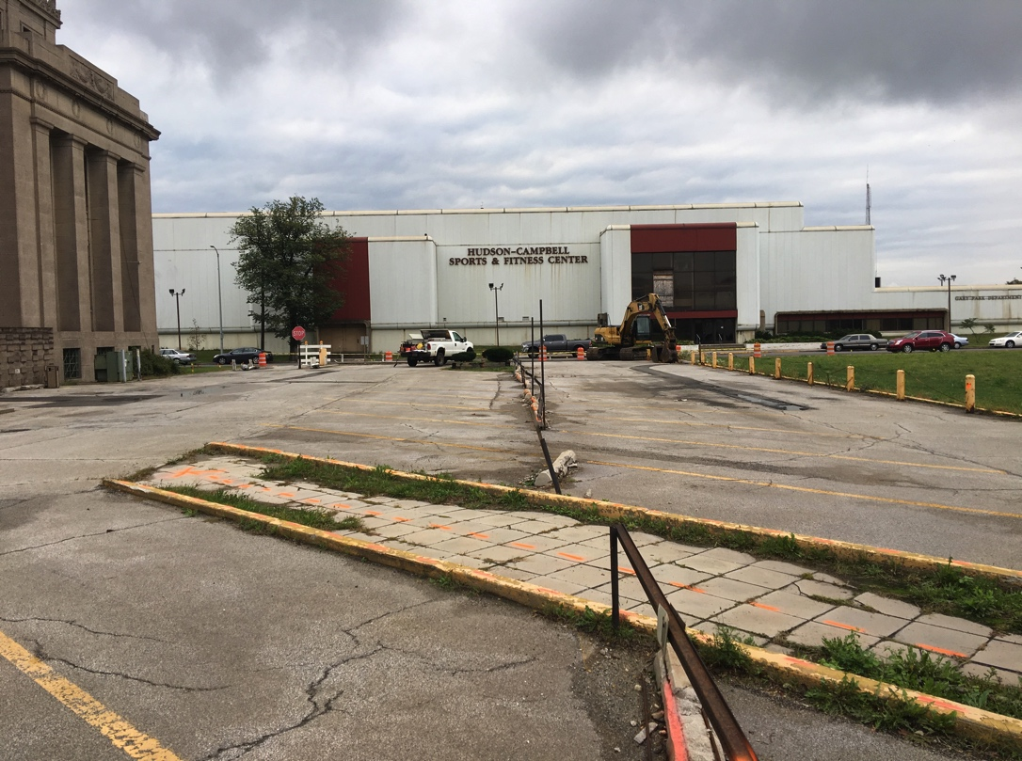
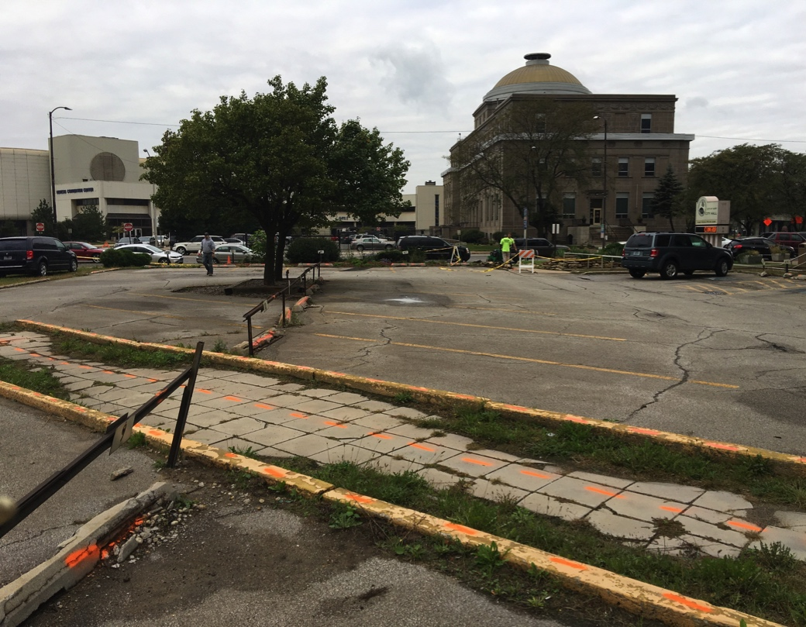
Vacant lot of former multi-story hotel adjacent to city hall
City hall parking lot prior to construction looking northwest
City hall parking lot prior to construction looking east
City hall parking lot prior to construction looking west
All photos: USGS

Slide 6
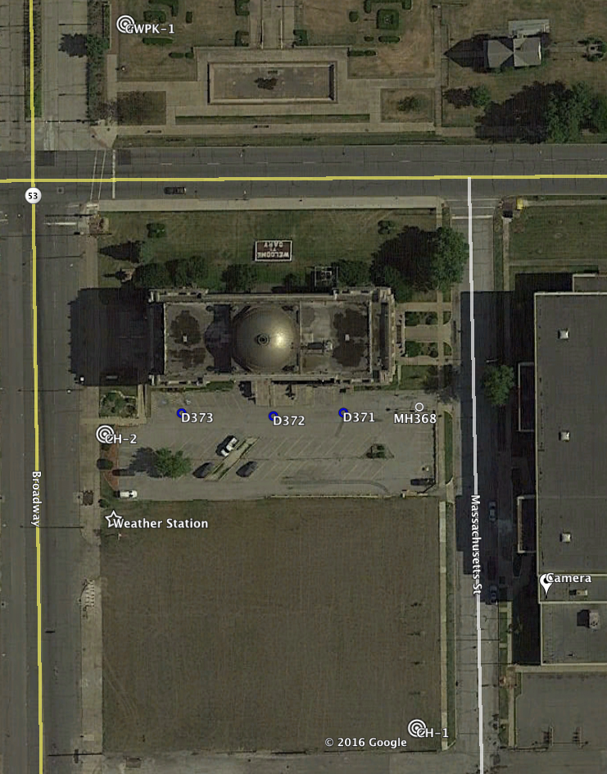
City Hall Monitoring Before Construction
Weather Station, piezometers and soil moisture probes installed in May 2016
Flow from three existing parking lot drains monitored from May-August 2016
Runoff to nearby storm drains will be compared before and after installation of a rain garden
Measured conditions will be compared to runoff predicted from design model results
Base credit: Gary, IN. Map Google Earth.

Slide 7
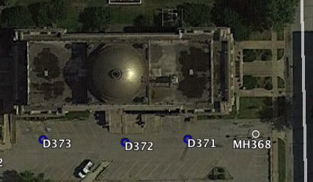
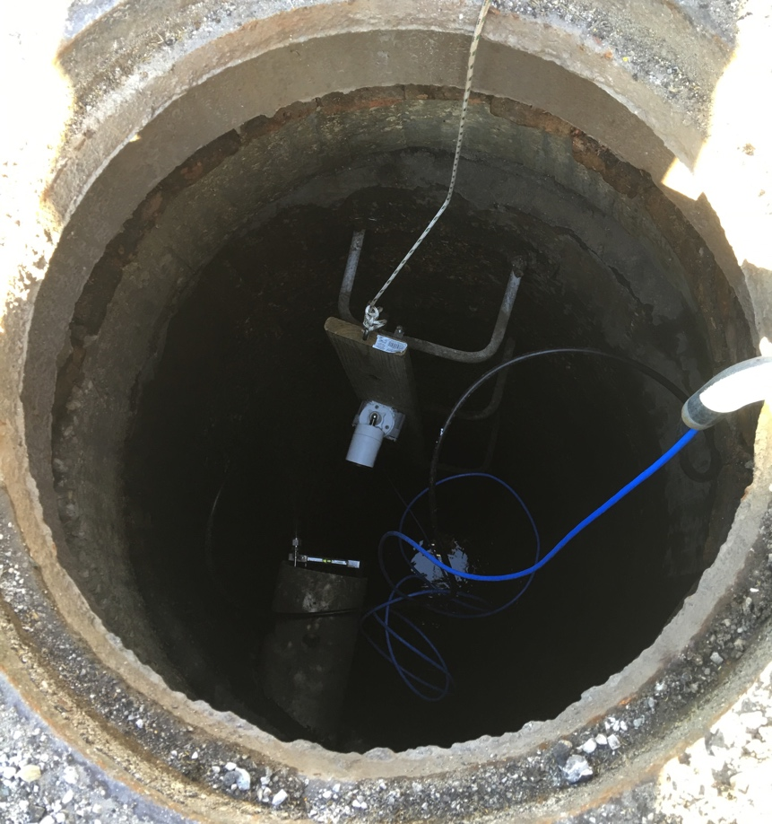
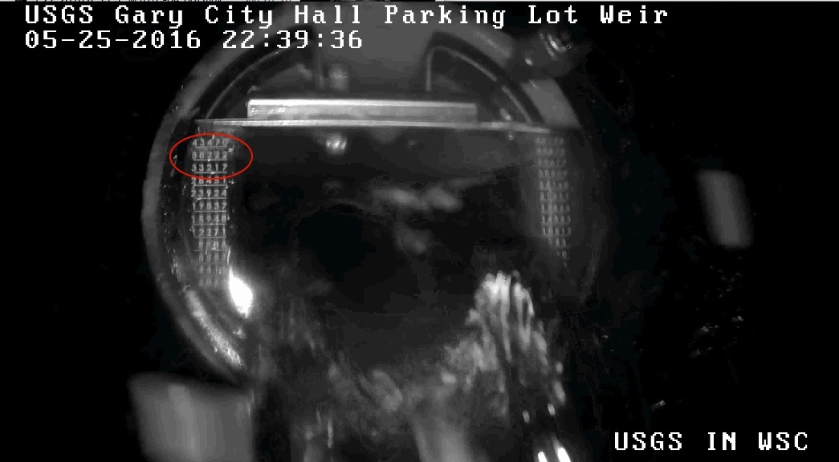
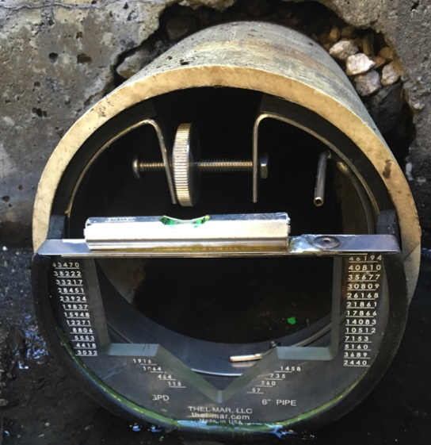
Storm Sewer Monitoring
Looking down manhole at effluent monitoring point
Direction of sewer flow
Monitoring points
Thel-mar weir at effluent monitoring point
All photos: USGS

Slide 8
Site Construction
~4,000 ft² rain garden
Sub-grade storage basins disconnected from sewer
  Below rain garden
  Below grassy areas near City Hall
Base credit: Brenda Scott-Henry, written commun., 2017

Slide 9
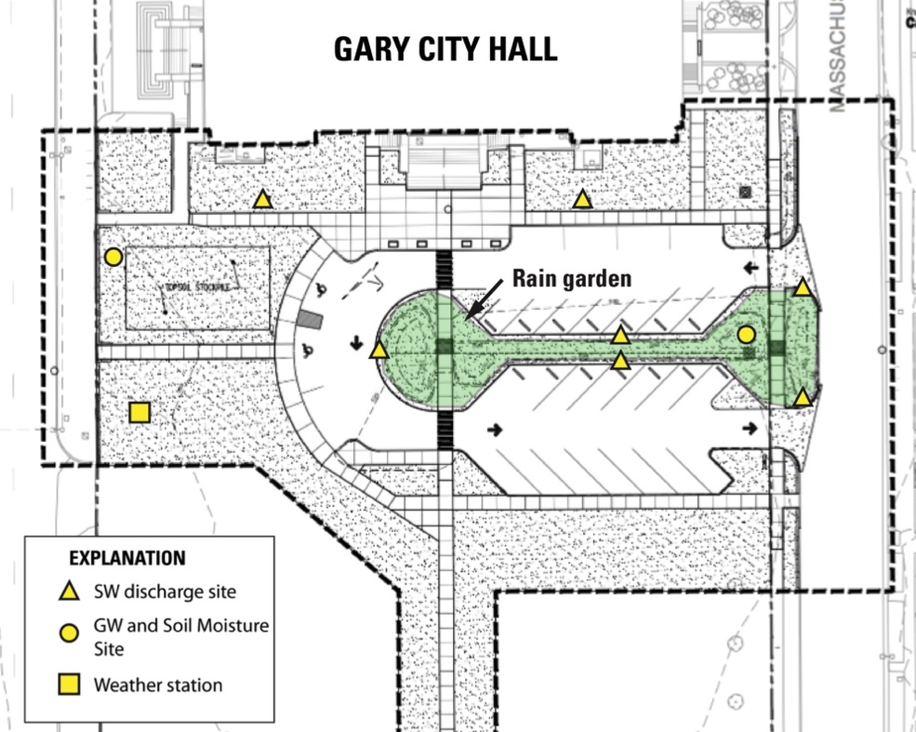
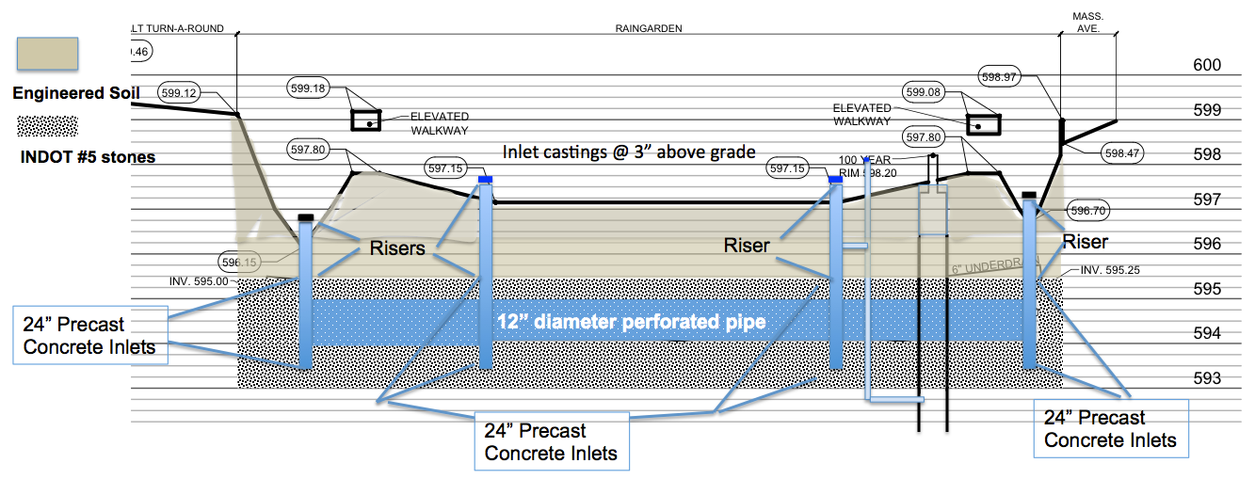
Green Infrastructure
Cross-section and plan view of rain garden installed to enhance infiltration and evapotranspiration of stormwater
A
A’
A
A’
Base credit: Brenda Scott-Henry, written commun., 2017
Notes:
Continuation of the previous slide, if necessary

Slide 10
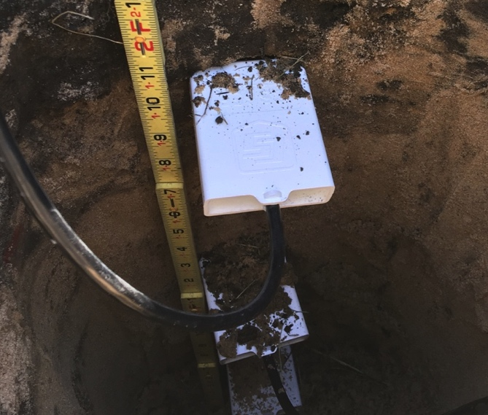
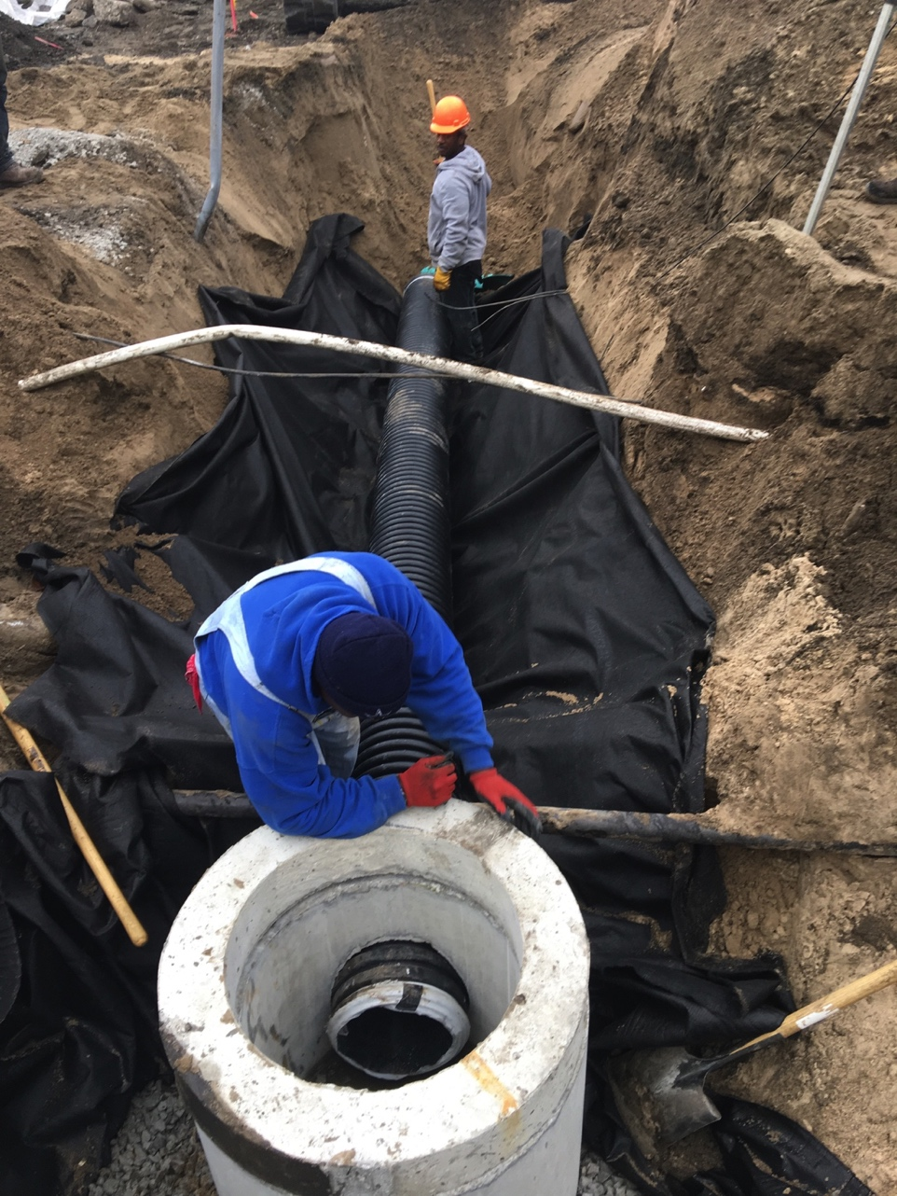
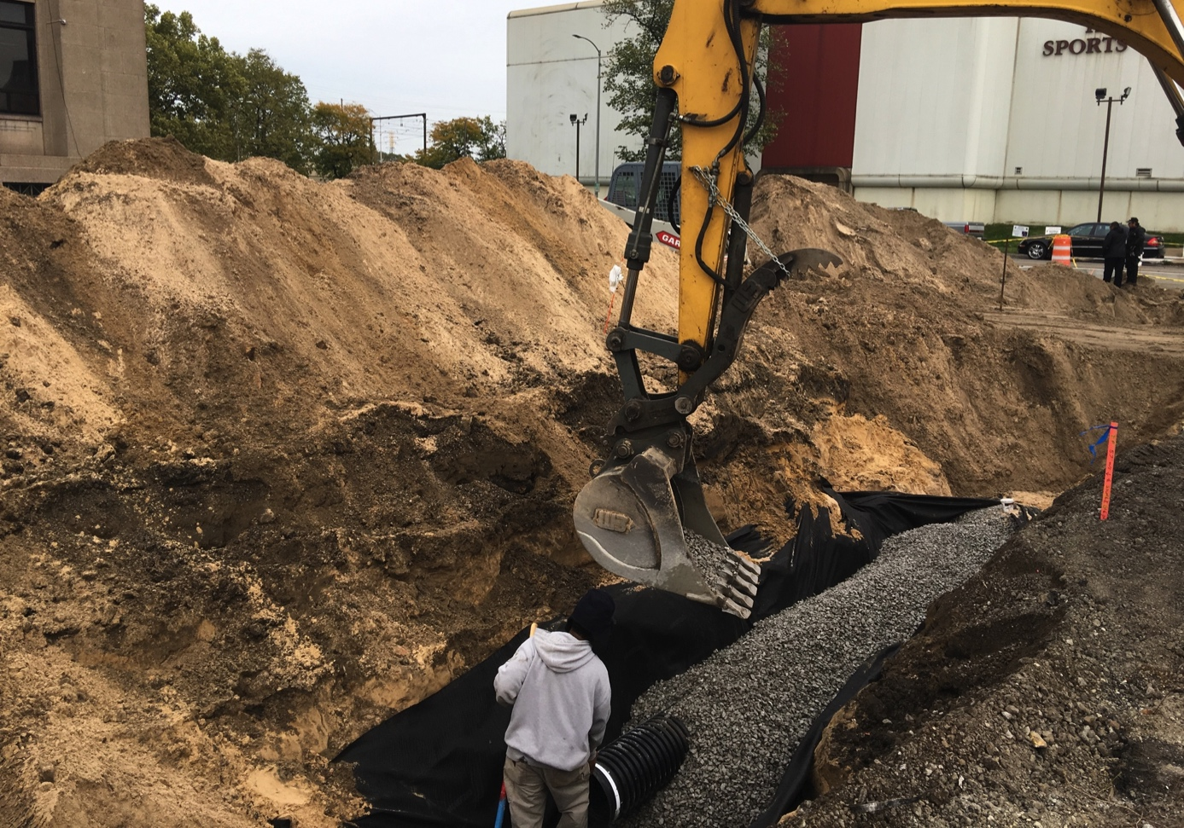
Installing perforated drain at base of rain garden
Soil moisture sensors were installed above
and below the perforated drain in order to
measure infiltration.
Adding aggregate and filter fabric around perforated drain
All photos: USGS

Slide 11
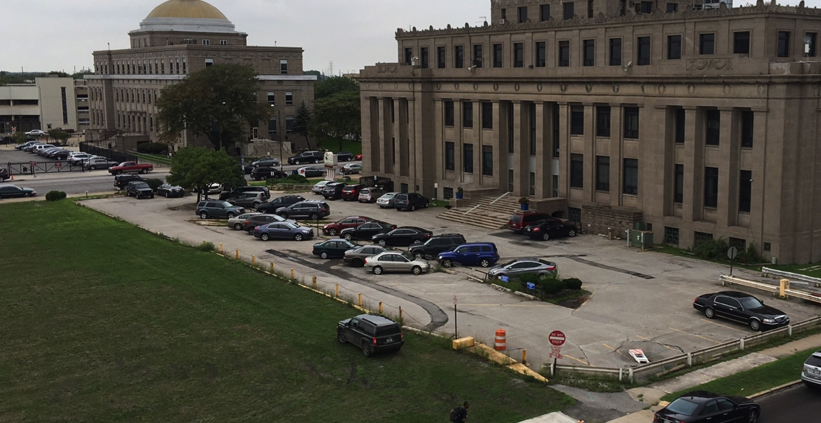
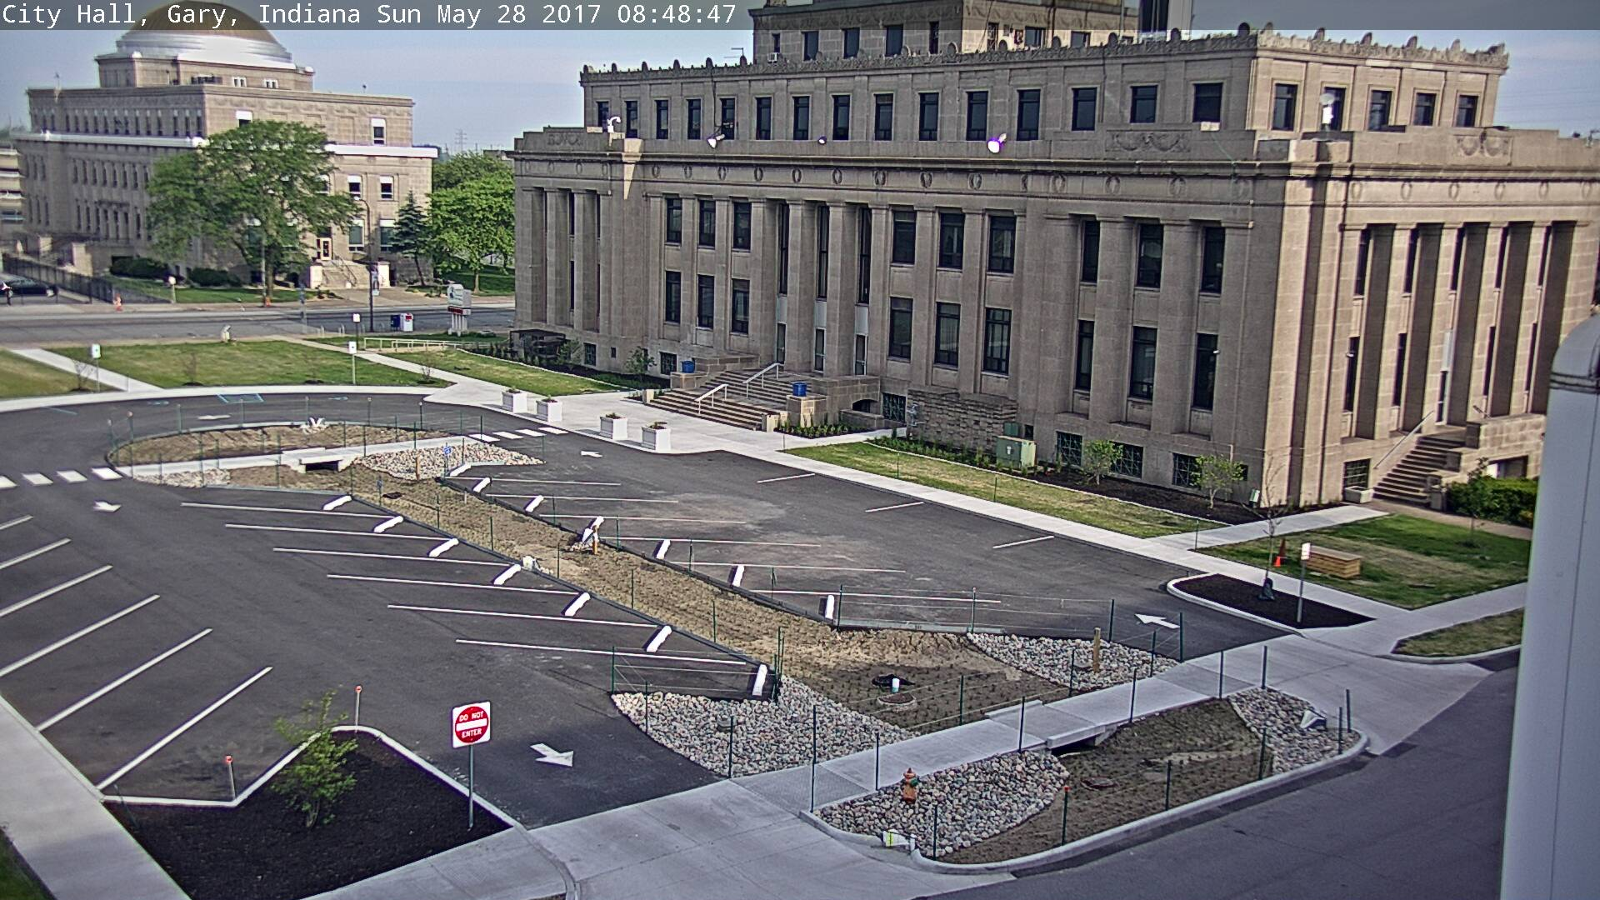
City hall parking lot in August, 2016,
prior to construction looking northwest
All photos: USGS
City hall parking lot following construction
in May, 2017 looking northwest

Slide 12
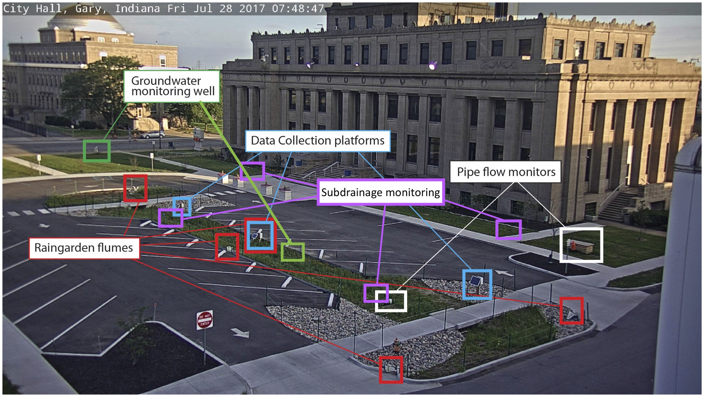
Post-Construction Monitoring
photo credit: USGS

Slide 13
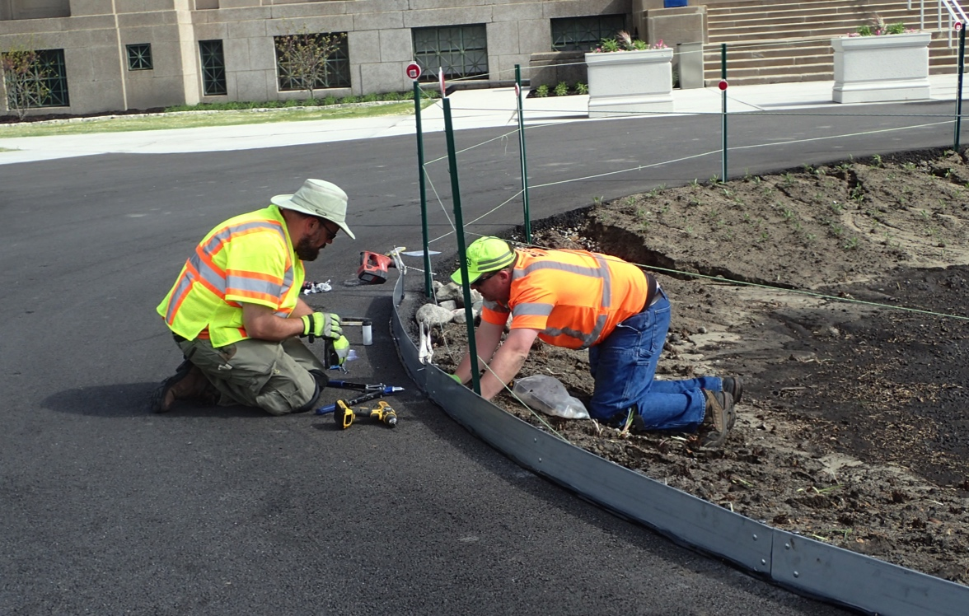
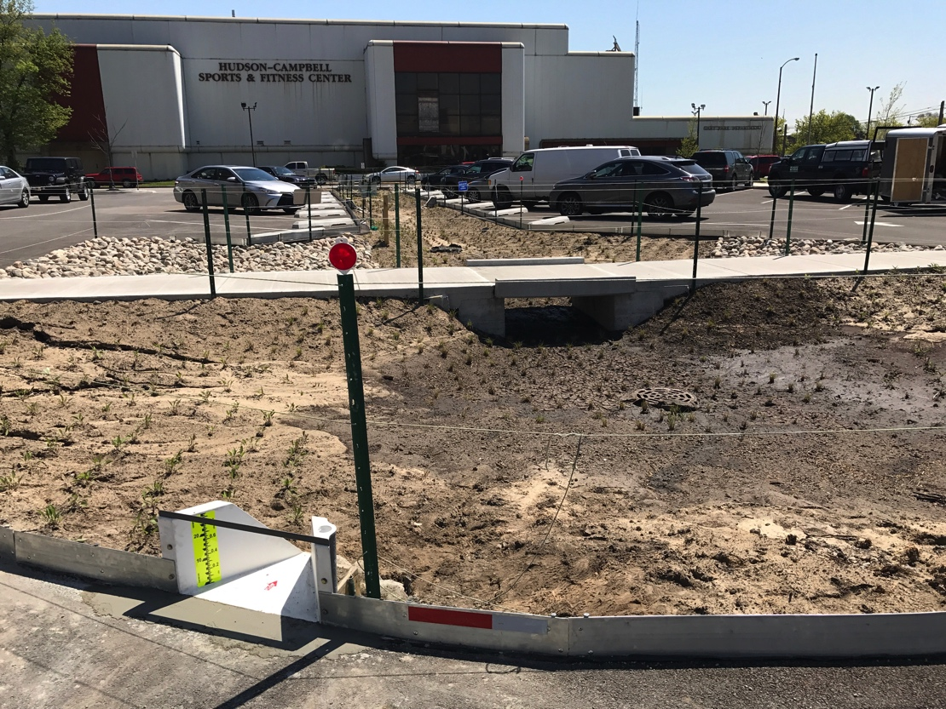
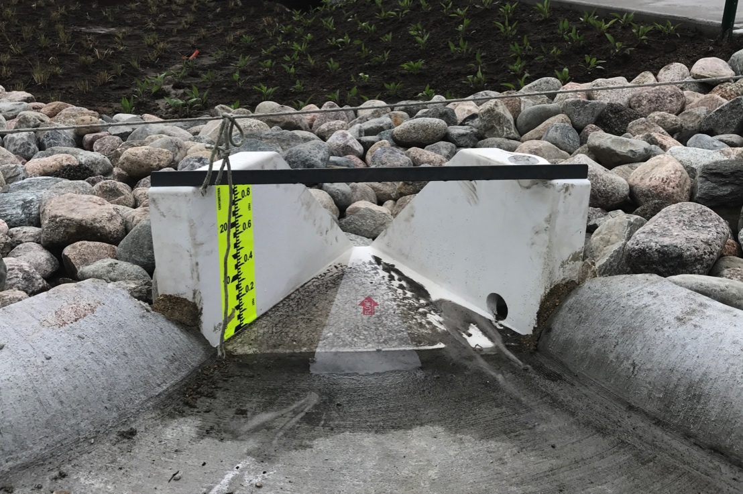
Flume installation
Native species of prairie vegetation were planted in the rain garden to promote
infiltration and evapotranspiration.
Installation of flumes and barriers around rain garden to
measure the volume of stormwater entering the rain garden.
All photos: USGS

Slide 14
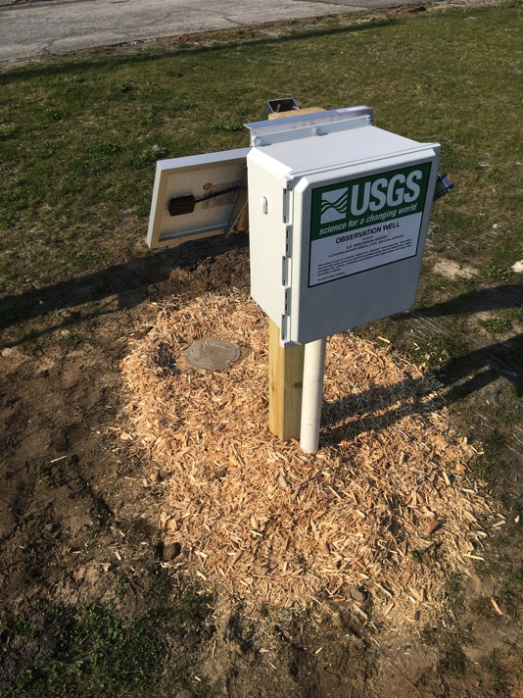
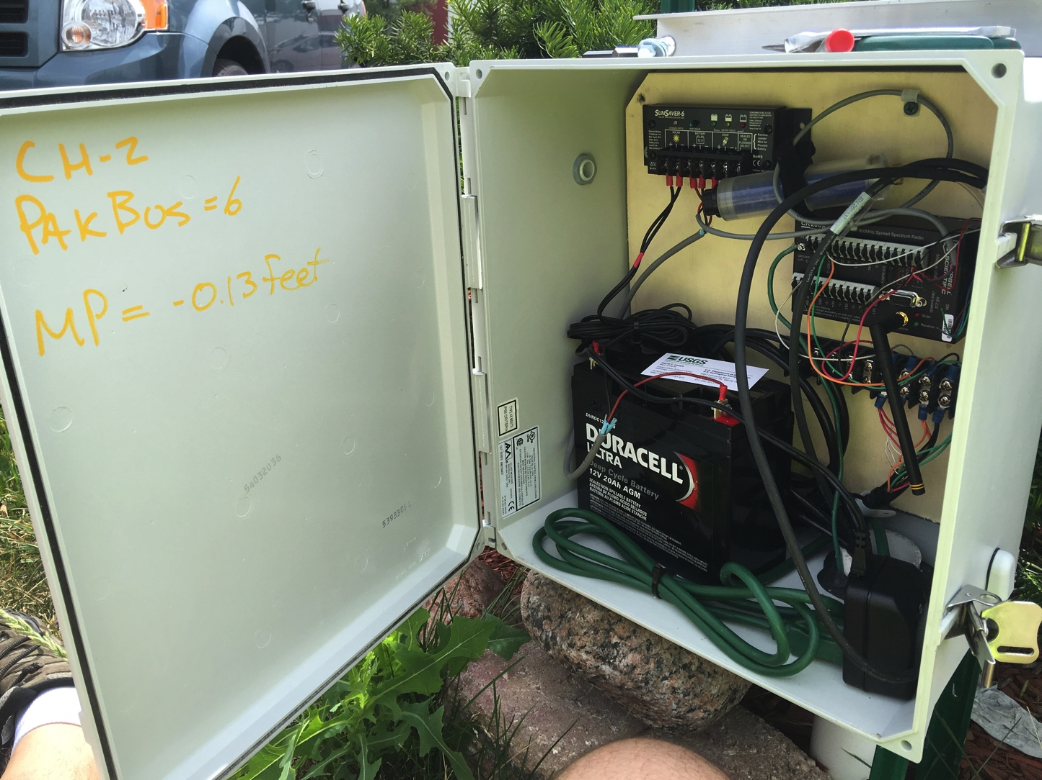
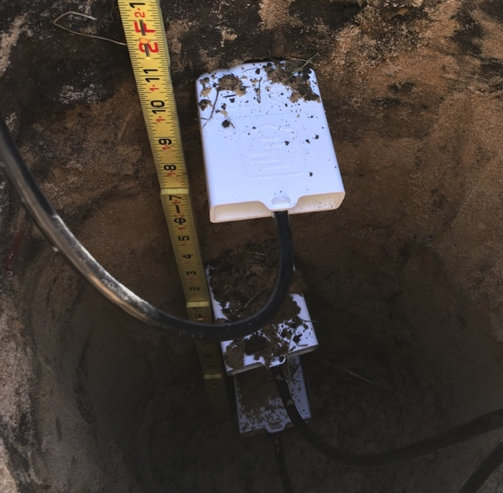
Groundwater Monitoring
Groundwater monitoring wells measuring the response of
groundwater levels to storm events near the rain garden
All photos: USGS

Slide 15
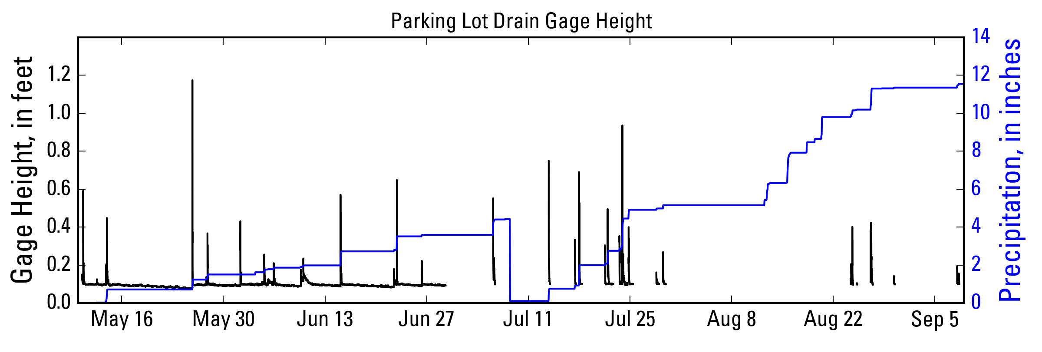
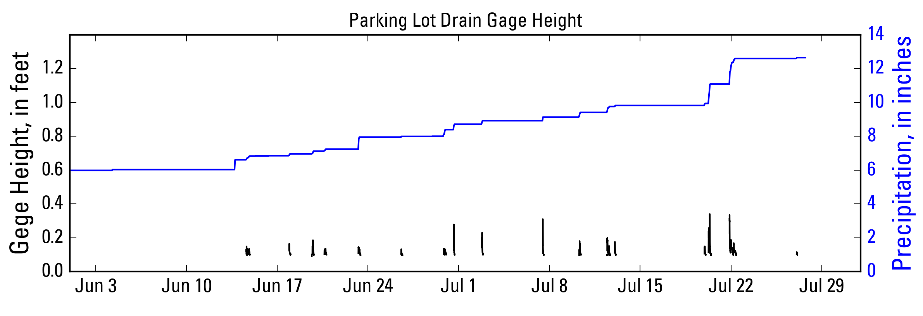
Rainfall-runoff Before and After Construction of Rain Garden
Runoff
Precipitation
PRE-CONSTRUCTION
(2016)
Drain pipe full
Precipitation
POST-CONSTRUCTION
(2017)
Drain pipe full
Runoff
Preliminary Information – Subject to Revision. Not for Citation or Distribution

Slide 16
Discharge to Storm Sewer
~390,000 gallons of water diverted from storm sewer in 2017
~430,000 gallons of water diverted from storm sewer in 2018
~ 98% reduction in runoff to sewer
Less runoff into storm sewer after construction (blue and green)
than before construction (red line)
Preliminary Information – Subject to Revision. Not for Citation or Distribution

Slide 17
Runoff Coefficients
Runoff coefficients were approximately 10% across a range of precipitation depths after construction of the rain garden, compared to approximately 30% before construction.
Preliminary Information – Subject to Revision. Not for Citation or Distribution

Slide 18

Estimated Water Budget
1
Plot showing substantial reduction in stormwater runoff entering storm drains in 2017 and 2018 following the construction of the rain garden.
1, Evapotranspiration was estimated by use of the modified Penman-Monteith equation that uses weather parameters such as precipitation, air temperature, relative humidity, solar radiation, and wind speed.
Preliminary Information – Subject to Revision. Not for Citation or Distribution

Slide 19
Estimated Study Timeline
Pre-construction monitoring
Active construction monitoring
Post-construction monitoring
Final report
2015
2017
2018
2020

