Slide 1

The 2016 Election Season
Hatch Act Information
Nancy Baumgartner
Deputy Ethics Counselor
Presented at the Human Capital All-Hands meeting
Sept 14, 2016

Slide 2
What Is the Hatch Act?
A law that governs the political activity of federal civilian executive branch employees
Why?
Ensures that programs are administered in a nonpartisan fashion
Protects employees from political coercion
Ensures that employee advancement is based on merit and not political affiliation

Slide 3
Who Is Covered by the Hatch Act?
      The Hatch Act has two categories of employees
Less Restricted
May actively participate in partisan political management and campaigns, subject to the prohibitions we are about to discuss
Further Restricted
Subject to additional restrictions regarding active participation in partisan political management and campaigns
5 U.S.C. § 7323(b)(2)(A); 5 C.F.R. § 734.401

Slide 4
Who Is Further Restricted?
Employees holding certain positions (in any agency)
Career Senior Executive Service (Career SES)
Administrative Law Judges
Contracts Appeals Board Members
Administrative Appeals Judges
5 U.S.C. § 7323(b)(2)(A); 5 C.F.R. § 734.401

Slide 5
Who Is Further Restricted?
Employees of certain intelligence or enforcement agencies and offices (except political appointees)
CIA
NSA
Defense Intelligence Agency
National Geospatial-Intelligence Agency
Office of the Director of National Intelligence
National Security Council
DOJ’s Criminal and National Security Divisions
FBI
Secret Service
IRS’s Office of Criminal Investigation
Federal Elections Commission
Election Assistance Commission
Merit Systems Protection Board
Office of Special Counsel
5 U.S.C. § 7323(b)(2)(A); 5 C.F.R. § 734.401

Slide 6
Penalties
The Merit Systems Protection Board may order:
Removal
Reduction in grade
Debarment from federal employment for a period up to five years
Suspension
Reprimand
Civil penalty up to $1,000
5 U.S.C. § 7326

Slide 7

Office of Special Counsel
  The independent Federal agency with the responsibility for enforcing the Hatch Act
    https://osc.gov/Pages/HatchAct.aspx
  FAQs
    https://osc.gov/Pages/HatchAct-FAQs.aspx
  The Departmental Ethics Office is the designated Hatch Act Compliance Office for DOI employees

Slide 8
DOI Hatch Act Compliance Office
  Phone (202) 208-7960
  Email DOI_Ethics@sol.doi.gov
Departmental Ethics Office Hatch Act website
  https://www.doi.gov/ethics/political-activity

Slide 9
What Does the Hatch Act Prohibit?
24/7 Prohibitions
Employees may NOT:
Use their official authority or influence to affect the outcome of an election
Solicit, accept, or receive a political contribution
Be candidates in partisan elections
Solicit or discourage the political activity of a person with business before their employing agency
9
5 U.S.C. § 7323(a)

Slide 10
What Does the Hatch Act Prohibit?
No Political Activity at Work Prohibition
Employees may NOT engage in political activity while:
on duty
in the federal workplace
wearing a government uniform or badge
in a government vehicle
5 U.S.C. § 7324

Slide 11
What is political activity?
Political Activity is any activity directed toward the success or failure of a partisan candidate, political party, or partisan political group.
5 C.F.R. § 734.101

Slide 12
What is not political activity?
  Legislation
  e.g., Affordable Care Act, Defense of Marriage Act
  Ballot Initiatives
  Budget
  Issues
  e.g., Gun control, Pro-choice/Pro-life
  Petitioning Congress
  KEY: Activity must not tie back to a political party, candidate for partisan office or partisan political group
5 C.F.R. § 734.101

Slide 13
On Duty/In the Workplace Prohibition
Employees may not engage in political activity while
  On duty
  including when telecommuting or on official time for union duties
In a government room or building
including break rooms, conference rooms, and union offices, if inside a federal building
Wearing an official uniform or insignia
In a government vehicle
Political Activity is any activity directed toward the success or failure of a partisan candidate, political party, or partisan political group.
13
13
13
13
5 U.S.C. § 7324; 5 C.F.R. § 734.306

Slide 14
On Duty/In the Workplace Prohibition
  Examples
  Wearing buttons, t-shirts, hats, etc.
Displaying screen savers, posters, candidate photographs, cartoons, etc.
Making online donations
However, one (or even two) bumper stickers on a personal vehicle is OK
5 U.S.C. § 7324; 5 C.F.R. § 734.306

Slide 15
On Duty/In the Workplace Prohibition
Examples
  E-mailing, blogging, tweeting, posting to social media, etc.
    Even if using a personal device or email account
    Even if sharing or forwarding content authored by others
    Even if sharing or forwarding to friends or like-minded coworkers
    Even union email if it meets the definition of political activity

Slide 16


May I use a smartphone or other personal device to post or share political content on Facebook or Twitter while I am on duty OR in the federal workplace?
NO. You may not engage in political activity via social media at any time when you are on duty or in the federal workplace, regardless of the method used to access your social media sites
You may not log on to a social media app on your smartphone and post political comments, or share, like, or retweet political content posted by others.
.

Slide 17
Social Media Guidance for All Employees
May Not:
Engage in political activity via social media while on duty or in the workplace (e.g., share, like, or retweet a post from a candidate or partisan group; or post/tweet a comment directed at the success or failure of a candidate or partisan group)
Like or Follow the social media page of a candidate or partisan group while on duty or in the workplace
Use a social media account in your official capacity to engage in political activity
17
17

Slide 18




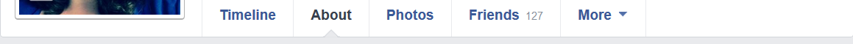
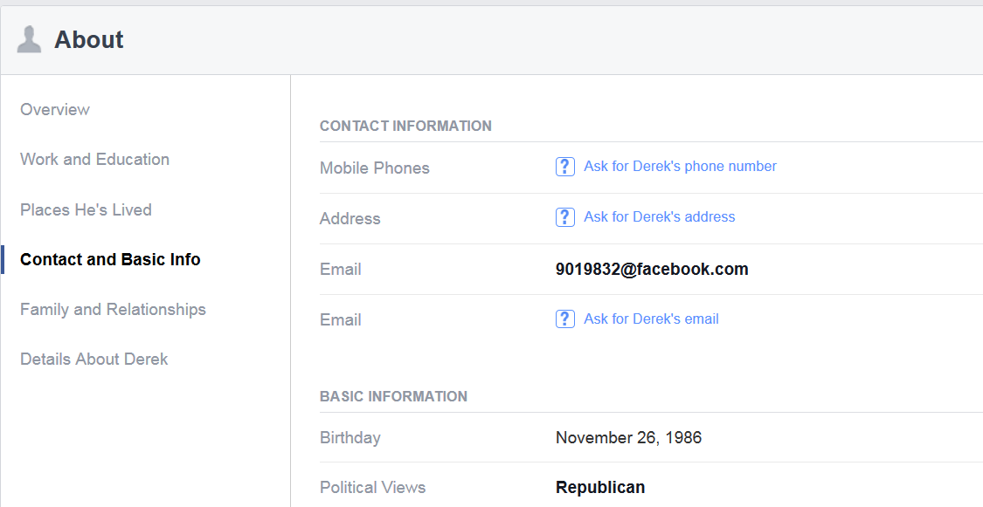
Hatch Actor
555-555-5555
It is OKAY to fill in your political views on your Facebook profile, even if you also identify your place of work elsewhere on your profile.
123 Main Street
HatchActor@facebook.com
ilovethehatchact@
Details about Hatch Actor
August 2, 1939
Republican, Democrat, etc.

Slide 19
Thank you for your time and attention

