Slide 1
CSDGM Entity and Attributes
Overview and Tips for Metadata Creation
Community for Data Integration (CDI) Metadata Reviewers Community of Practice
2026

Slide 2
Purpose of Slide Deck
Use while creating metadata in Metadata Wizard or looking at existing metadata record
This slide deck will help users understand the types of information to include in each field associated with the Entity and Attribute section of CSDGM
An example metadata record is provided (Pepper_Contest_Metadata.xml) for an example dataset (ScovilleDataset.csv & Pepper_Contest_Participants.csv)

Slide 3
Entity and Attributes
Definitions:
Entity = File
Attribute = Field (Column headers)
Domain = Type of Values
The Entity and Attribute section provides details about the information content of the data set, including the entity types (files), their attributes (fields), and the domains (e.g., numeric, text) from which attribute values may be assigned.

Slide 4
Entity Type Label & Definition
Each file in the data release should be described with an entity type label and definition
Label should exactly match the filename and extension
Definition should describe the data within the file in addition to the file format
Good example: "Comma Separated Value (CSV) file containing the names of people that participated in the 2026 pepper eating contest and the name of the hottest pepper each contestant was able to consume. See ScovilleDataset_update.csv for information about each of the listed peppers."
Poor example: "CSV file containing data"
The definition field can be used to describe abbreviations in file names and other data file naming conventions
e.g., WYYYYY_IDXX_***.csv where WY is 'Water Year' and 'YYYY' is the water year in which the data was collected, IDXX is the two-digit numerical site identifier and *** is the three-character alphabetical code for the constituent measured e.g., ppt = precipitation, sed = sediment, etc.,

Slide 5
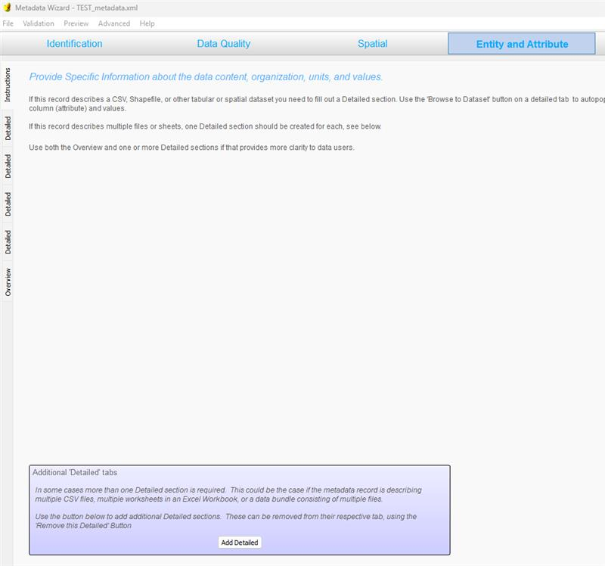
Adding New Entity in Metadata Wizard
In the Metadata Wizard, click "Add Detailed" on the Entity and Attribute Tab to add subsequent entities

Slide 6
Attribute Definition Tips
The list of attributes defined should match the order of attributes in the dataset (e.g., order of columns in tabular data)
Types of information to include in the attribute definition:
References to standards followed (e.g., ISO 8601, Datum WGS-84, Time Datum)
Descriptions of anything non-standard, especially values that may be interpreted or converted by different applications (e.g., how many significant digits, data contain leading zeros, numbers stored as text, trailing zeros).
If it applies to the entire data set, you can include this type of information in the logical consistency report or supplemental information
See Pepper_Contest_Metadata.xml for examples of different attribute definitions.

Slide 7
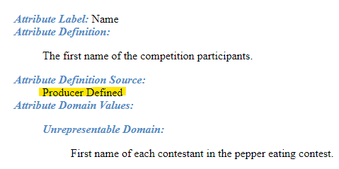
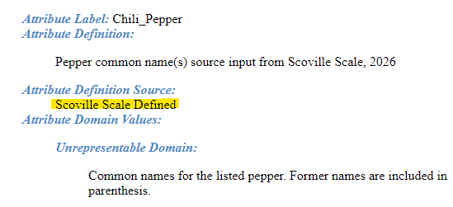
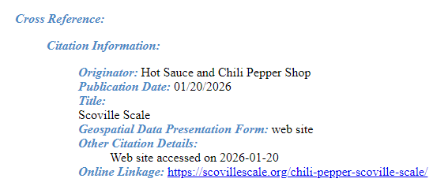
Attribute Definition Source
'Producer Defined' can be used when the author creates the definition.
If a definition for the attribute exists from another source, cite the source.
The citation for this source should be available either in cross-references or source information
Example: 'Scoville Scale Defined' is used when the definition was copied directly from https://scovillescale.org/chili-pepper-scoville-scale/

Slide 8
Attribute Domain Types
Enumerated
Codeset
Range
Unrepresentable
If using the Metadata Wizard, it can provide a best guess of the domain type; however, it can be wrong and all domain types and values should be doublechecked.

Slide 9
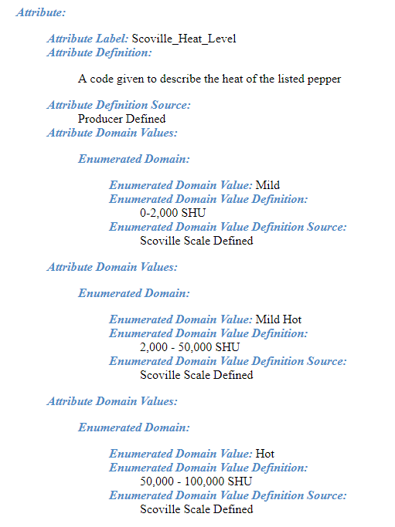
Attribute Domain Types: Enumerated
Definition:
Categorical data; Codes that need to be defined
Examples:
Beaufort Wind Scale (calm, light air, light breeze, etc.). Values correspond to a numeric force code (0-12), representing wind speed ranges in miles per hour or knots.
Scoville_Heat_Level has categories (mild, hot, really hot, etc.) that are defined by Scoville Heat Unit (SHU) ranges
Experimental Condition (control – heat autoclaved bottle, experimental condition 1 – added substrate, experiemental condition 2 – no added substrate)

Slide 10
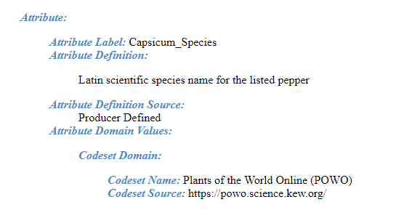
Attribute Domain Types: Codeset
Definition:
Type of enumerated domain that is published and well-recognized
Examples:
Zip Code
State Code
Notes:
Citation or URL to published codeset must be provided
Authors may choose to fully document a codeset in their metadata using enumerated domain. For example, only a portion of a codeset is used or an obscure codeset (e.g., Scoville_Heat_Level).

Slide 11
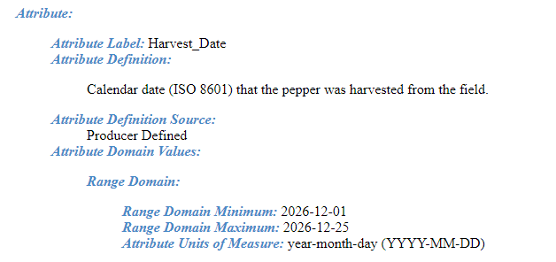
Attribute Domain Types: Range
Definition:
The minimum and maximum values of a continuum of valid values.
Examples:
Dates
Measurements (e.g., length, weight, concentration)
Lat/Lon
Notes:
Often a numeric array
Acceptable null values (e.g., NA) can be defined as an enumerated or unrepresentable value within a range attibute
Units need to be defined
If numeric values represent categorical data, the domain should be defined as 'Enumerated' or 'Codeset' (e.g., transect numbers, censor numbers, serial numbers)
Attribute measurement resolution should be provided (e.g., define number of significant figures). This can be documented in a separate column if it varies from observation to observation. (e.g., This is how NWIS documents significant figures.)

Slide 12
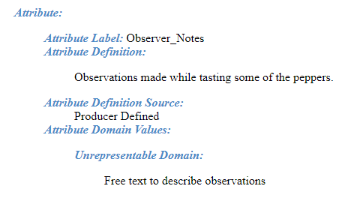
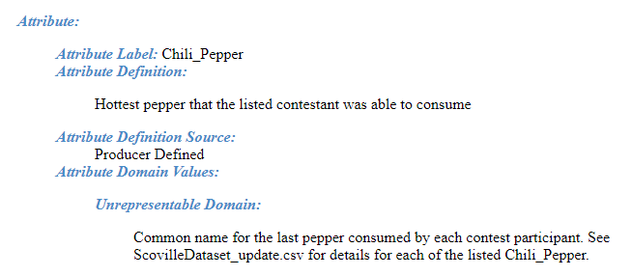
Attribute Domain Types: Unrepresentable
Definition:
Values that do not fit in any other domain categories
Examples:
Unique Identifiers
Site Numbers
Names
Notes
Citations
Feature Geometry
Notes:
Provide a description of the values and reasons why they cannot be represented.
If possible, define the standard format (e.g., usgs-xxxxxxxx) or type of input (e.g., free text)

Slide 13
Entity and Attribute Overview Description
Provide an Overview that summarizes and explains the overall content (e.g., ALL files referenced by their filenames – including which child page or zip file they are in) and structure of the data release (DR) in general terms, file contents, purpose, and any relation or dependency to other files in the DR. Include:
how many files users should expect to find
refer to each file by its file name
where (e.g., in a Child item? or in a .zip file?)
what do the files contain
how/what the files should be used for (e.g., inputs vs outputs; data vs metadata; calibration/quality control)
relation or dependency between files such as join fields, lookup fields, or data dictionary files describing data files.
a final sentence or two directing users to see the data_dictionary.csv (or readme.txt) if there is one for more details; and/or see the version_history.txt "for details about changes made in this revised version." (if applicable)

Slide 14
Entity and Attribute Detail Citation
This is a required field if the E&A overview description field has been populated
Options for completing this field include:
Note to "see Detailed Entity & Attribute section for full description"
Citation of external, published data dictionary
Citation of this data release
"Producer defined"
"USGS"
N/A

Slide 15
Other tips
Err on the side of being redundant instead of omitting important information
If you are exclusively using data dictionaries to describe the data set entities and attributes:
You must provide a comprehensive statement in the Entity and Attribute Overview field
Make sure to fully define each entity
Provide the relationships between the provided data dictionaries and the data set

Slide 16
Tools and Resources
Metadata Wizard (application to write XML)
Metadata Parser (to validate XML, also produces FAQ HTML format for metadata for easy viewing for humans)
XML Notepad (to view and edit XML, slightly more advanced)

