Slide 1
Building a robust community of content Managers
DrupalGovCon
Scott Horvath USGS Office of Communications and Publishing (OCAP), Digital Services
Nov 2023
Notes:
Original Vector Graphic (Altered for DS purposes):
Designed by vector stock (Image #34445283 at VectorStock.com)

Slide 2

Disclaimer
Any use of trade, firm, or product names is for descriptive purposes only and does not imply endorsement by the U.S. Government.
USGS Fundamental Science Practices
drupalGovcon govsummit
Notes:
.”

Slide 3
Agenda
Who we are
Current state
Background
Training and Community
The Service Center/Ticketing (Jira) and Knowledge Base (Confluence)
CMS Certification
drupalGovcon govsummit

Slide 4
U.S. Geological Survey (USGS)
Created by an act of Congress in 1879, the USGS provides science for a changing world, which reflects and responds to society’s continuously evolving needs. As the science arm of the Department of the Interior, the USGS brings an array of earth, water, biological, and mapping data and expertise to bear in support of decision-making on environmental, resource, and public safety issues.

Slide 5

OcAP Digital Services Team
We manage:
USGS.gov (www) site
USGS @theCore (our internal site)
Ask USGS online request system
Jira and Confluence environments for OCAP
Bureau-wide social media efforts
6-person team
drupalGovcon govsummit

Slide 6












Current state
Policy
CMS Course
Drupal Training
Continuous Training &
Support
Service Center
Tickets &
Customer Service
Knowledge Base
drupalGovcon govsummit
Notes:
.”

Slide 7
Current State
Community
302 user accounts
users (access236 Content Managers
201 active ed within last 30 days)
531 members in our Drupal CMS Teams channel
~500 microsites under one subdomain (all using COPE)
Communications
Monthly community meeting
Monthly newsletter
Weekly Help Call (open)
Monthly SMART analytics meeting
Monthly bureau-wide announcements
Drupal CMS Teams channel
Monthly Advanced Topic Series
Monthly WWW Drupal Training
Monthly Internal Drupal Training
Internal site updates (everything posted there)
Continuous updates to the KB/Service Center
Yearly workshops
General announcements, Release Notes, Plain language tips
drupalGovcon govsummit

Slide 8
Customer Satisfaction ACSI Trends
FY23 USGS ACSI Score
USGS compared to Government website trends citizen experience.
76
76
75
73
73
73
73
70
Overall government satisfaction had plateaued in previous years and declined in past 2 years while USGS Customer Satisfaction ASCI scores have increased.
68
68
67
66
© 2023 CFI Group. All rights reserved.
drupalGovcon govsummit

Slide 9
Overall USGS Customer Satisfaction
Information gathered from CFI Customer Satisfaction Questionnaire that users can complete during www.usgs.gov web experience.
drupalGovcon govsummit

Slide 10
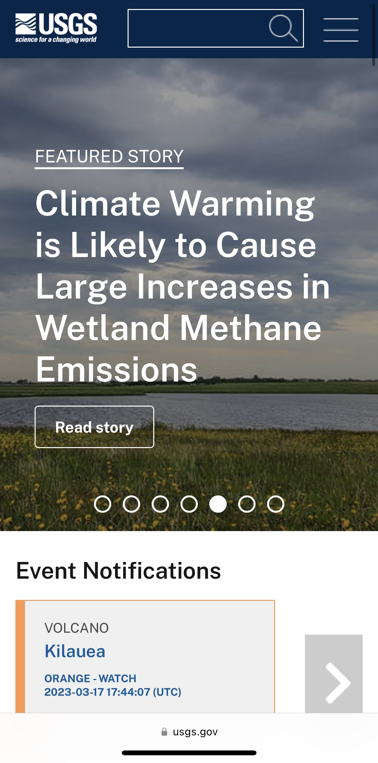
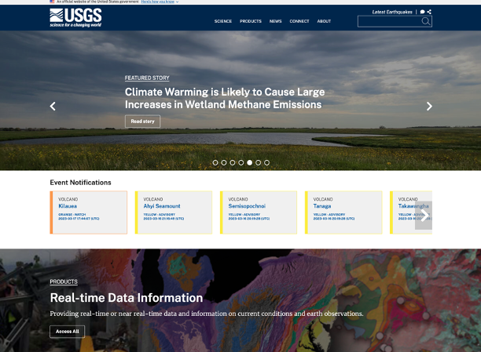
Background
We didn’t get here overnight!
drupalGovcon govsummit

Slide 11
Background
From 1994 to 2016 (before we launched our Drupal 7 site)
~500 subdomains
20+ years of disconnected sites
Lots of duplication
Lack of web strategies
Lack of consistent tech/tools
Lots of position overturn
Hard to implement policies
Hard to enforce policies
Disjointed user experience
Low public satisfaction scores
Low search scores
Mobile support? Impossible.
drupalGovcon govsummit

Slide 12
We had to do something! BUT…
We started a ~50-person team in 2012 to discuss future of the USGS web
Lots of opinions
Everyone is a developer/UX/UI/strategy expert
Lots of spin-off teams
Lack of funding/support (everyone was volunteering time)
Some groups didn’t want to play
Internal cultural issues
Other priorities and work to do
Knowledge gaps
drupalGovcon govsummit

Slide 13
Eventually we got there (2014 - 2016)
Created a dedicated CMS team (in Comms office)
Leadership support to run the bureau-wide CMS
Conducted high level strategy and planning
Researched our existing sites, used web analytics, customer feedback, etc. to develop our information architecture.
Developed a Drupal 7 prototype
“Roadshow” to gather internal feedback (identified “early adopters”)
Continued updating leadership of our movements
Starting planning the internal D7 site.
Secured funding to implement the CMS as the bureau platform for USGS websites.
drupalGovcon govsummit

Slide 14
Training and Community
Strengthening the content manager community
drupalGovcon govsummit

Slide 15
Content Manager Training
2015 – 2017 (In-Person/Virtual) | 2018 – 2021 (Virtual) | 2021 – Present (Self-Training/Virtual)
Traveled to offices across the country. Had some virtual students. Length: 3 days, 8 hours each day | Converted to live online training. Length: 3 days, 8 hours a day | Hybrid model, Confluence-based (izi module). Length: 5 days 10 - 10:30 AM (instructor) 10:30 – 3:30 PM (self-training, Teams) 3:30 - 4 PM (instructor) Lab work each day
Advantages: Made connections Built trust Socialize | Advantages: Saved money! (no more traveling) Support more time zones Screenshare to troubleshoot | Advantages: Self-paced (just complete by week’s end) Mock site for training Less stress on the team Always up-to-date
Disadvantages: Costly (monthly travel, productivity loss) Limited by geography Mixed training (difficult) | Disadvantages: Lost personal face time Time consuming for trainers Technical issues | Disadvantages: Some people need video to help them. Some details can get lost if not discussed during instructor sessions.
drupalcon govsummit

Slide 16
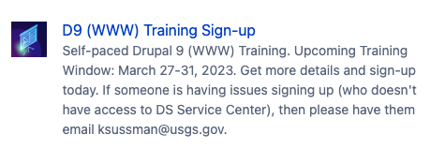
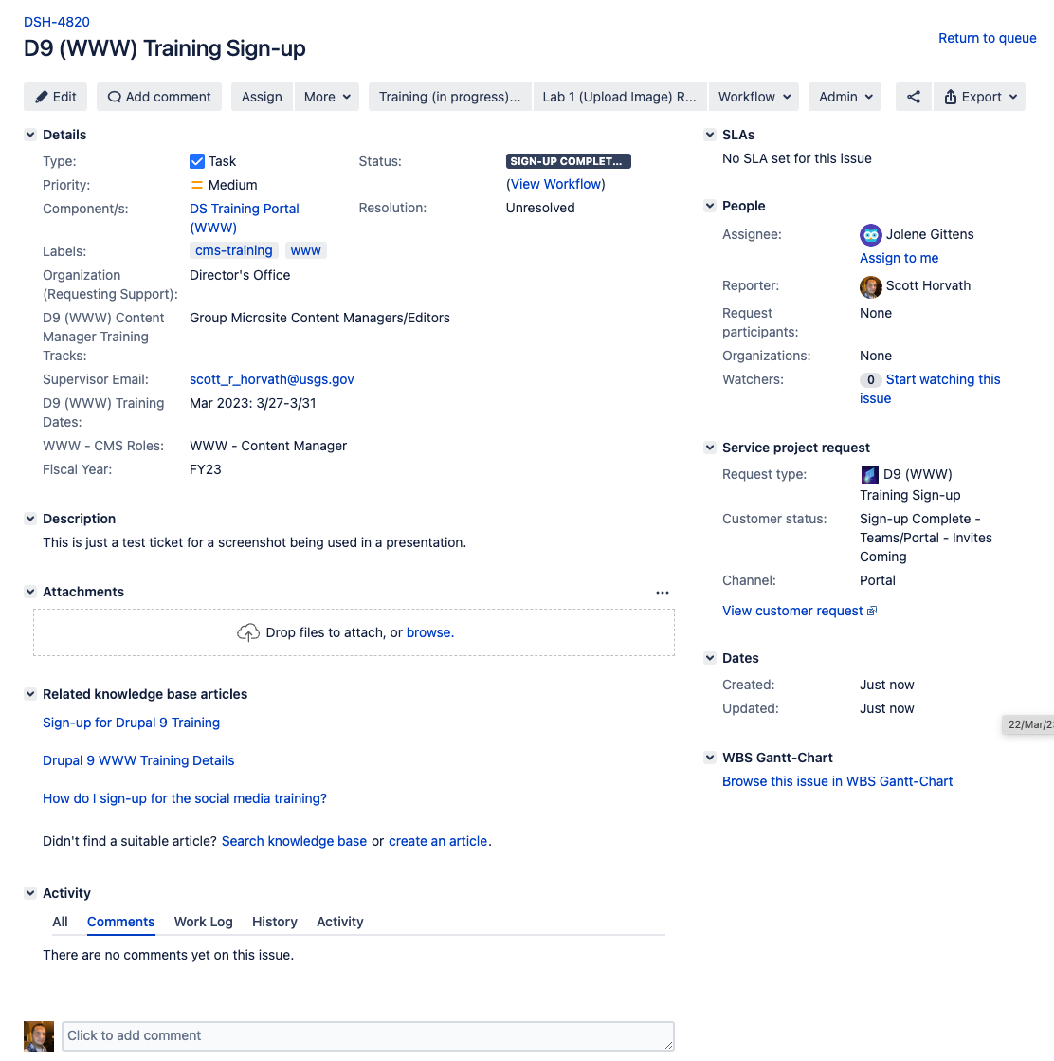
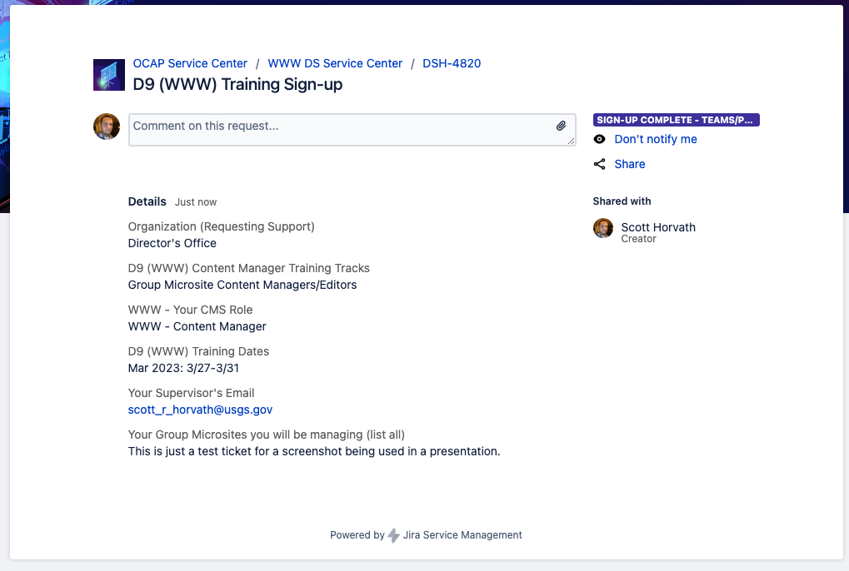
Self-Training (mid 2021)
drupalGovcon govsummit

Slide 17
Cost Savings on Training
Drupal 7 Training (for WWW) – In Person
1200 hours per year (4 FTE)
Drupal 9 Training (for WWW) – Self-Training
148 hours per year (5FTE)
drupalGovcon govsummit

Slide 18
Strengthening the community
Chose ”early adopters” to create their Center sites in our working prototype
They provided vital feedback on actual use cases—improved the CMS
Started monthly community meetings in June 2015 for content managers
Hosted spin-off meetings on other topics as needed.
Created internal site to post slides, meetings, documentation.
Started yearly web workshops to talk Drupal, web, future plan.
Provided internal chat for content managers (questions, learn from each other)
Post announcements in groups chat/Teams, etc.
After D7 launch (April 2016) we started mandatory migration of all sites.
Reporting to leadership on migration efforts (who’s moved, who hasn’t).
drupalGovcon govsummit

Slide 19
Strengthening the community
Sent out monthly newsletters recapping everything.
Brought on a detailees from other Centers to see the sausage making. (two of them became full-time teammates).
In 2019 we began planning our move toward self-service options (our Service Center).
Communicate!
When you’re done communicating…you’ve only just started.
drupalGovcon govsummit

Slide 20
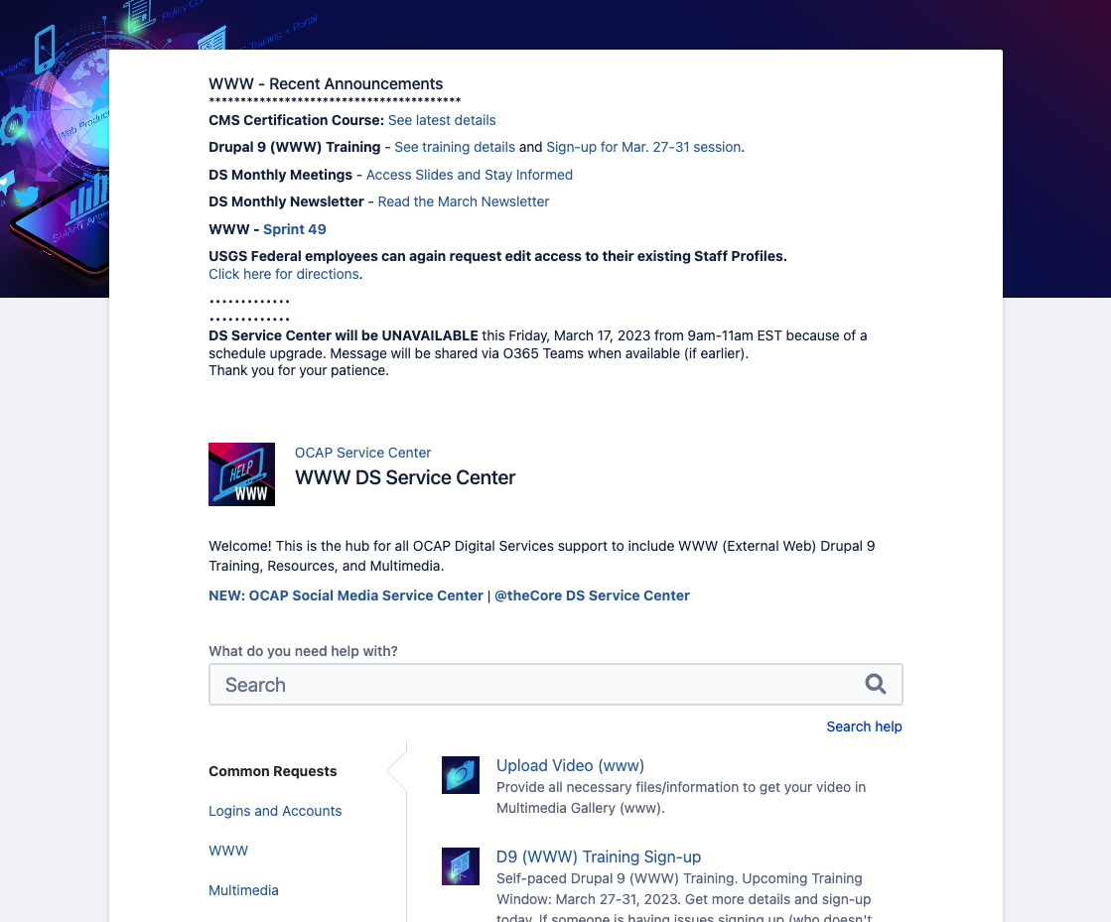
The Service Center
Empowering the content manager community
drupalGovcon govsummit

Slide 21
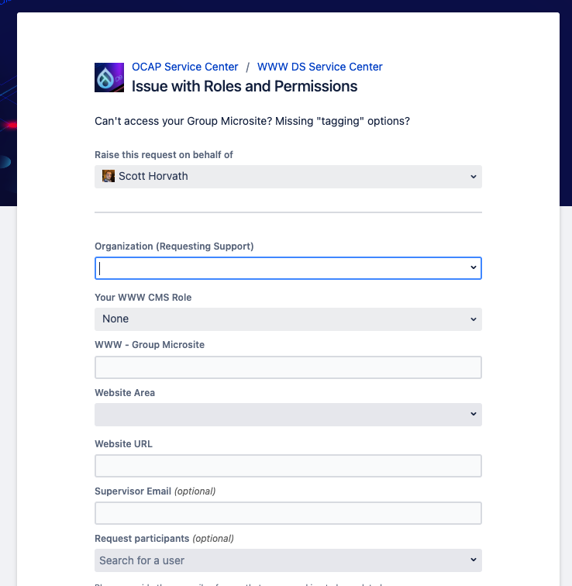
DS Service Center
Late 2019:
We started migrating our Drupal CMS documentation to a Confluence space (”DS Knowledge Base”).
We added a Jira Service Desk (“DS Service Center”) and tied that to our DS Knowledge Base.
In May 2020:
We launched our DS Service Center for content managers allowing self-service support, submitting requests for various services (e.g., general help, permissions issues, microsite creation, audio/video upload, vanity URLs, HQ content updates, etc), general announcements, sprint updates, etc.
drupalGovcon govsummit

Slide 22
Why use Jira/Confluence?
Already worked in Jira with our developers.
Already worked in Confluence to document CMS requirements.
We wanted to empower the community to troubleshoot their own issues.
We needed to get out of email submissions (hard to track & analyze, cumbersome, repeated questions, etc). (Yes, we use Jira, not email)
We needed more time to do product management and less answering the same questions over and over.
We needed to track analytics on our customer support (how many tickets, how many people, tracking group usage, pick up time, resolution time, how many tickets were bugs vs. user error, etc.)
drupalGovcon govsummit

Slide 23
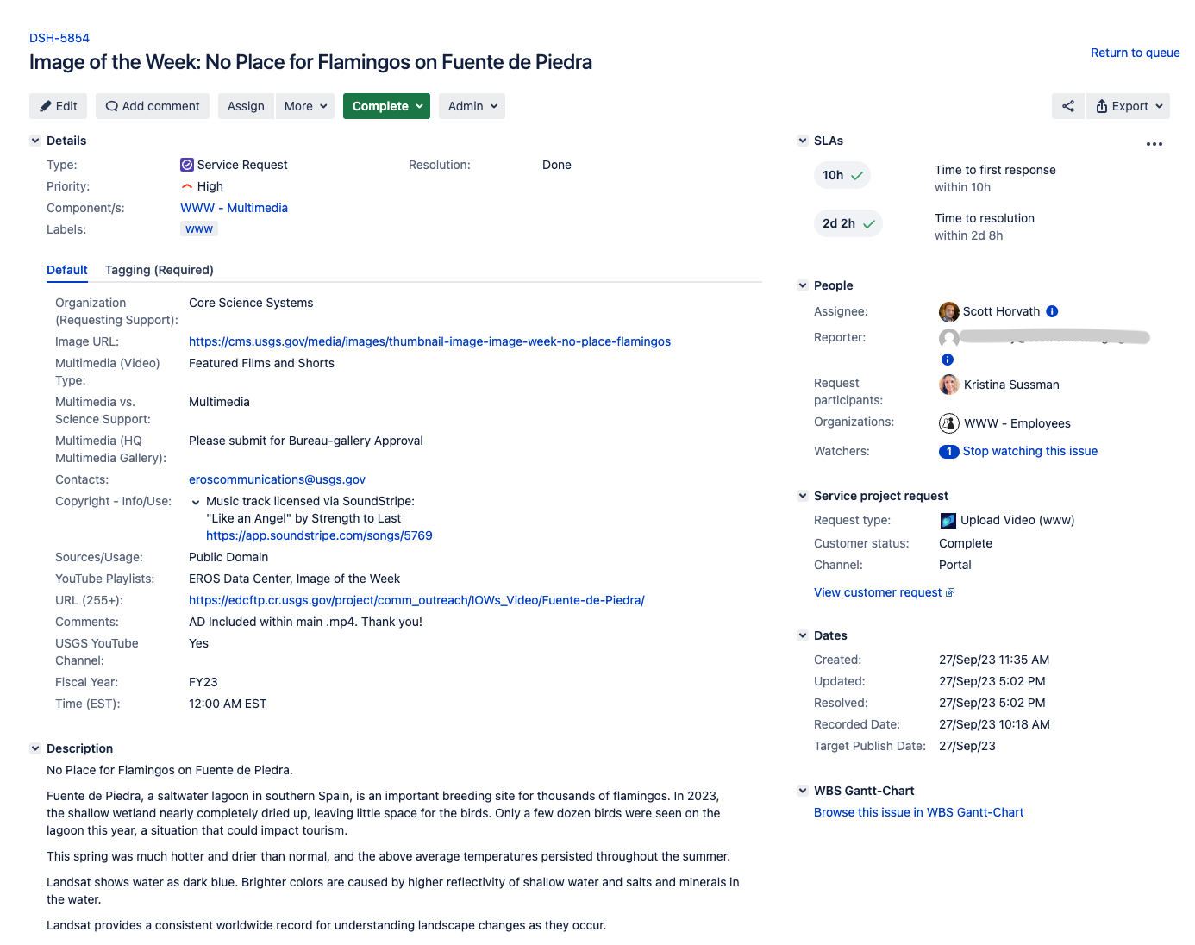
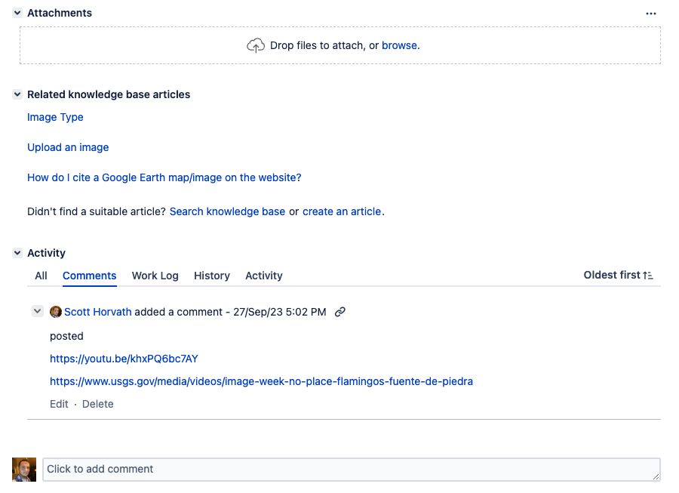
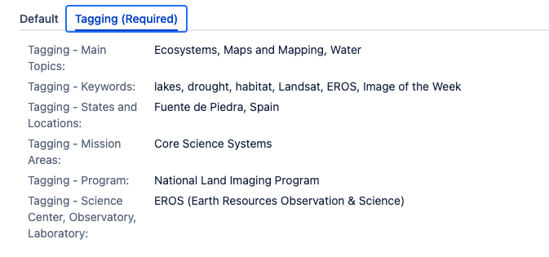
Analytics
Every ticket type has an SLA (Service Level Agreement) with our customers
Ticket pickup time
Resolution time from pickup
Ticket statuses (e.g., In Progress, Done, Cancelled, On Hold, Submitted for Bug, etc)
Our Confluence articles have thumb up/down
We use tickets analytics to help with our EPAPs as well.
drupalGovcon govsummit

Slide 24
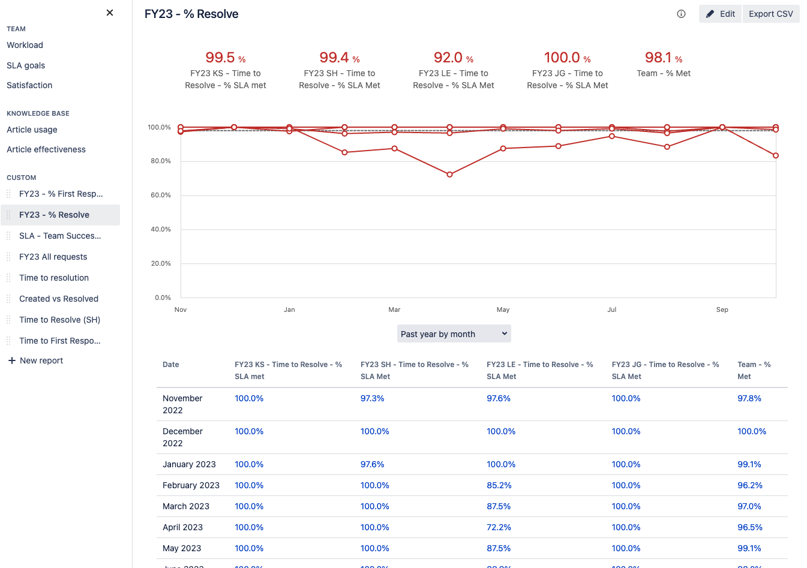

Analytics
We use ticket analytics to help with our EPAPs.
drupalGovcon govsummit

Slide 25

CMS Certification Course
Improving policy knowledge of the content manager community.
drupalGovcon govsummit

Slide 26
CMS Certification Course - Policy
Implemented USGS policy requiring CMS Certifications Course in order to gain access to the CMS.
Survey Manual Chapter 601.2 – Content Management System Certification
Requires any person needing CMS access must take the CMS Certification Course.
Requires the course be taken, yearly, to retain that access.
Provides enforcement for removing access.
drupalGovcon govsummit

Slide 27
CMS Certification Course – Why?
Ensure awareness of Federal, Agency, Bureau, CMS requirements.
Introduces new requirements yearly, at minimum.
Restricts access by policy (those who need it will take it).
Improves security by reducing unnecessary accounts.
Helps address A&A requirements (AC – Access Control).
drupalGovcon govsummit

Slide 28
CMS Certification Course
In January of each year, we start communication about that year's course.
Existing accounts: To keep access to the CMS, complete the course between May and July.
New accounts: Take CMS course and take Drupal training (role dependent)
On August 1st, any person that does not complete the CMS Course has their account blocked.
We communicate through meetings, newsletter, trainings, Service Center, internal site, etc.
In May, we open the CMS Certification Course
Enrollment through DOI Talent
Download and review the materials (Federal, DOI, USGS, and CMS policies and requirements)
Get 100% on quiz
You’re set until next May
Previous course in 2022 was hosted in our Confluence LMS
drupalGovcon govsummit

Slide 29
CMS Certification Course – 2022 Results
Accounts prior to Certification: 2,765
Accounts after Certification: 322 = 86% reduction in accounts
We blocked 2443 accounts as a result. Huge security win!
Having a deadline helped to identify accounts that should be blocked from the CMS
We captured course feedback to help to build the 2023 course.
Our 2023 version just ended in July. New people can still take the course, and anyone can repeat the course if they want to.
drupalGovcon govsummit

Slide 30
repeating the model
Expanding this model to other lines of business
drupalGovcon govsummit

Slide 31
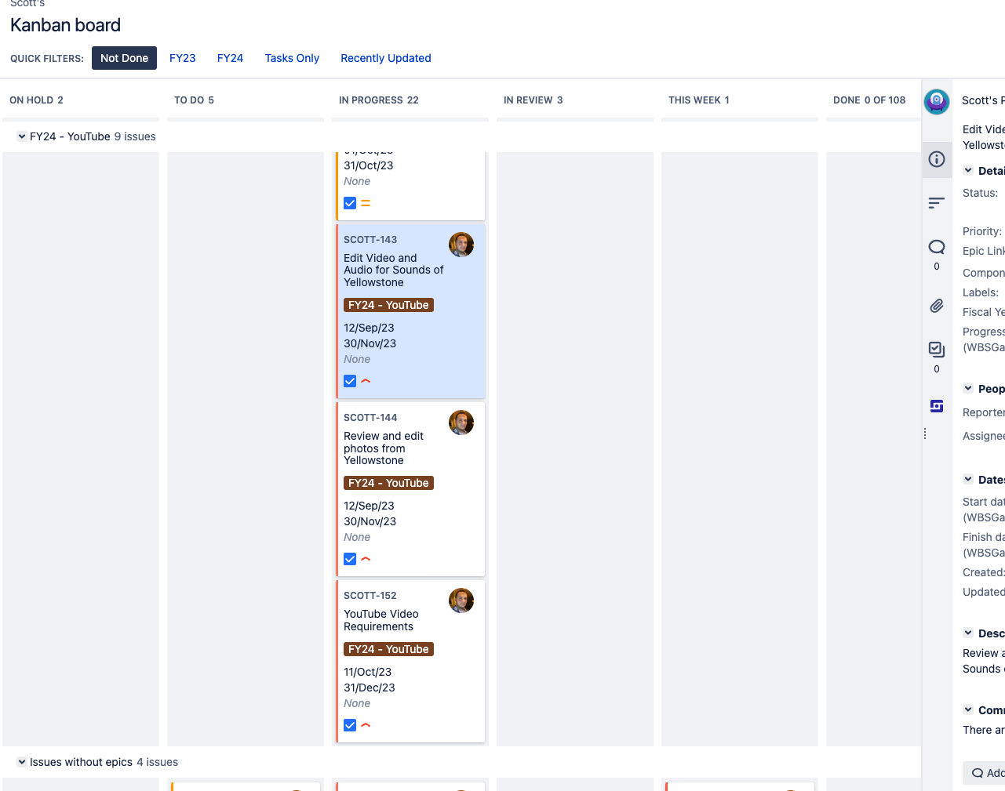
Repeating the model
We have a Service Center/Confluence/LMS space for:
Internal Drupal CMS
Bureau Social Media team
Public Affairs, Internal, Budget, and others
Each member of our Digital Services Team has their own Jira project
Enter and track our own tasks/works/special projects
Kanban boards
Gantt charts for special projects and tasks throughout the year
We use this for our own EPAPs!
Each performance element = Epic
Add your stories and tasks to each epic
Track updates, analytics, export all work for mid-year and final review.
drupalGovcon govsummit

Slide 32
Questions?
drupalGovcon govsummit

