Slide 1
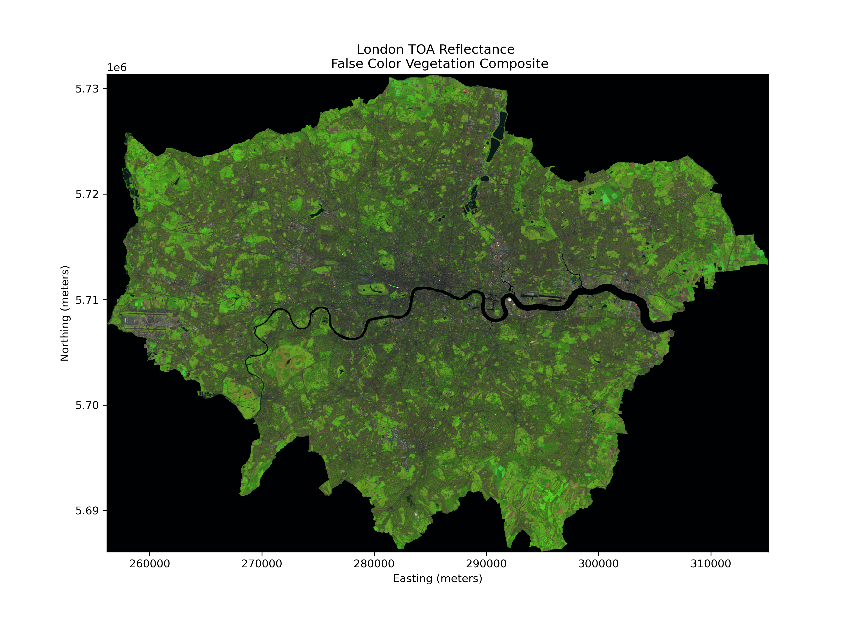
An Introduction to Landsat Data Access and Processing in the Cloud
Tonian Robinson
Earth Space Technology LLC, contractor to the U.S. Geological Survey (USGS)
Earth Resources Observation and Science (EROS) Center, Sioux Falls, SD 57198, USA.
Work performed under USGS Contract G0121D0001.
Notes:
Hello I’m Toni Robinson and I will be introducing you all to the materials we have to help you get started with working with Landsat in the cloud.

Slide 2
What to Expect in this Webinar
Today we will:
  Outline Landsat Product S3 Storage: Discuss how Landsat data is stored and how metadata is structured for data search.
  Demo Available Workflows: We now provide Python workflows to support Landsat users who wish to process data in the cloud.
  Highlight Valuable Cloud Resources: Discuss resources that can guide you in using Landsat data and tools in the Cloud.
Notes:
Outline of how Landsat data is stored in the cloud
Demo the workflow available for users
Highlight/introduce the resources available to get started in the cloud
This webinar provides workflows to support users as they transition or explore working with Landsat data in the cloud.

Slide 3
Landsat Data in the Cloud
The Landsat data in the cloud is stored in an Amazon Web Services (AWS) Simple Storage Services (S3) bucket.
The s3://usgs-landsat requester pays bucket is located in the Oregon us-west-2 region.
Notes:
Landsat data is now available in the cloud. It's stored in an Amazon Web Services S3 bucket in the Oregon US West 2 region. Users can access the data using direct requester pays.

Slide 4
Available Data Products in the Cloud
Level-1
Landsat Collection 2 Level-1 Radiance
Level-2
Surface Reflectance (SR)
Surface Temperature (ST)
Analysis Ready Data (ARD):
Level-3
Burned Area (BA)
Dynamic Surface Water Extent (DSWE)
Fractional Snow-Covered Area (fSCA)
Surface Temperature (ST)
Top of Atmosphere Brightness Temperature (BT)
Top of Atmosphere (TA) Reflectance
Surface Reflectance (SR)
Notes:
The available products in the cloud are:
Level-1 Radiance products with geometric and radiometric corrections
Level-2 Which are corrected for atmospheric conditions and separated into Surface reflectance and temperature products. This also includes Analysis Ready Data products.
Level-3 Thematic products derived from higher-level processing of the imagery, e.g., Burned Area (BA), and Fractional Snow-Covered Area (fSCA)

Slide 5
Landsat S3 Cloud Storage Structure
Example location of product in the USGS Landsat S3 Bucket
LT05_L2SP_029030_20110605_20200822_02_T1
LT05_L2SP_029030_20110605_20200822_02_T1
LT05_L2SP_029030_20110605_20200822_02_T1
LT05_L2SP_029030_20110605_20200822_02_T1
LT05_L2SP_029030_20110605_20200822_02_T1
LT05_L2SP_029030_20110605_20200822_02_T1
LT05_L2SP_029030_20110605_20200822_02_T1
LT05_L2SP_029030_20110605_20200822_02_T1
LT05_L2SP_029030_20110605_20200822_02_T1
S3 Bucket
collection
Processing Level
Projection
Sensor
Year
Path
Row
Product
usgs-landsat
collection02
level-2
standard
tm
2011
029
030
LT05_*
Notes:
Here we provide an example of how a product in the Landsat S3 bucket is stored:
The product is a level-2 collected with the Thematic Mapper in 2011.
To start all products are located inside the Landsat usgs-landsat bucket in collection 2, the only collection available to users.
The processing level is level-2, the Projection which is WGS84 UTM
The sensor is the TM for the thematic mapper (Landsat 4-5)
The year is 2011
The path and row are 29 and 30
The final directory is the product name

Slide 6
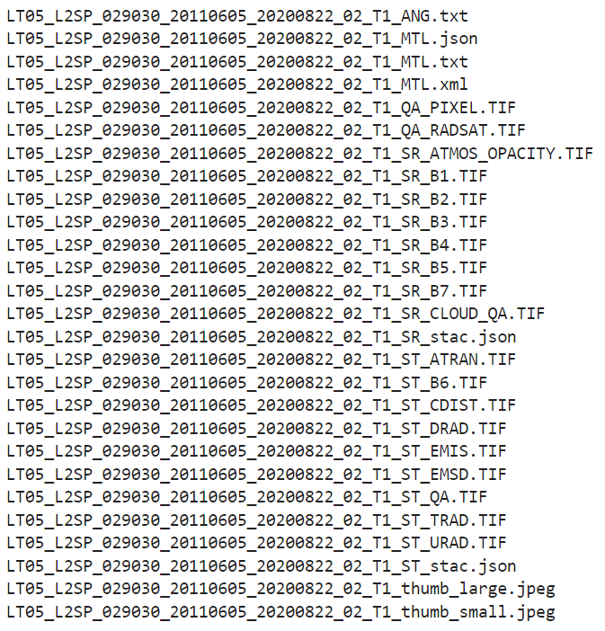
Product Structure
The band files, metadata, and auxiliary files within each product are called objects. The available objects for product LT05_L2SP_029030_20110605_20200822_02_T1 are:
Notes:
Under the product structure, there are various objects ranging from metadata to the band products as tif files

Slide 7
How do you find Landsat data?
Notes:
Now that you know how the data is structured in the Landsat S3 bucket, how do you find the data you need?

Slide 8
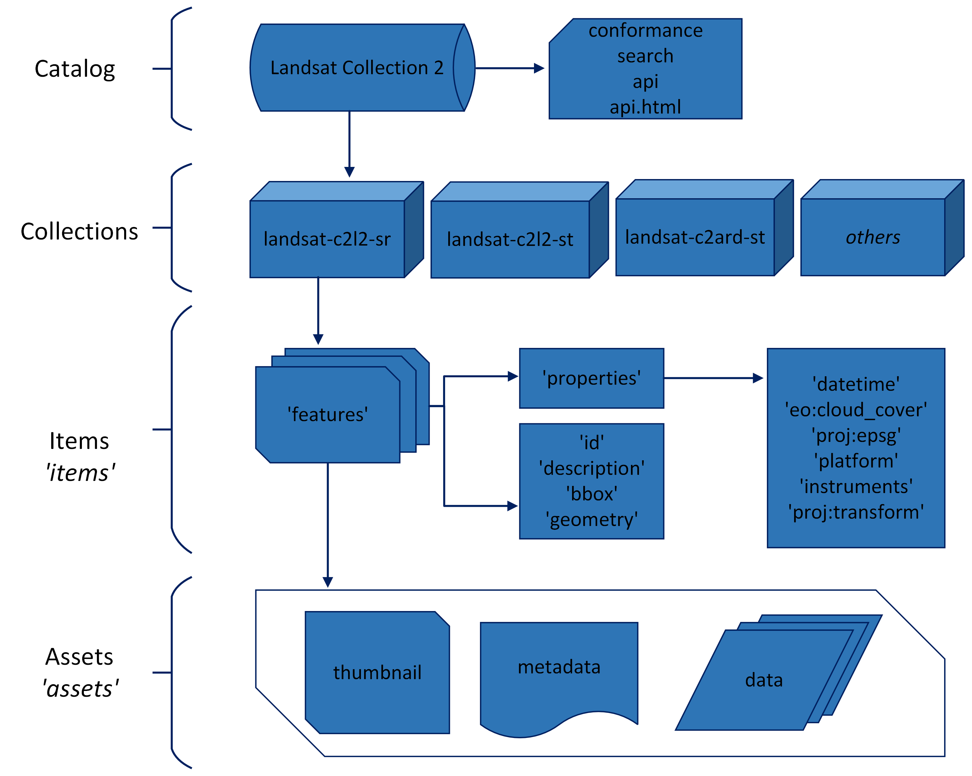
Landsat
STAC
Catalog
How different Landsat products are grouped
Individual Landsat data products within each product grouping
Where links to band files located in S3 are stored
Notes:
Spatio Temporal Asset Catalog (STAC) family of specifications standardizes how geospatial metadata is structured for easier/simpler data access.
Here at the United States Geological Survey (USGS) we use STAC because it allows users to conveniently access metadata associated with Landsat products that are accessible through the Amazon Web Services (AWS) cloud platform.
The Landsat STAC Catalog has only Landsat Collection 2 data with 13 collections e.g. landsat-c2l2-sr is the Surface Reflectance Dataset and has all SR products. Note that a Landsat STAC collection is separate from a Landsat Collection, where a Landsat Collection is the reprocessing of the Landsat Archive to improve geometry accuracy and data organization.
Each collection has items which are the individual products.
Each Item has assets for example are thumbnails, metadata and data i.e. the band files as geotiffs.

Slide 9
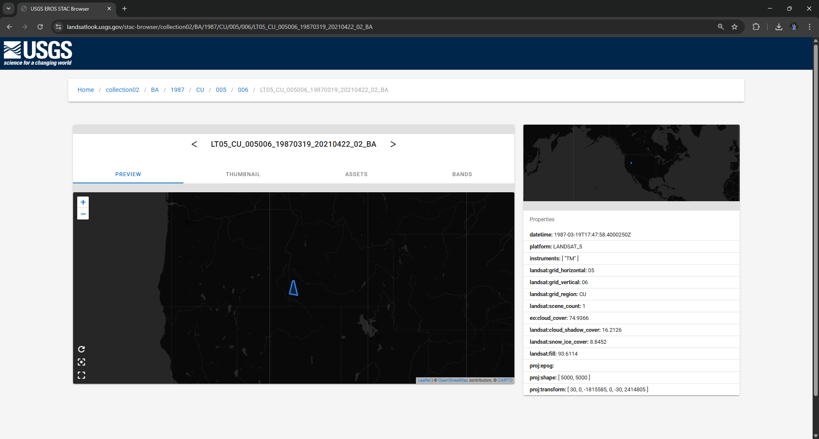
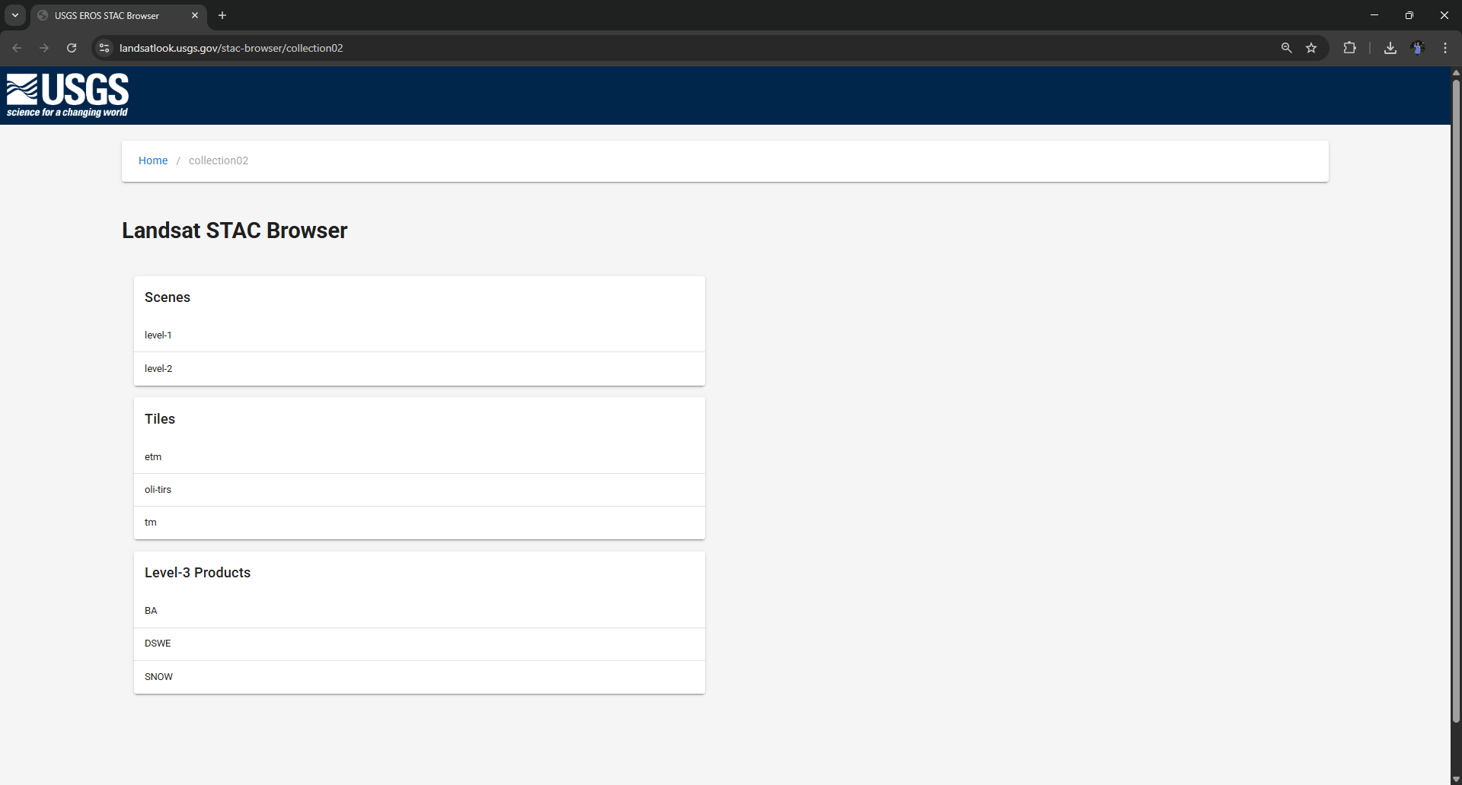
Landsat STAC Browser
https://landsatlook.usgs.gov/stac-browser/collection02
Notes:
We provide the Landsat STAC browser which is a simple way to search for the available Landsat products.
https://landsatlook.usgs.gov/stac-browser/collection02
Heres an example of viewing a single burn-area product, collected in 1987. You can see the outline of the product on the map and its metadata to the right.

Slide 10
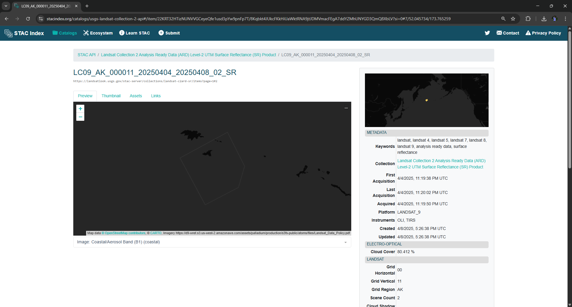
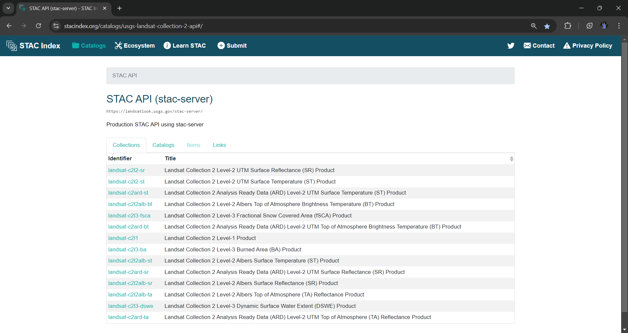
https://stacindex.org/catalogs/usgs-landsat-collection-2-api#/
Landsat
STAC
API
Notes:
https://stacindex.org/catalogs/usgs-landsat-collection-2-api#/
Heres an example of a single product selected from the Surface Reflectance ARD STAC Collection. You can see a map with the outline of the ARD and the metadata to the right.

Slide 11
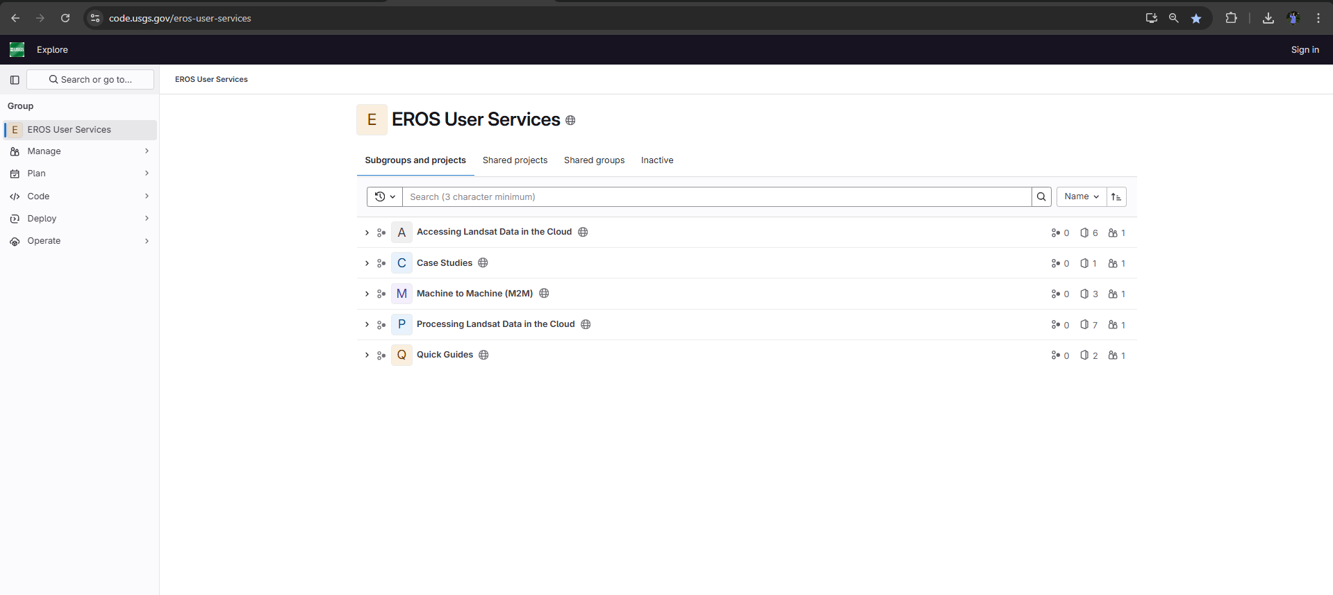
USGS User Services Gitlab
https://code.usgs.gov/eros-user-services
Notes:
Here at the USGS EROS, we provide Python notebooks to help users start working with Landsat data in a cloud environment. These are housed on the USGS User Services Gitlab account.

Slide 12
Landsat Cloud Tutorial Gitlab Projects
Accessing Landsat Data in the Cloud
Focus on retrieving Landsat data as Cloud Optimized GeoTIFFs
Processing Landsat Data in the Cloud
Focus on scaling, filtering, and visualizing Landsat products
Quick Guides
Additional support for tutorials
Case Studies
Real world examples of processing Landsat in the cloud
Notes:
We have multiple projects within our User Services Gitlab
The first listed here is focused on accessing Landsat data.
The second is processing Landsat data.
The 3rd is quick guides that supplement tutorials.
The fourth is Case Studies, which present real-world problems and use cases of processing Landsat data.
Next, we’ll head over to the browser to show you all what’s available and go through some of the tutorials.

Slide 13
USGS User Services GitLab Demo
https://code.usgs.gov/eros-user-services
Notes:
From here, we will continue to the USGS User Services GitLab to show you how to use our tutorials.

Slide 14
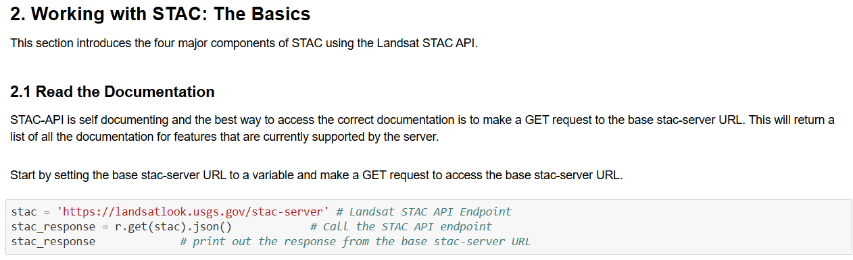
Demo 1: Introduction to Landsat STAC

Slide 15
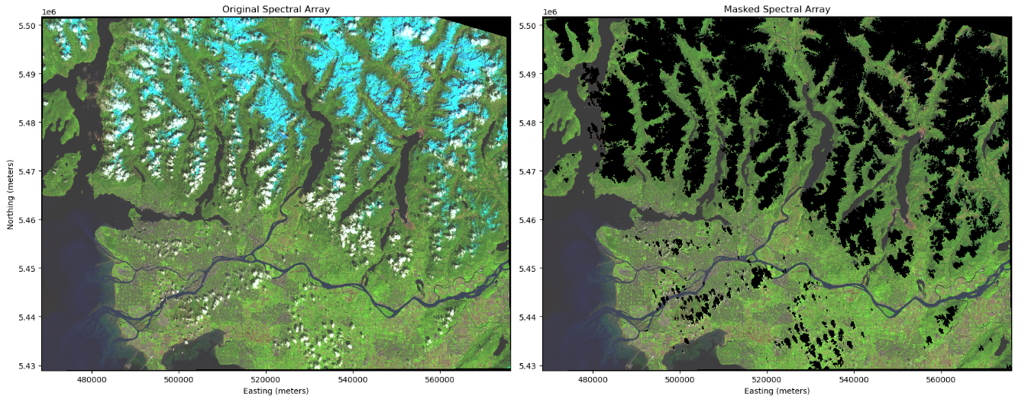
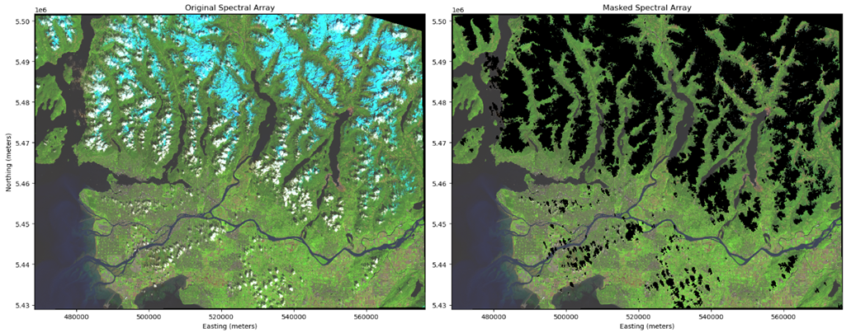
Demo 2: Decoding and using the Landsat Pixel Quality Assessment Band for Masking

Slide 16
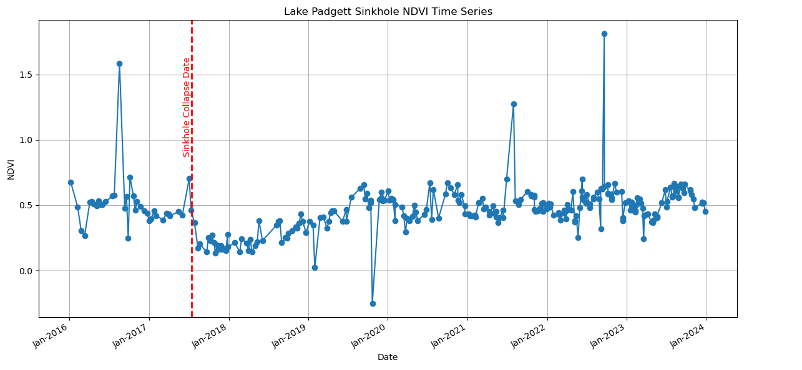
Demo 3: Retrieving Band Values for a Single Pixel Through Time
Notes:
We have a tutorial that introduces retrieving band values for a single pixel location using a GeoJSON point object. This serves as a preliminary step to time series analysis with Landsat data. This work focuses on the Land-o-Lakes Sinkhole collapse that took 2 houses and caused the condemnation of 7 others. The time series plot shows the Normalized Vegetation Index for a single pixel influenced by a collapsing sinkhole. The red dashed line is the date of the sinkhole collapse. You can see the change in the NDVI after the collapse.

Slide 17
Available Cloud Resources

Slide 18
Cloud Resource Suggestions
Pangeo | https://www.pangeo.io/
NASA EarthData Cloud Primer for Amazon Web Services | https://www.earthdata.nasa.gov/learn/webinars-and-tutorials/cloud-primer-amazon-web-services
Alaska Satellite Facility OpenScienceLab | https://asf.alaska.edu/asf-services-open-science-lab/
NASA Openscapes | https://openscapes.org/
Cloud Native Geo | https://cloudnativegeo.org/
Notes:
THESE ARE NO COST not FREE
Pangeo provides cloud computing resources for Geoscientists.
https://www.pangeo.io/
The NASA EarthData Cloud Primer for AWS Services provides information on how to get started in AWS cloud services i.e., setup and understanding pricing/costs.
https://www.earthdata.nasa.gov/learn/webinars-and-tutorials/cloud-primer-amazon-web-services
You can analyze/visualize your Landsat data in the ASF OpenScienceLab. OpenScienceLab has free but limited access to a cloud-hosted JupyterHub where you can access and work with a variety of satellite imagery.
https://asf.alaska.edu/asf-services-open-science-lab/
NASA OpenScapes provides a community for users interested in getting started in the cloud. Upon joining an OpenScapes event or Science Champions Cohort you will have access to the 2i2c JupyterHub, where you can get started on processing imagery in a cloud environment—also a great place to find collaborators. Openscapes is in-region so it doesn’t cost to pull from Landsat S3 bucket?
https://openscapes.2i2c.cloud/hub/login?next=%2Fhub%2F
Cloud Native Geo like Pangeo, provides cloud computing community for geoscientists where users can connect, collaborate, and deepen our understanding of the world through the power of geospatial data.
https://cloudnativegeo.org/

Slide 19
Contact Us
Email: custserv@usgs.gov​ ​
Voice: (605) 594-6151
Toll Free: 1 (800) 252-4547
USGS EROS GitLab: https://code.usgs.gov/eros-user-services

