Slide 1


USGS Ores to Minerals
Lesson 1
Rocks Versus Minerals | Student Slides

Slide 2

Guiding Questions
Lesson 1
Rocks Versus Minerals | Student Slides
Can you tell a rock from a mineral by looking?
What are the differences between a rock and a mineral?

Slide 3

Descriptions
Lesson 1
Rocks Versus Minerals | Student Slides
Minerals have distinctive chemical and physical properties, composition, and atomic structure. They may be found in soil, rocks, rivers, lakes, or oceans. Plants and animals take up minerals that are essential for life. Minerals generally form crystals.

Slide 4
Descriptions Continued
Lesson 1
Rocks Versus Minerals | Student Slides
Rocks are generally made up of two or more minerals that are mixed together during a geological process when they are formed. New rocks are made from cooled lava, from compressed sediment, or by transforming other rocks into new forms.
Sometimes single minerals form rocks, but generally, “A good way to think about it is if a chocolate chip cookie was a rock, then the flour, sugar, butter, chocolate chips are the minerals that make up that rock!”
U.S. Geological Survey, 2017, EarthWord–Rock vs. Mineral, accessed January 4, 2025 at https://www.usgs.gov/news/science-snippet/earthword-rock-vs-mineral

Slide 5

Instructions
Lesson 1
Rocks Versus Minerals | Student Slides
Use your Student Worksheet to evaluate as you complete these slides.
There are no right or wrong answers—use your judgment to determine if the formations you see are rocks or minerals. Your teacher may have samples of these to help you.

Slide 6
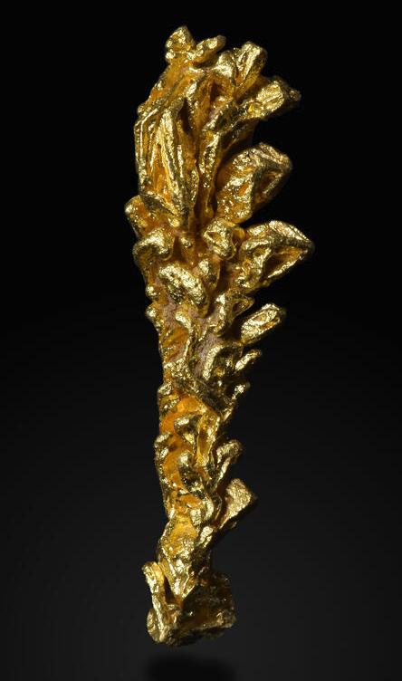
(Native) Gold
Lesson 1
Rocks Versus Minerals | Student Slides
Rock or Mineral?
“Gold has been treasured since ancient times for its beauty and permanence. Most of the gold that is fabricated today goes into the manufacture of jewelry. However, because of its superior electrical conductivity and resistance to corrosion and other desirable combinations of physical and chemical properties, gold also emerged in the late 20th century as an essential industrial metal.”
U.S. Geological Survey, 2024, Gold Statistics and Information, accessed January 4, 2025 at https://www.usgs.gov/centers/national-minerals-information-center/gold-statistics-and-information
Native Gold courtesy of the U.S. Geological Survey, https://www.usgs.gov/media/images/native-gold

Slide 7
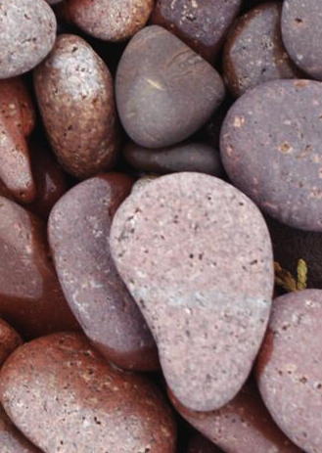
Basalt
Lesson 1
Rocks Versus Minerals | Student Slides
Rock or Mineral?
Basalt is the dominant feature in Earth’s upper oceanic crust. Volcanoes such as Mt. Kilauea in Hawaii and Mt. Etna in Sicily are composed of basalt. Generally dark-colored, Basalt is rich in iron, magnesium, and calcium and is finely crystalline (crystals less than 1 mm in size) which occurred during the quick cooling of lava.”
Amygdaloidal basalt rock on Great Sand Bay beach in Keweenaw Peninsula, Michigan courtesy of the U.S. Geological Survey, https://www.usgs.gov/media/images/amygdaloidal-basalt-rock-great-sand-bay-beach-keweenaw-peninsula-michigan

Slide 8
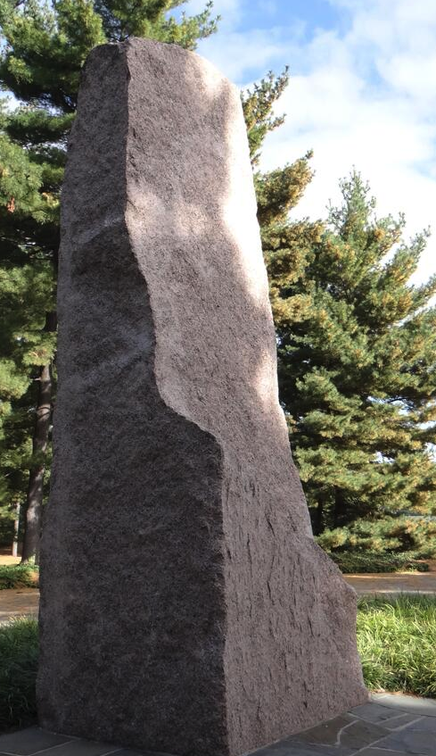
Granite
Lesson 1
Rocks Versus Minerals | Student Slides
Rock or Mineral?
Granite is a coarse-grained formation found in continental crust and is composed mostly of quartz, alkali feldspar, and plagioclase. It forms from slowly cooled magma with a high content of silica and alkali metal oxides. It is often used in monuments and countertops.
Granite Monument at the LBJ Memorial courtesy of the U.S. Geological Survey, https://www.usgs.gov/media/images/granite-monument-lbj-memorial-0

Slide 9
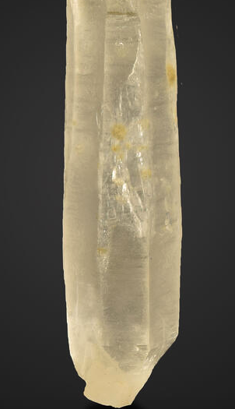
Quartz
Lesson 1
Rocks Versus Minerals | Student Slides
Rock or Mineral?
Quartz is common in the Earth's crust and it is made of silicon and oxygen. Quartz is a popular material for jewelry and hardstone carvings, and it is the main component in beach sand. Pure quartz is colorless, but impurities can give it a range of colors, including yellow, pink, purple, white, and black. These are known respectively as citrine, rose quartz, amethyst, milky quartz, and smoky quartz.
Pyrite and Quartz courtesy of the U.S. Geological Survey, https://www.usgs.gov/media/images/pyrite-and-quartz

Slide 10
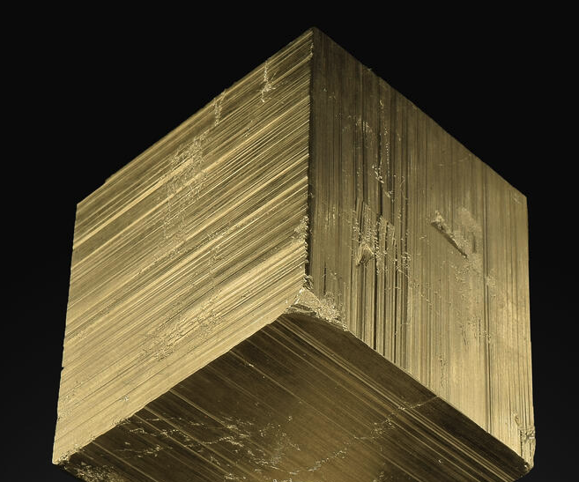
Pyrite
Lesson 1
Rocks Versus Minerals | Student Slides
Rock or Mineral?
Pyrite is a common metal made up of iron and sulfur that's also known as "fool's gold" because of its gold-like color and metallic luster. The name comes from the Greek word for fire, “pyr,” because pyrite emits sparks when struck by metal and it was used in early flintlock rifles for that reason. It can also be used in home decor and jewelry.
Pyrite and Quartz courtesy of the U.S. Geological Survey, https://www.usgs.gov/media/images/pyrite-and-quartz

Slide 11
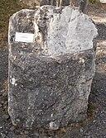
Limestone
Lesson 1
Rocks Versus Minerals | Student Slides
Rock or Mineral?
Limestone is primarily made up of different forms of calcium carbonate. It is usually gray, but it can also appear more brownish-yellow or white. Limestone is used extensively in road and building construction, and it is a material found in aggregate, cement, building stones, chalk, and crushed stone.
Szilas. (2014). Red limestone, Miocene, 15 million years old, Fertőrákos [Photograph]. Wikimedia Commons. https://commons.wikimedia.org/wiki/File:Lajta_limestone,_Fert%C5%91r%C3%A1kos.jpg

Slide 12
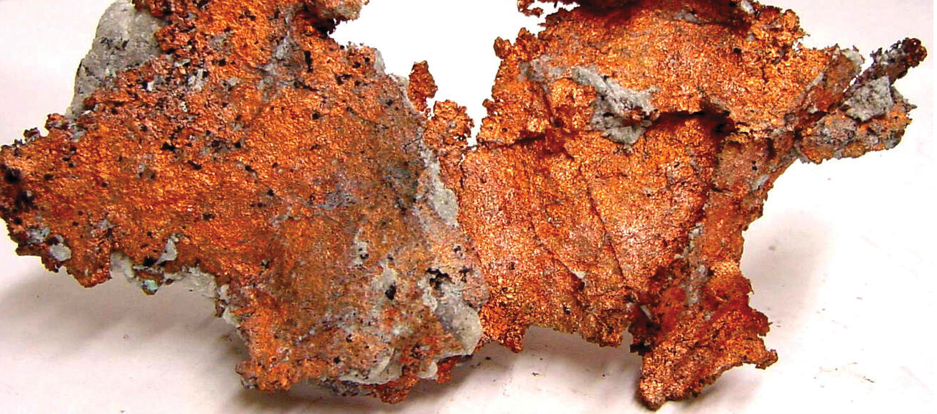
(Native) Copper
Lesson 1
Rocks Versus Minerals | Student Slides
Rock or Mineral?
Native copper is orangish in color on fresh surfaces but typically forms a green patina when it is exposed to air. The name comes from the Latin word “cuprum.” It is a soft, malleable, and ductile metal with very high thermal and electrical conductivity. Copper helps make red blood cells, it forms collagen for bones and tissue, and it acts as an antioxidant to protect cells and DNA.
Copper courtesy of the U.S. Geological Survey, https://www.usgs.gov/media/images/copper
https://www.usgs.gov/media/images/copper

Slide 13
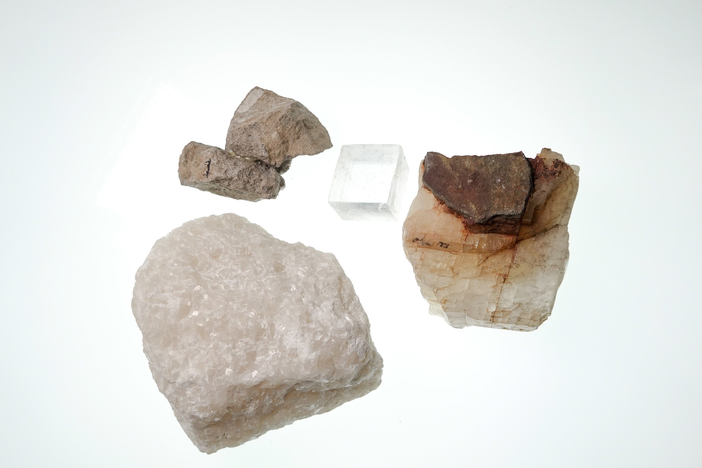
Lesson 1
Rocks Versus Minerals | Student Slides
Rock or Mineral?
Calcite
Calcite is usually white or colorless, but impurities can cause it to be many colors. Calcite formations can be found in caves, lakes, rivers, and oceans. Calcite is very soft and easily scratched. It can also be dissolved by weak acids, like vinegar. Calcite can take many shapes, like the rhomboidal shape or hexagonal shape.
U.S. Geological Survey. (2025). Calcite Samples [Photograph].

Slide 14
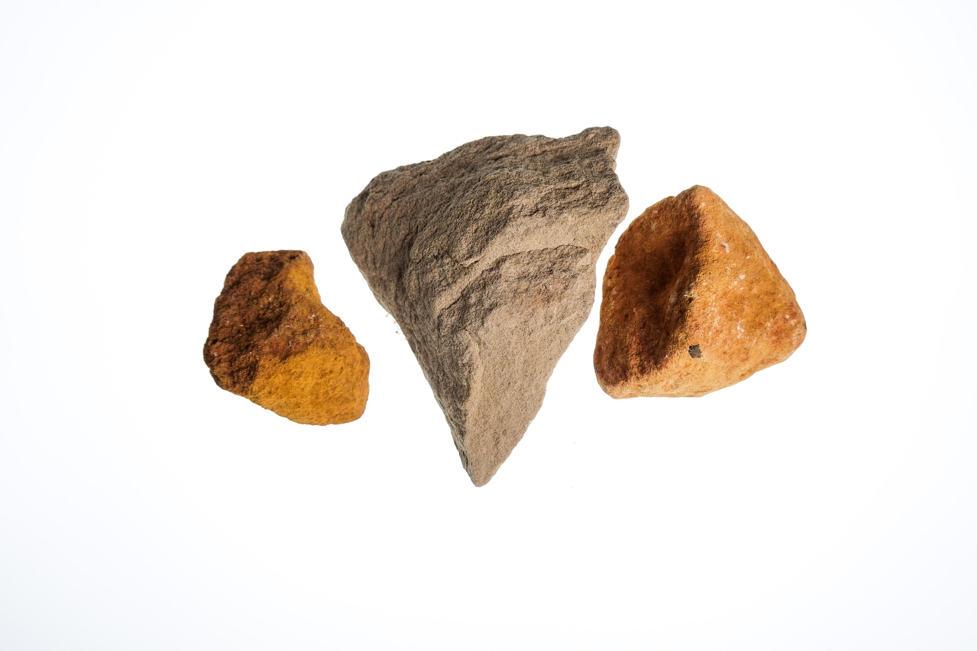
Lesson 1
Rocks Versus Minerals | Student Slides
Rock or Mineral?
Sandstone is very porous and water will penetrate it easily. Brown, red, purple, and pink sandstones are commonly called brownstone, but there are many possible colors. Sandstone is characterized by sheets of different colors of sediment that have been cemented together. It is commonly used for building, abrasives, glass-making, computer chips, paint, and TV screens.
U.S. Geological Survey. (2025). Sandstone Samples [Photograph].
Sandstone

Slide 15
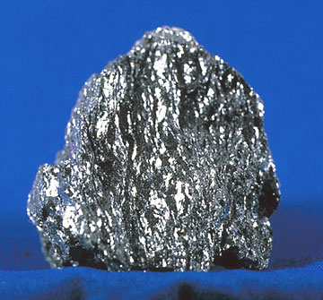
Hematite
Lesson 1
Rocks Versus Minerals | Student Slides
Rock or Mineral?
Hematite is made of iron and oxygen, and it usually appears metallic gray, black, or silver, but it may also be brownish-red. When tumbled, it becomes very lustrous, so it is popular for jewelry. In 2004, NASA's Mars rover discovered hematite on the Martian surface, which gives Mars its reddish appearance.
U.S. Geological Survey. (2004). Hematite [Photograph]. Wikimedia Commons. https://commons.wikimedia.org/wiki/File:HematiteUSGOV.jpg

Slide 16
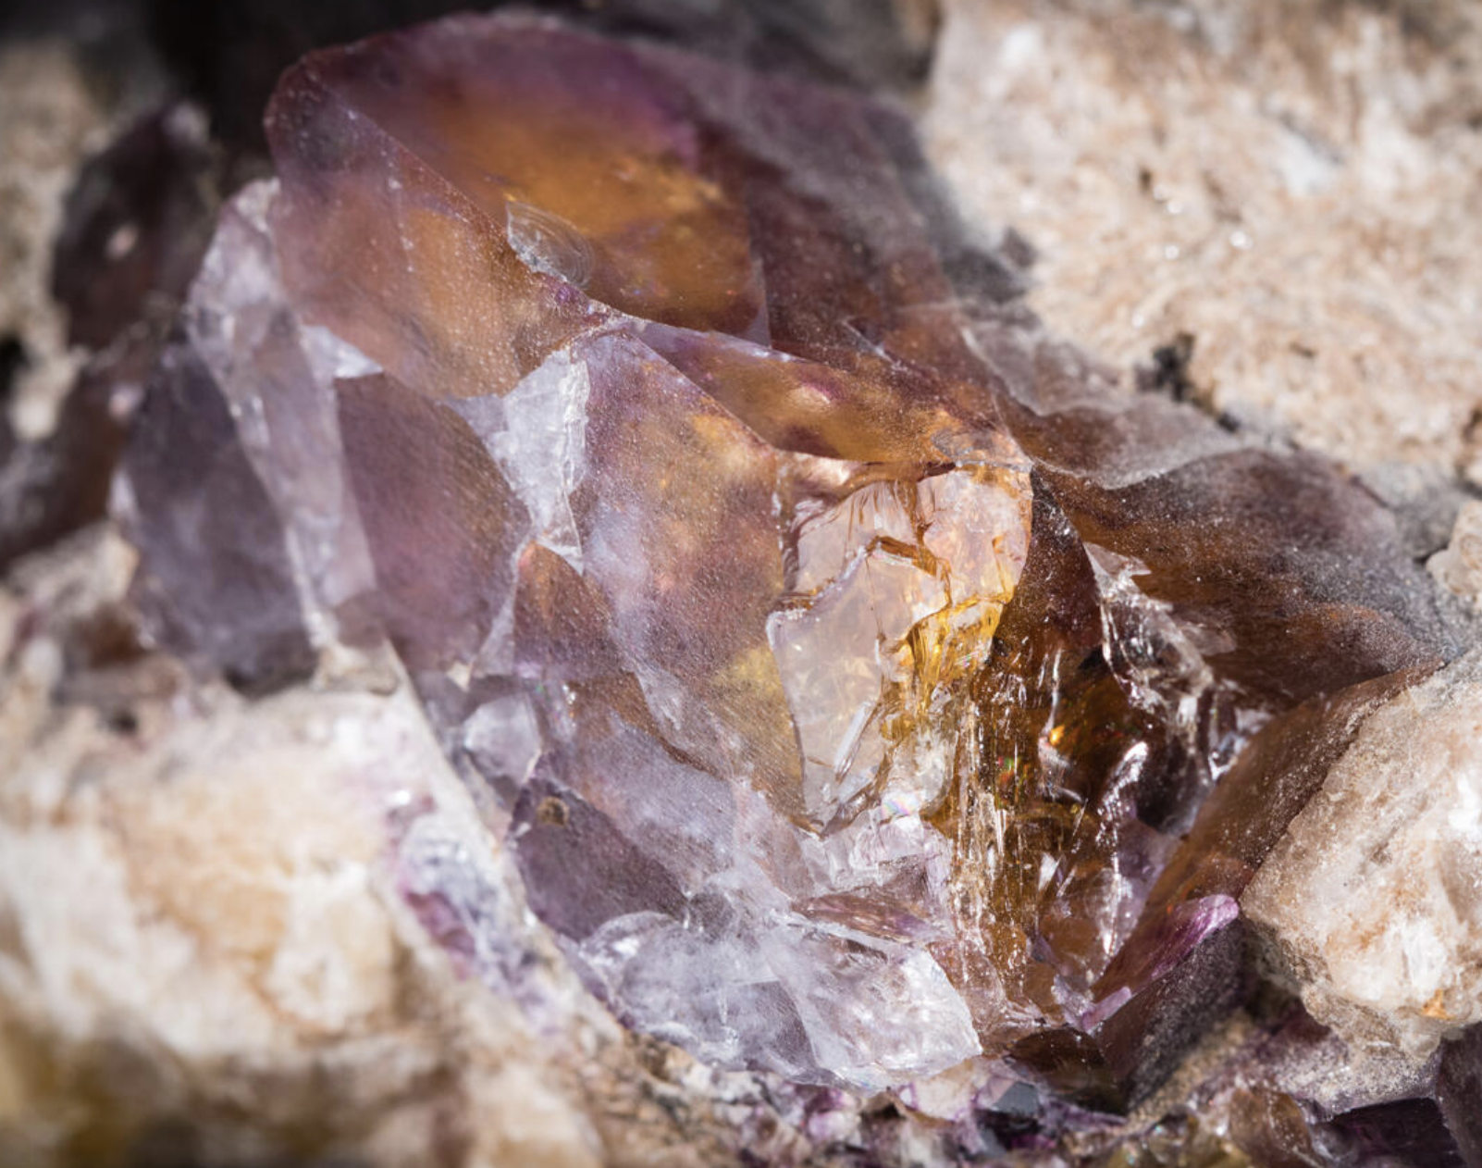
Fluorite
Lesson 1
Rocks Versus Minerals | Student Slides
Rock or Mineral?
Fluorite is also called fluorspar, and it “is used directly or indirectly to manufacture products such as aluminum, gasoline, insulating foams, refrigerants, steel, and uranium fuel.” It is composed of calcium and fluorine, and it can come in a variety of colors such as purple, yellow, green, blue, pink, and brown.
Fluorite courtesy of the U.S. Geological Survey, https://www.usgs.gov/media/images/fluorite

Slide 17
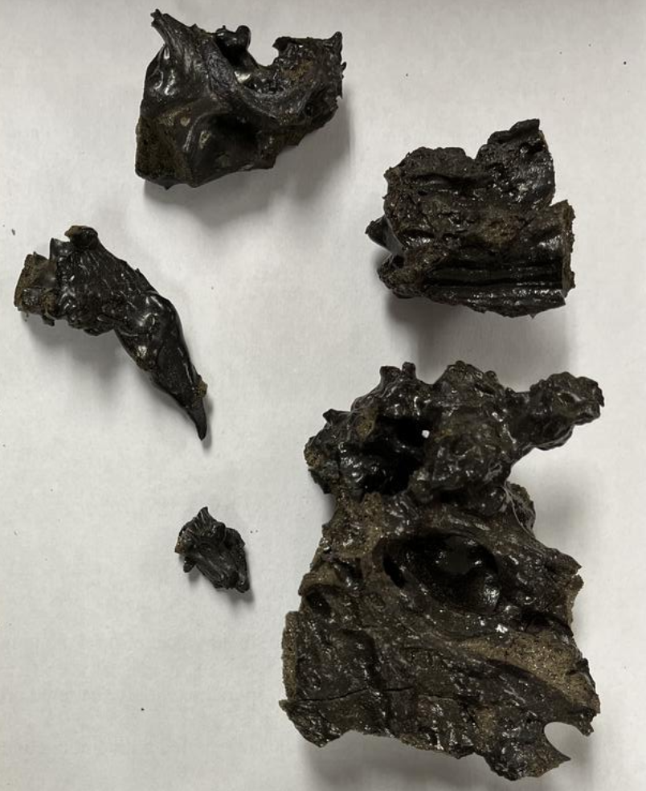
Pumice
Lesson 1
Rocks Versus Minerals | Student Slides
Rock or Mineral?
Pumice is the result of cooled volcanic lava that contained lots of water and gases. It is typically grayish-black with many small holes left behind by the gases released during the cooling process. Pumice is commonly used as a mild abrasive and to improve soil quality by absorbing excess moisture.
December 23, 2024 — Kīlauea newest lava samples courtesy of the U.S. Geological Survey, https://www.usgs.gov/media/images/december-23-2024-kilauea-newest-lava-samples

Slide 18
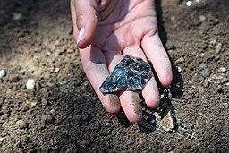
Obsidian
Lesson 1
Rocks Versus Minerals | Student Slides
Rock or Mineral?
Obsidian was once used for blades and arrowheads because it can be as sharp as surgical steel scalpels. Now, obsidian is used as a gemstone for jewelry. Obsidian is black and lustrous, and it comes from rapidly cooled volcanic rock.
Yellowstone National Park. (2018). Obsidian flake found on an archaeological dig (2) [Photograph]. Wikimedia Commons. https://commons.wikimedia.org/wiki/File:Obsidian_flake_found_on_an_archaeological_dig_(2)_(41192043680).jpg

Slide 19
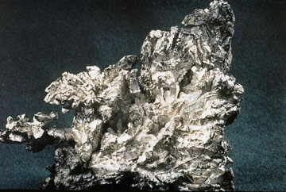
(Native) Silver
Lesson 1
Rocks Versus Minerals | Student Slides
Rock or Mineral?
Silver has long been valued as a precious metal, and it is now used in solar panels, water filtration, utensils, electrical contacts, and special mirrors. It is soft, ductile, lustrous, and malleable, making it ideal for coins and jewelry. The world’s top silver-producing mines can be found in Australia, Mexico, Bolivia, Peru, and Poland.
U.S. Geological Survey. (2005). Silver [Photograph]. Wikimedia Commons. https://commons.wikimedia.org/wiki/File:SilverUSGOV.jpg

Slide 20
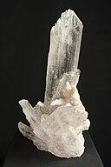
Gypsum
Lesson 1
Rocks Versus Minerals | Student Slides
Rock or Mineral?
Gypsum consists of calcium, sulfur, and oxygen, and it is mined for use as a fertilizer and as a component of chalk, plaster, and drywall. Gypsum was discovered in the northern polar regions of Mars by a Mars rover; on Earth, it can be found in Brazil, Pakistan, Jamaica, Iran, Thailand, Spain, Germany, Italy, England, Ireland, Canada, and the United States.
Naturalis Biodiversity Center. (2014). White gypsum mineral [Photograph]. Wikimedia Commons. https://commons.wikimedia.org/wiki/File:Naturalis_Biodiversity_Center_-_Gypsum_-_mineral.jpg

Slide 21
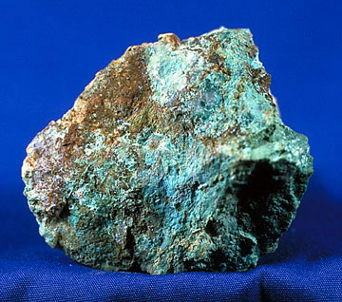
Malachite
Lesson 1
Rocks Versus Minerals | Student Slides
Rock or Mineral?
Malachite was given its name due to its resemblance to the green leaves of the mallow plant of Africa, Asia, and Europe. Its green color is due to the copper in its chemical makeup. It also contains carbon, oxygen, and hydrogen. It is found throughout Africa, Mexico, southern Australia, France, Israel, Russia, and the southwestern United States.
U.S. Geological Survey. (2005). Malachite [Photograph]. Wikimedia Commons. https://commons.wikimedia.org/wiki/File:MalachiteUSGOV.jpg

Slide 22
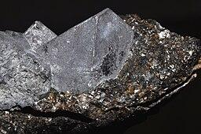
Galena
Lesson 1
Rocks Versus Minerals | Student Slides
Rock or Mineral?
Galena is composed of lead and sulfur. Its deposits often also contain silver. Among other places, galena is found in England, Bulgaria, Australia, Spain, Sardinia, and the United States. Galena was once used in decorative paints and cosmetics, but it is now mainly obtained for its lead content.
Géry PARENT. (2008). galena, sphalerite : Planioles Mine, Planioles, Lot, Midi-Pyrénées, France [Photograph]. Wikimedia Commons. https://commons.wikimedia.org/wiki/File:Galena,_sphalerite.jpg

Slide 23
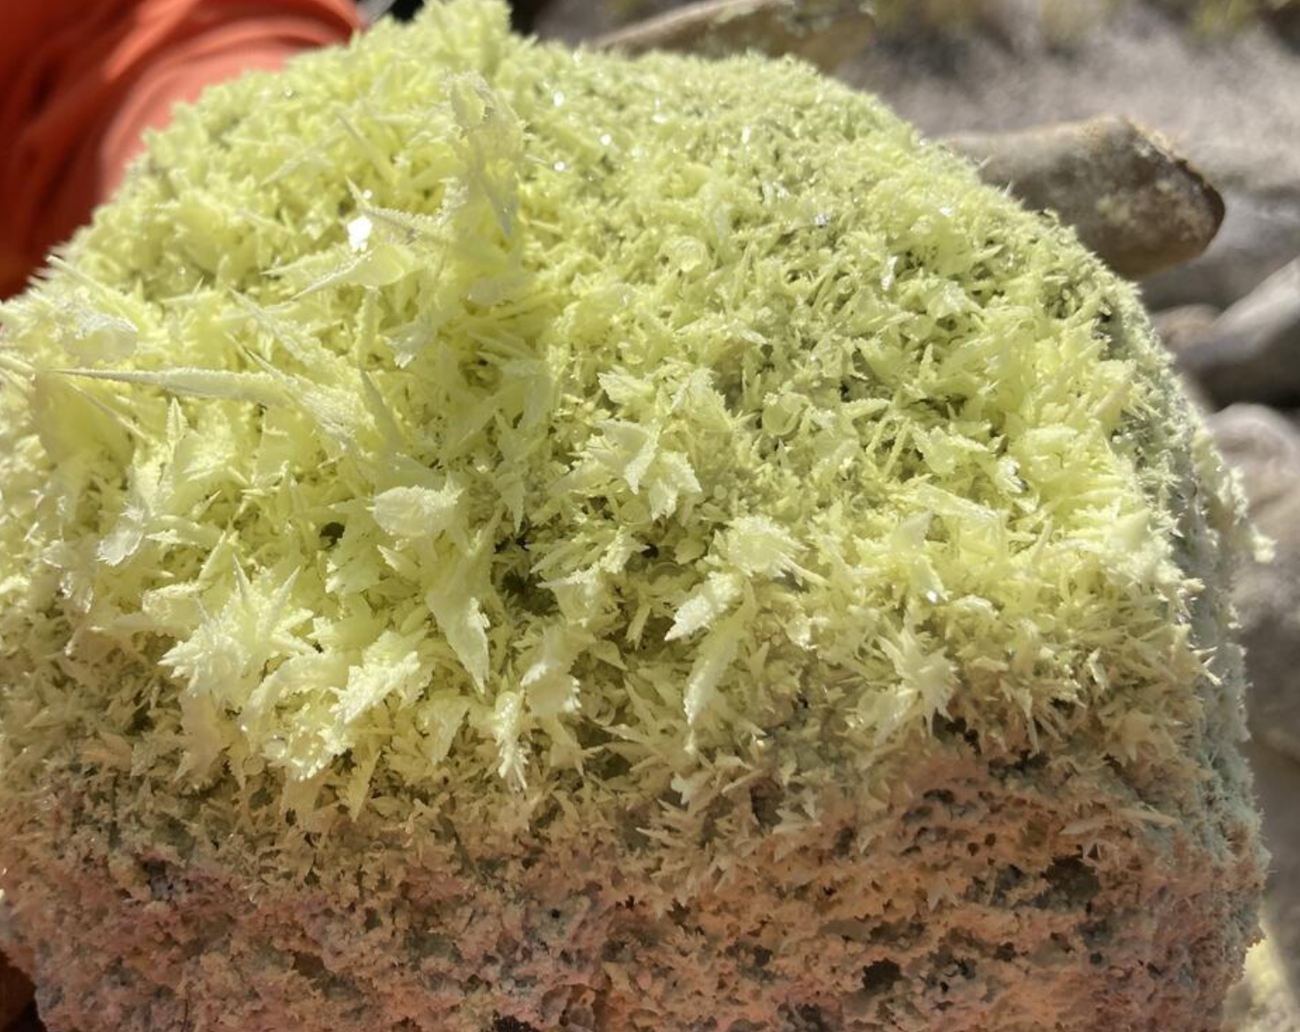
(Native) Sulfur
Lesson 1
Rocks Versus Minerals | Student Slides
Rock or Mineral?
Sulfur is a yellow solid that is found in crystal form all throughout the Earth’s crust. Historically, sulfur was also called brimstone, which means “burning stone,” and it has a powerful distinctive smell. It is a necessary element for life because it makes up proteins, bones, and teeth. It also helps with energy production, cell protection, DNA repair, and regulating blood sugar.
Crystals of pure native sulfur at sites of degassing called fumaroles courtesy of the U.S. Geological Survey, https://www.usgs.gov/media/images/crystals-pure-native-sulfur-sites-degassing-called-fumaroles

Slide 24
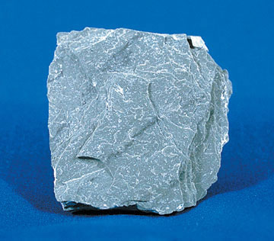
Slate
Lesson 1
Rocks Versus Minerals | Student Slides
Rock or Mineral?
Slate was used in electric switchboards and relay controls for large electric motors. Now it is used as roofing tile and for heat-proof countertops. Slate can be easily cleaved, or cut, into thin sheets. It can be found in Australia, Spain, Brazil, the Arctic, the UK, Belgium, France, and the United States. It is hard and heat-resistant, and it once served as a common writing surface for chalk before paper was widely available.
U.S. Geological Survey. (2005). Slate [Photograph]. Wikimedia Commons. https://commons.wikimedia.org/wiki/File:SlateUSGOV.jpg

Slide 25
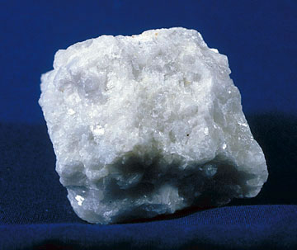
Marble
Lesson 1
Rocks Versus Minerals | Student Slides
Rock or Mineral?
Marble is commonly used as a building material or for monuments and sculptures. It forms from limestone under intense heat and pressure, which makes it resistant to shattering and good for shaping with tools. Often, marble has striations, or steaks, that are due to various mineral impurities. Marble is obtained by quarrying, where large blocks are removed by careful drilling and blasting.
USGS. (2005). MarbleUSGOV [Photograph]. Wikimedia Commons. https://commons.wikimedia.org/wiki/File:MarbleUSGOV.jpg

Slide 26
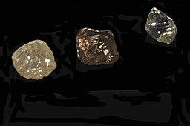
(Native) Diamond
Lesson 1
Rocks Versus Minerals | Student Slides
Rock or Mineral?
Diamonds form from ancient deposits of organic carbon—once living organisms—that are heated and pressurized in Earth’s crust. Raw diamonds are mined mainly in Africa, Russia, Australia, and the United States. Diamonds are the hardest substance on Earth, and they can be used for cutting tools, such as drills and scalpels.
Géry PARENT. (2009). diamonds : Venezuela, South Africa [Photograph]. Wikimedia Commons. https://commons.wikimedia.org/wiki/File:Diamonds_1.jpg

Slide 27
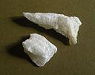
Talc
Lesson 1
Rocks Versus Minerals | Student Slides
Rock or Mineral?
Talc is a soft crystalline solid that can be powdered to make solid lubricants and baby powder. It is composed of magnesium, hydrogen, oxygen, and silicon. Talc is used in paper making, plastics, paints, rubber, pharmaceuticals, cosmetics, and ceramics. It can be found in Afghanistan, Turkey, Oman, China, France, Australia, Brazil, Finland, and the United States.
Ji-Elle. (2008). Talc from Luzenac (Ariège) [Photograph]. Wikimedia Commons. https://commons.wikimedia.org/wiki/File:LuzenacTalc.jpg

Slide 28
Physical Differences - Minerals
Lesson 1
Rocks Versus Minerals | Student Slides
How did you decide which was a rock and which was a mineral? Only physical differences can help.
MINERALS
Together, the types of atoms and the structure of how they connect determine the physical properties of minerals. To identify a specific mineral, geologists will usually examine the color, luster, and shape. They will also test to see how the mineral fractures, its hardness, and its streak—the color mark it leaves when rubbed. Minerals have a specific chemical formula, like SiO₂ or NaCl.

Slide 29
Physical Differences - Rocks
Lesson 1
Rocks Versus Minerals | Student Slides
ROCKS
Rocks can be composed of varying ratios of different minerals. Rocks may even include organic matter. They have no predetermined physical characteristics or chemical formula. Rocks are categorized according to the process by which they form.
Rocks that form from cooled lava are called igneous.
Rocks that form from compacted sediment are called sedimentary.
Rocks that form when other rocks are chemically transformed by heat and pressure are called metamorphic.

Slide 30
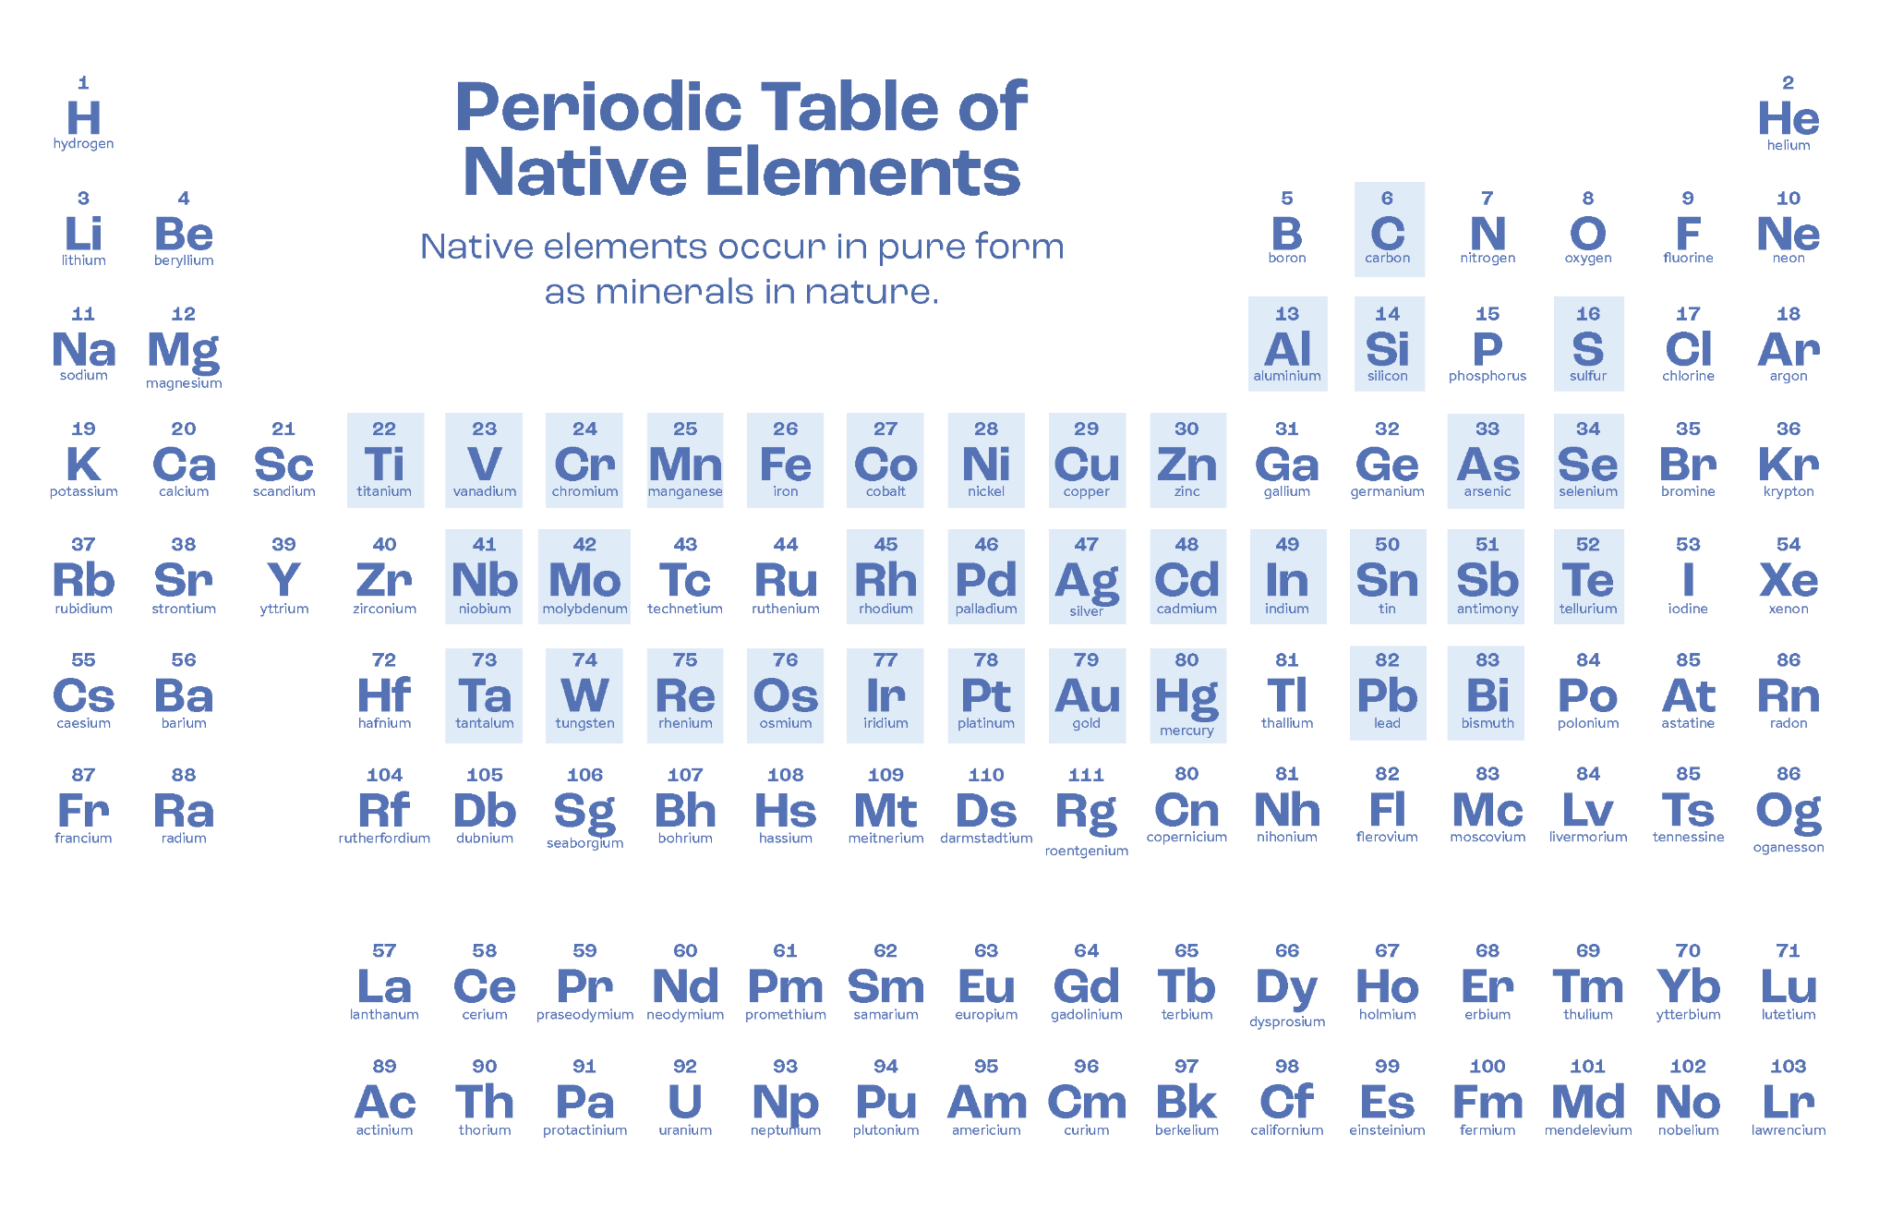
Native Elements
Lesson 1
Rocks Versus Minerals | Student Slides
Native elements are minerals that contain only one type of atom. Native elements occur in their pure, or nearly pure, form in the Earth’s crust.
The native elements include:
Gold (Au)
Silver (Ag)
Copper (Cu)
Sulfur (S)
Diamond (C)

Slide 31
Review of Guiding Questions
Lesson 1
Rocks Versus Minerals | Student Slides
✔
Can you tell a rock from a mineral by looking?
What are the differences between a rock and a mineral?
✔

Slide 32
Student Worksheet
Lesson 1
Rocks Versus Minerals | Student Slides
Great work! Now, complete the Student Worksheet and be sure to answer the conclusion questions.
Did you have fun looking at different rocks and minerals?
Rocks and minerals are the building blocks of Earth. They are important because they provide essential materials for us.

Slide 33
✔ Correct Answers
Lesson 1
Rocks Versus Minerals | Student Slides
Formation | Rock (R) or Mineral (M)? | Formation | Rock (R) or Mineral (M)?
(Native) Gold | M | Pumice | R
Basalt | R | Obsidian | R
Granite | R | (Native) Silver | M
Quartz | M | Gypsum | M
Pyrite | M | Malachite | M
Limestone | R | Galena | M
(Native) Copper | M | (Native) Sulfur | M
Calcite | M | Slate | R
Sandstone | R | Marble | R
Hematite | M | (Native) Diamond | M
Fluorite | M | Talc | M

Slide 34
Up Next
Lesson 1
Rocks Versus Minerals | Student Slides
Continue on to the next lesson: “Where in the World?”
You’ll find out where essential minerals and the rocks that contain them can be found.

