Slide 1


USGS Ores to Minerals
Lesson 2
Where in the World? | Student Slides

Slide 2

Think About It
Lesson 2
Where in the World? | Student Slides
“During the last 12 decades (1900–2020), the amounts of raw materials used in the United States have increased significantly due to economic development, technological innovations, and population growth.”
Matos, G.R., 2022, Materials flow in the United States—A global context, 1900–2020: U.S. Geological Survey Data Report 1164, 23 p., https://doi.org/10.3133/dr1164. [Supersedes USGS Fact Sheet 2017–3062.]

Slide 3
Think About It - More
Lesson 2
Where in the World? | Student Slides
“Over the past few decades (1990–2019), the United States has become reliant on foreign sources to meet domestic demand for a large and growing number of mineral commodities.”
Nassar, N. T., Alonso, E., and Brainard, J. L., 2020, Investigation of U.S. Foreign Reliance on Critical Minerals—U.S. Geological Survey Technical Input Document in Response to Executive Order No. 13953 Signed September 30, 2020 (Ver. 1.1, December 7, 2020): U.S. Geological Survey Open-File Report 2020–1127, 37 p., https://doi.org/10.3133/ofr20201127.

Slide 4
Learning Objectives (1)
Lesson 2
Where in the World? | Student Slides
Define “critical minerals.”
Relate the strategies for identifying critical minerals.
Analyze the supply of a mineral resource in terms of geographic region.

Slide 5

What Are Critical Minerals?
Lesson 2
Where in the World? | Student Slides
Critical minerals are minerals that are vital for the economic or national security of the United States and…

Slide 6
What Are Critical Minerals? Continued
Lesson 2
Where in the World? | Student Slides
critical minerals have supply chains that are vulnerable to disruption.

Slide 7
Learning Objectives (2)
Lesson 2
Where in the World? | Student Slides
Define “critical minerals.”
Relate the strategies for identifying critical minerals.
Analyze the supply of a mineral resource in terms of geographic region.

Slide 8
Are Critical Minerals Always the Same? (1)
Lesson 2
Where in the World? | Student Slides
No. Criticality changes over time because it is based on demand and supply, and…

Slide 9
Are Critical Minerals Always the Same? (2)
Lesson 2
Where in the World? | Student Slides
different government agencies—like the USGS—regularly assess what minerals are considered critical, and…

Slide 10
Are Critical Minerals Always the Same? (3)
Lesson 2
Where in the World? | Student Slides
information on critical minerals is released publicly to help ensure that the supply is protected.

Slide 11
How Are Critical Minerals Chosen?
Factor 1 - Economics
Lesson 2
Where in the World? | Student Slides
Factors that must be considered are:
Economics
Supply chain limitations
Demand for technology
Geopolitical considerations
Geological feasibility

Slide 12

Economics
Lesson 2
Where in the World? | Student Slides
Industrial development
Commercial development
Transportation development
Infrastructure support
Consumer choice

Slide 13
Factor 2 Supply Chain Limitations
Lesson 2
Where in the World? | Student Slides
How Are Critical Minerals Chosen?
Factors that must be considered are:
Economics
Supply chain limitations
Demand for technology
Geopolitical considerations
Geological feasibility

Slide 14
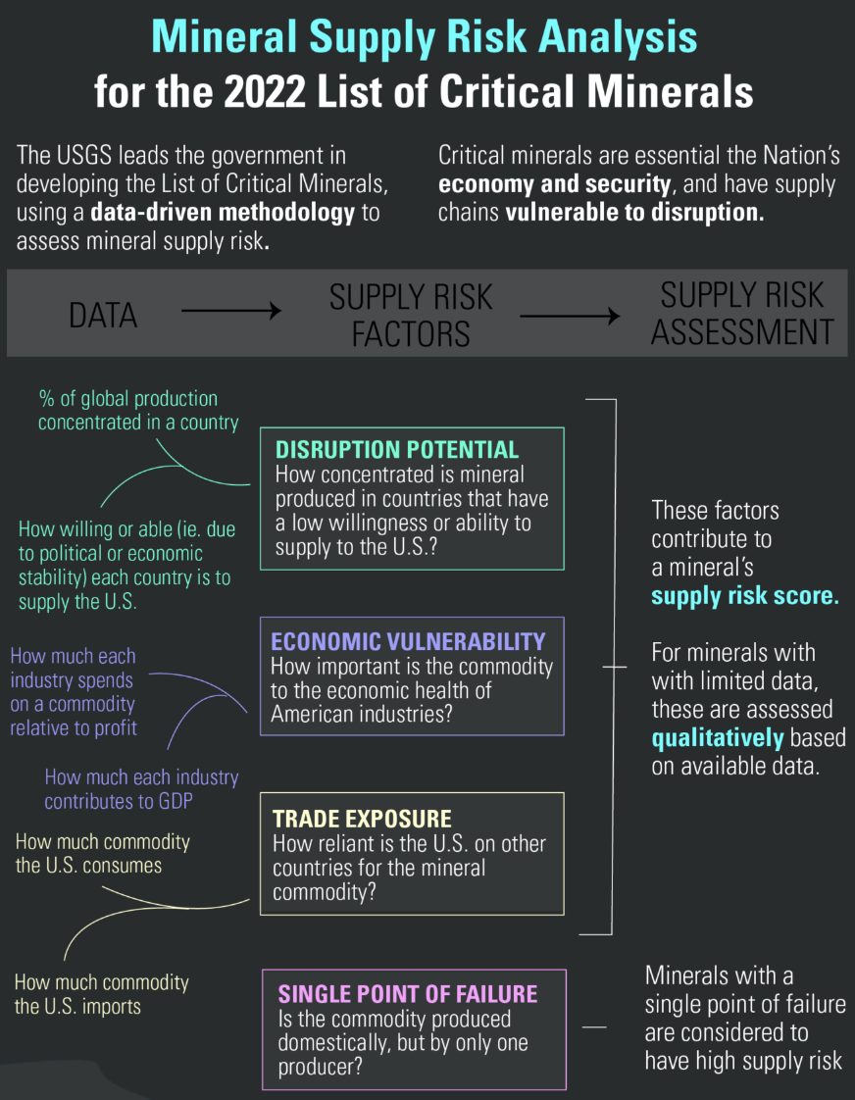
Supply Chain Limitations
Lesson 2
Where in the World? | Student Slides
Supply risks and vulnerability
Location of refineries
Viability of substitutes
Production capacity
Amount needed to import
Mineral Supply Risk Analysis for the 2022 List of Critical Minerals Infographic courtesy of the U.S. Geological Survey, https://www.usgs.gov/media/images/mineral-supply-risk-analysis-2022-list-critical-minerals-infographic

Slide 15
Factor 3 Demand for Technology
Lesson 2
Where in the World? | Student Slides
How Are Critical Minerals Chosen?
Factors that must be considered are:
Economics
Supply chain limitations
Demand for technology
Geopolitical considerations
Geological feasibility

Slide 16
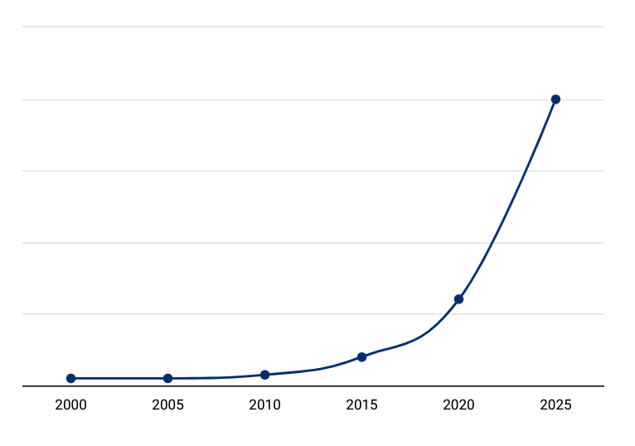
Demand for Technology
Lesson 2
Where in the World? | Student Slides
Accelerating Growth in Technology
Need for clean energy
Innovations in:
Personal devices
Artificial intelligence
Robotics
Smart products
And others
Population growth

Slide 17
Factor 4 Geopolitical Considerations
Lesson 2
Where in the World? | Student Slides
How Are Critical Minerals Chosen?
Factors that must be considered are:
Economics
Supply chain limitations
Demand for technology
Geopolitical considerations
Geological feasibility

Slide 18
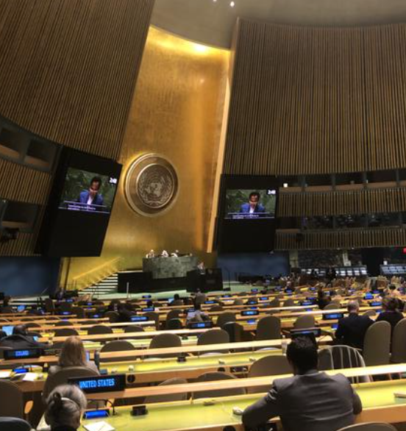
Geopolitical Considerations
Lesson 2
Where in the World? | Student Slides
National security needs
Risks of stockpiling
Political alignments
Changes to borders
Nationalization of resources
Trades deals and tariffs
Taxes
United Nations General Assembly courtesy of the U.S. Geological Survey, https://www.usgs.gov/media/images/united-nations-general-assembly

Slide 19
Factor 5 Geological Feasibility
Lesson 2
Where in the World? | Student Slides
How Are Critical Minerals Chosen?
Factors that must be considered are:
Economics
Supply chain limitations
Demand for technology
Geopolitical considerations
Geological feasibility

Slide 20
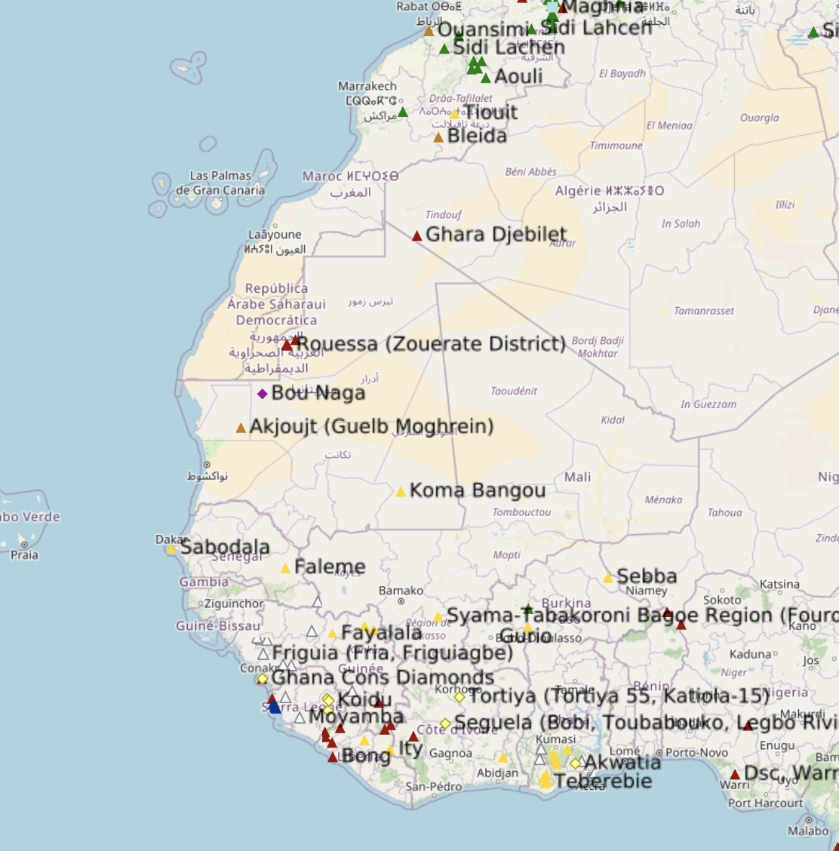
Geological Feasibility
Lesson 2
Where in the World? | Student Slides
Uneven distribution of minerals in Earth’s crust
Availability of U.S. reserves
Location of mines/quarries
Quality of mines/quarries
Depletion rates
Mineral Resources Online Spatial Data courtesy of the U.S. Geological Survey, https://mrdata.usgs.gov/general/map-global.html

Slide 21
Learning Objectives (3)
Lesson 2
Where in the World? | Student Slides
Define “critical minerals.”
Relate the strategies for identifying critical minerals.
Analyze the supply of a mineral resource in terms of geographic region.

Slide 22
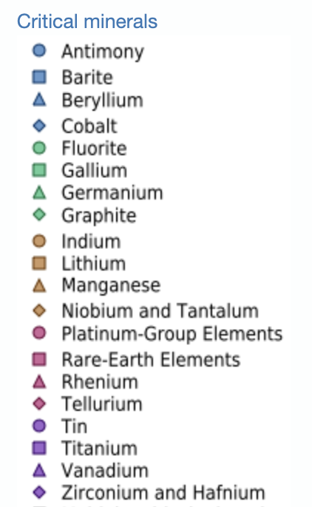
Choose a Critical Mineral
Lesson 2
Where in the World? | Student Slides
Your teacher may assign teams and a mineral to you.
Image Courtesy of the U.S. Geological Survey https://mrdata.usgs.gov/general/map-global.html

Slide 23
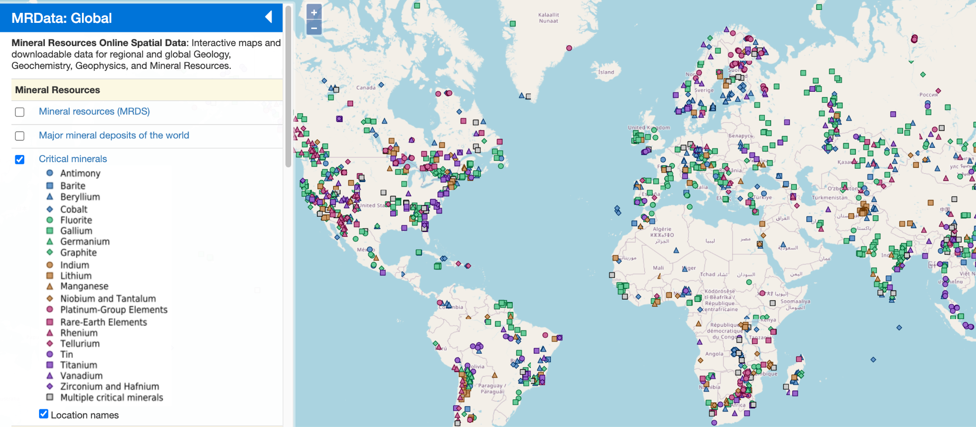
Visit the Map
Lesson 2
Where in the World? | Student Slides
Use your device to go to:
https://mrdata.usgs.gov/general/map-global.html
Click the box next to “Critical minerals” and then click the box next to “Location names.”
Courtesy of the U.S. Geological Survey https://mrdata.usgs.gov/general/map-global.html

Slide 24
Find the Regions
Lesson 2
Where in the World? | Student Slides
Use the zoom tool and legend to find the regions where your assigned critical mineral can be found.
Courtesy of the U.S. Geological Survey https://mrdata.usgs.gov/general/map-global.html

Slide 25
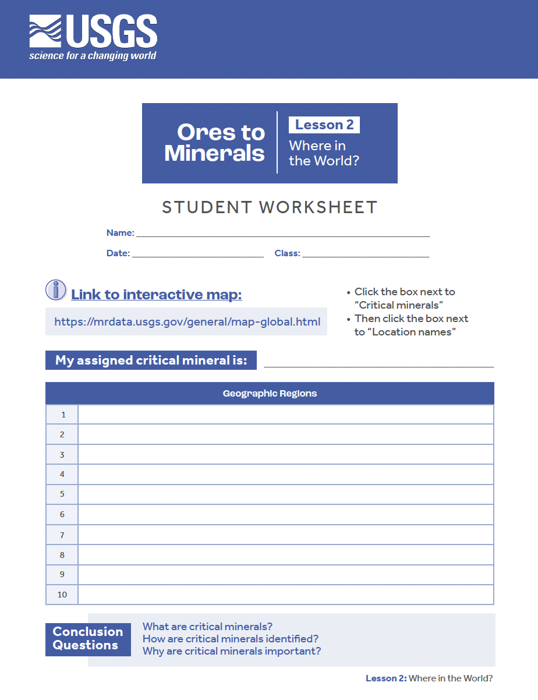
Instructions
Lesson 2
Where in the World? | Student Slides
Complete the Student Worksheet using your device and the interactive map for Mineral Resources Online Spatial Data.

Slide 26
Up Next
Lesson 2
Where in the World? | Student Slides
In the next lesson, you will investigate Ore and Mineral Vocabulary and co-construct some definitions and examples with your teacher.

