Slide 1


USGS Ores to Minerals
Ore and Mineral Vocabulary | Student Slides
Lesson 3

Slide 2

Learning Objective
Lesson 3
Ore and Mineral Vocabulary | Student Slides
Ore and Mineral Vocabulary | Student Slides
Identify and apply language to highlight vocabulary related to magnetism.

Slide 3
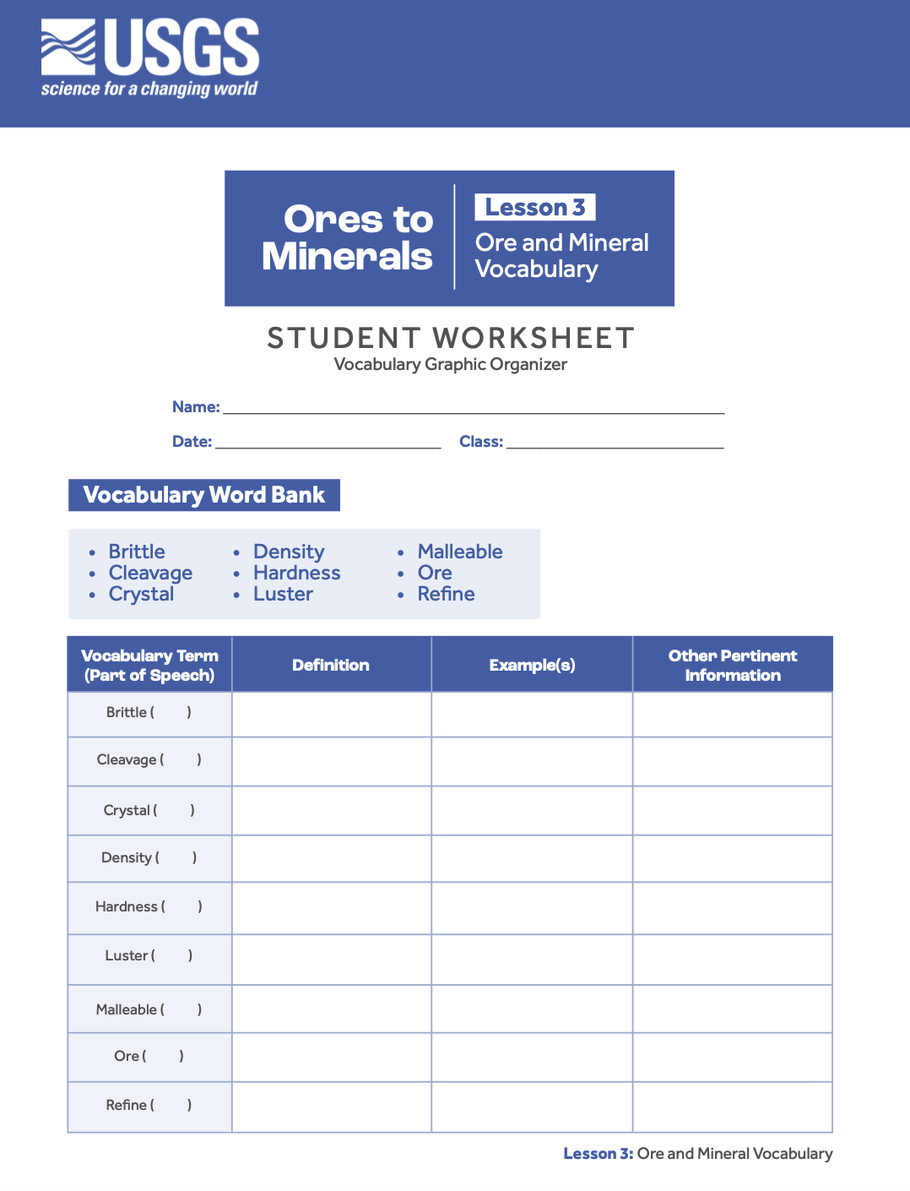
Instructions
Lesson 3
Ore and Mineral Vocabulary | Student Slides
Use your Student Worksheet - Vocabulary Graphic Organizer as you co-construct definitions and examples for terms in the given word bank.

Slide 4

Brittle
Lesson 3
Ore and Mineral Vocabulary | Student Slides
Things like glass and pottery are brittle. Minerals can be brittle too.
What happens if you hit them with a hammer?
Medjaï. (2009). Eclatement d'un bloc de grès [Photograph]. Wikimedia Commons. https://commons.wikimedia.org/wiki/File:Eclatement_d%27un_bloc_de_gr%C3%A8s.jpg

Slide 5
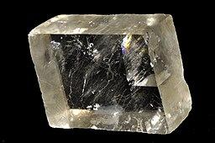
Cleavage
Lesson 3
Ore and Mineral Vocabulary | Student Slides
Some things will break into specific shapes. Calcite is a mineral that breaks into a rhomboid shape.
Will all minerals break in the same shape?
Parent Géry. (2009). Calcite 10(Chine) [Photograph]. Wikimedia Commons. https://commons.wikimedia.org/wiki/File:Calcite_10(Chine).jpg

Slide 6
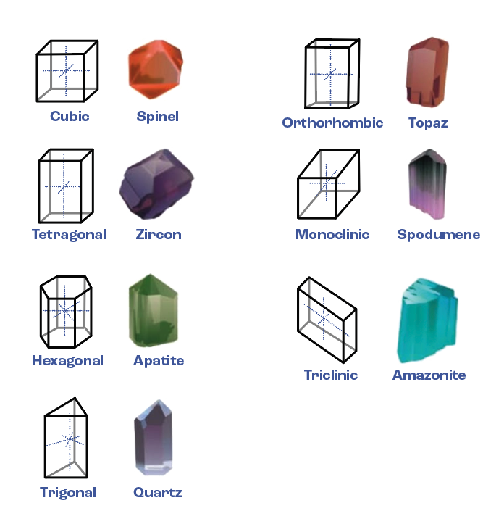
Crystal
Lesson 3
Ore and Mineral Vocabulary | Student Slides
Minerals exist as crystals and their atoms can bond together to make different shapes.
What do you notice about the minerals’ shapes, and what causes them to have specific shapes?

Slide 7
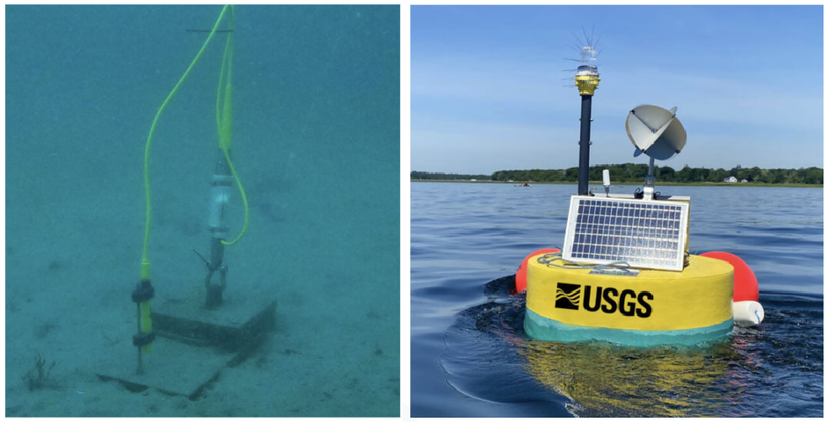
Density
Lesson 3
Ore and Mineral Vocabulary | Student Slides
Materials can have different densities.
How would the density of an anchor compare to the density of a buoy?
Anchor system for a smart mooring and spotter buoy courtesy of the U.S. Geological Survey, https://www.usgs.gov/media/images/anchor-system-smart-mooring-and-spotter-buoy
USGS Buoy courtesy of the U.S. Geological Survey, https://www.usgs.gov/media/images/usgs-buoy

Slide 8
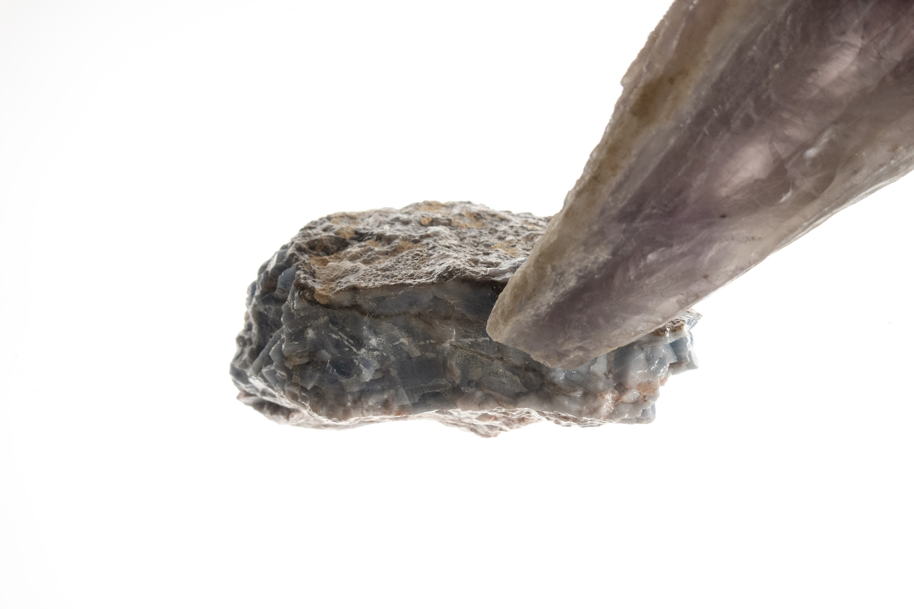
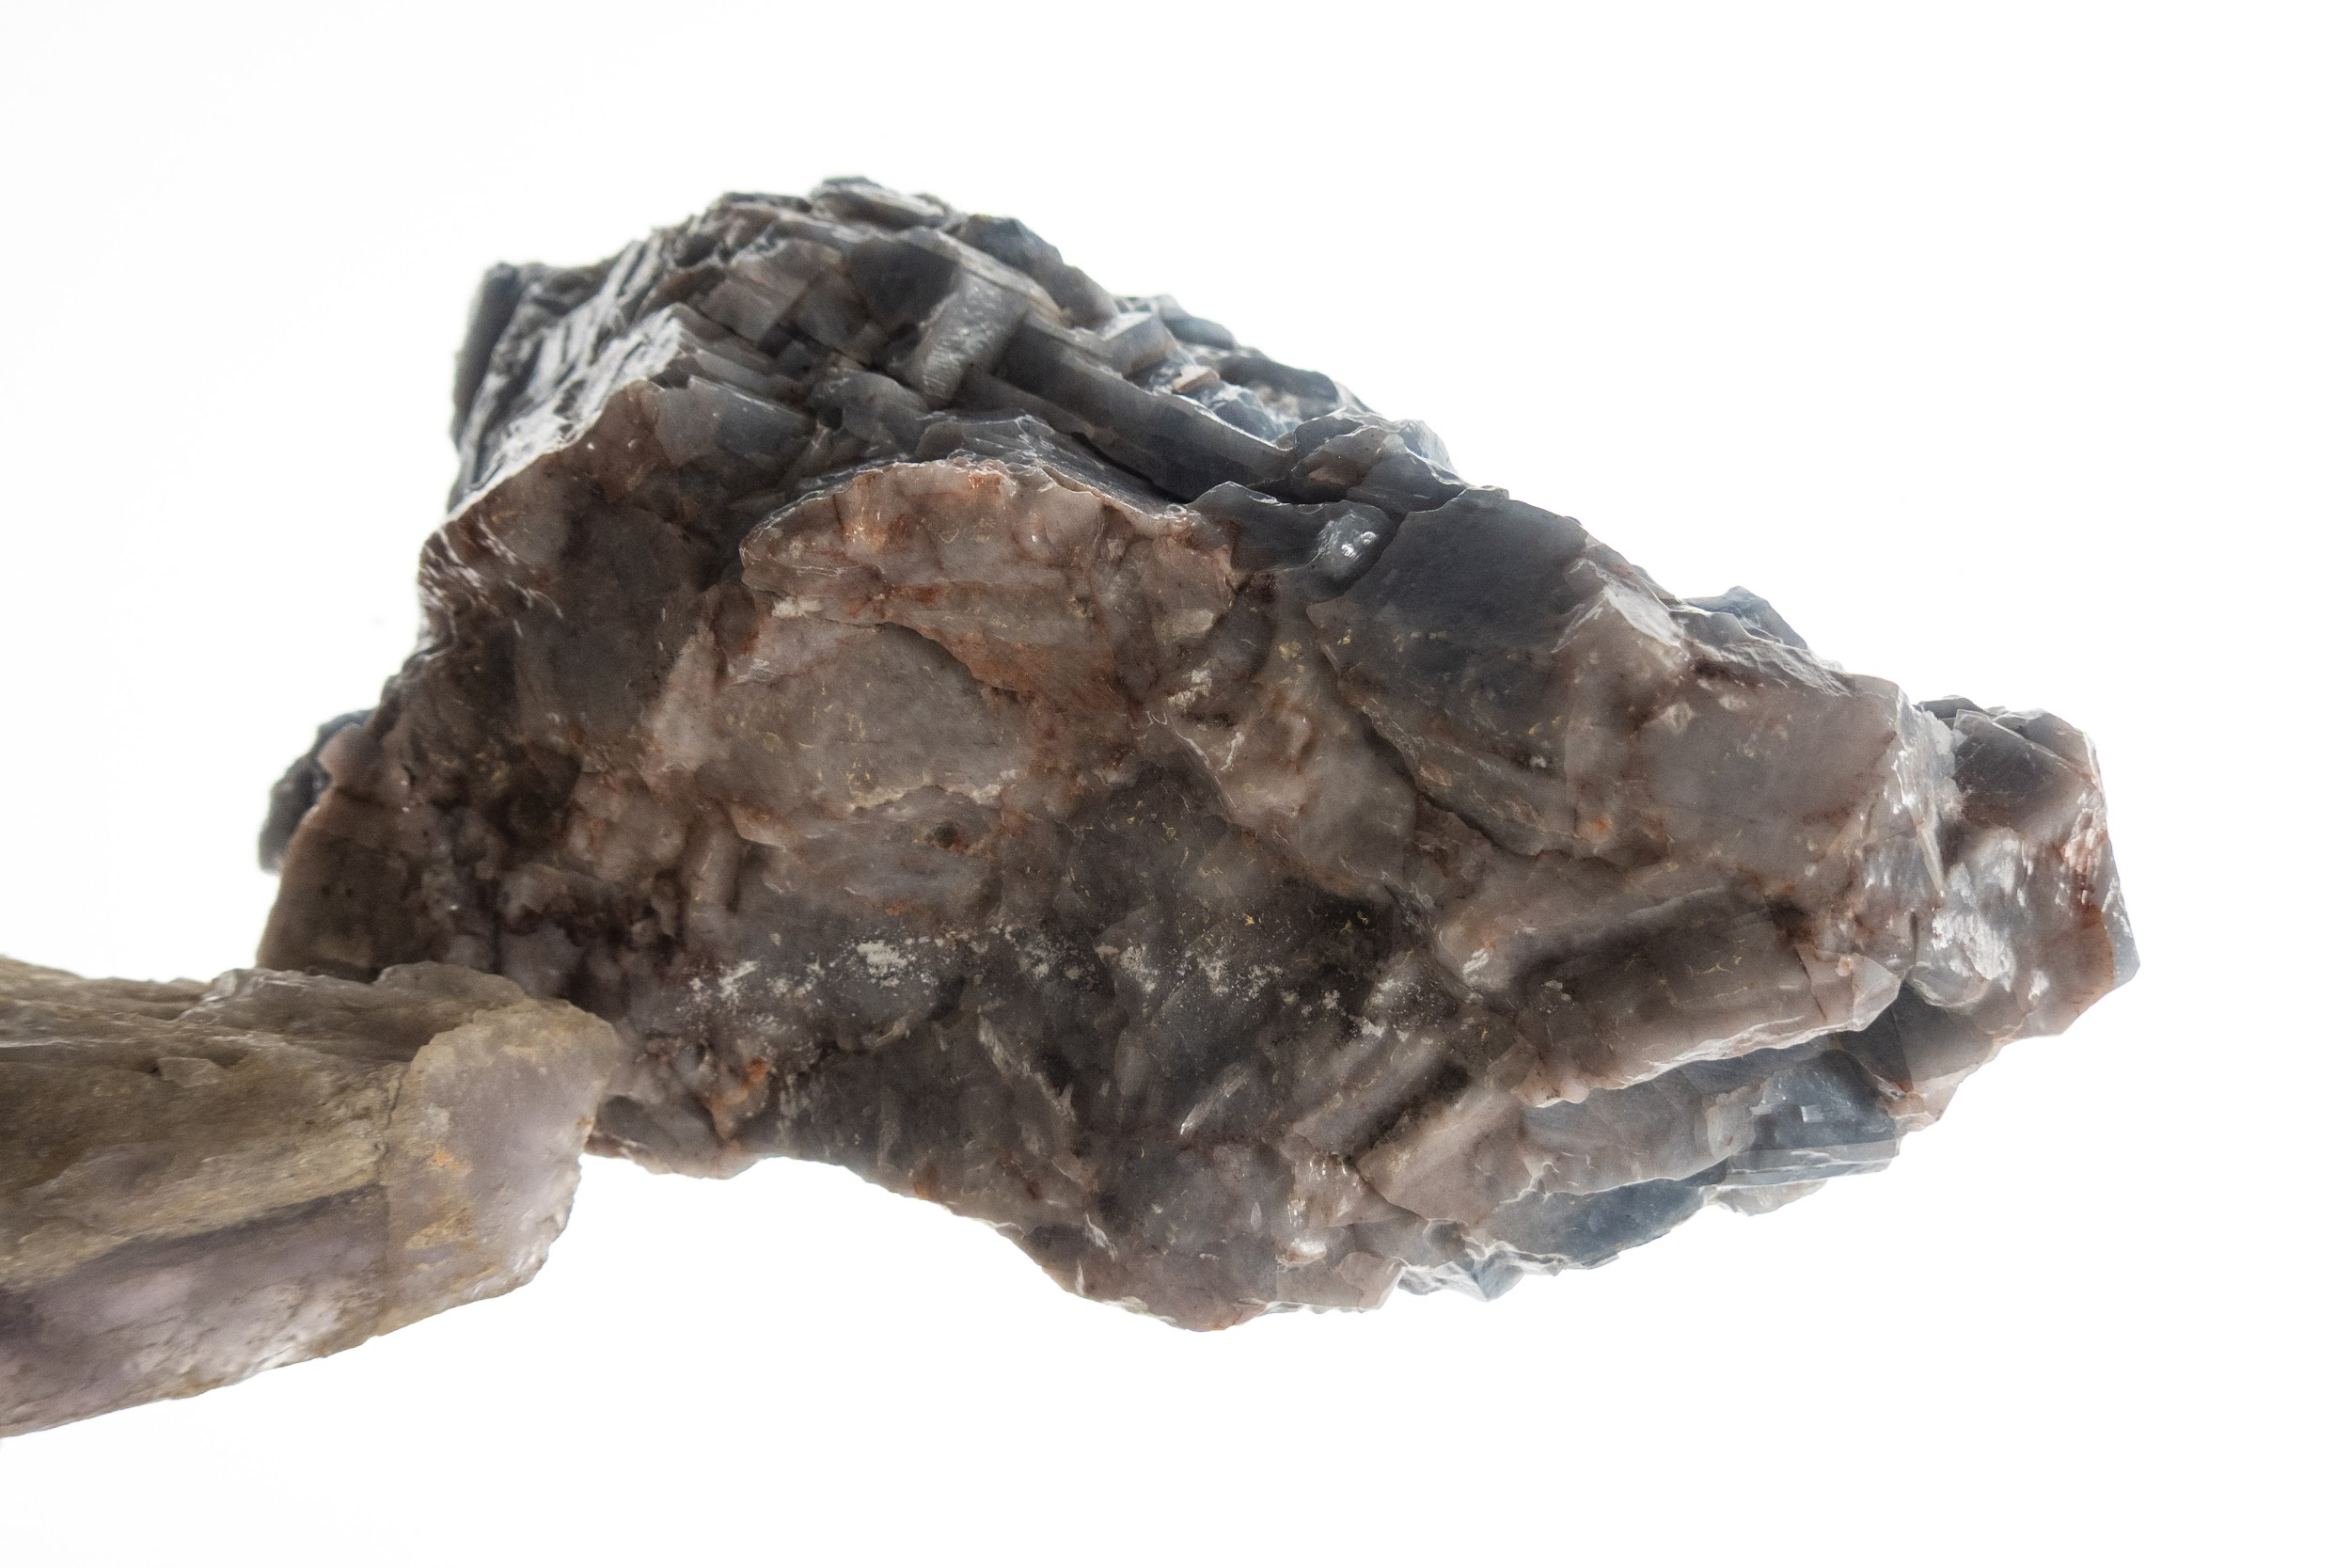
Hardness
Lesson 3
Ore and Mineral Vocabulary | Student Slides
Smokey quartz will scratch calcite but not the other way around.
Why do minerals sometimes get scratched and other times not?
(top)U.S. Geological Survey. (2025). Scratch test 1 [Photograph]
(bottom) U.S. Geological Survey. (2025). Scratch test 2 [Photograph]

Slide 9
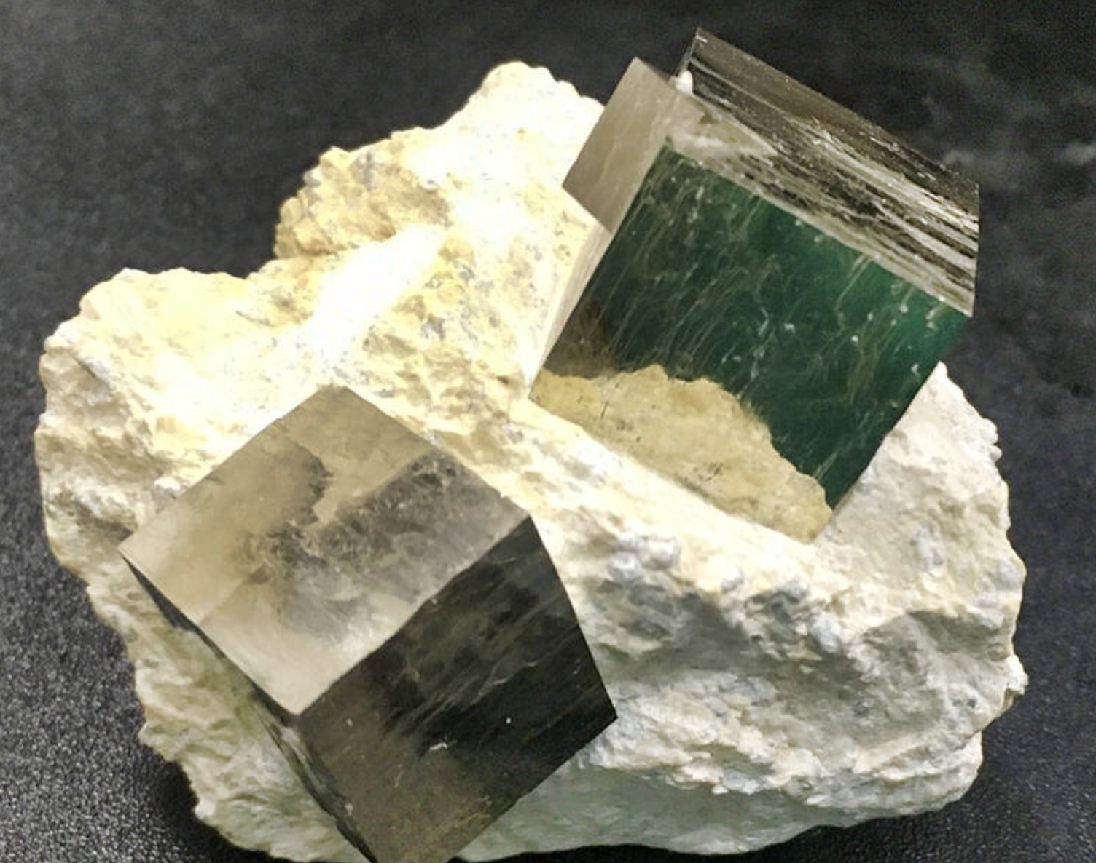
Luster
Lesson 3
Ore and Mineral Vocabulary | Student Slides
Minerals like sulfur are not shiny. Minerals like pyrite are shiny.
How does light behave differently on sulfur and pyrite?
Sulfide minerals courtesy of the U.S. Geological Survey, https://www.usgs.gov/media/images/sulfide-minerals

Slide 10
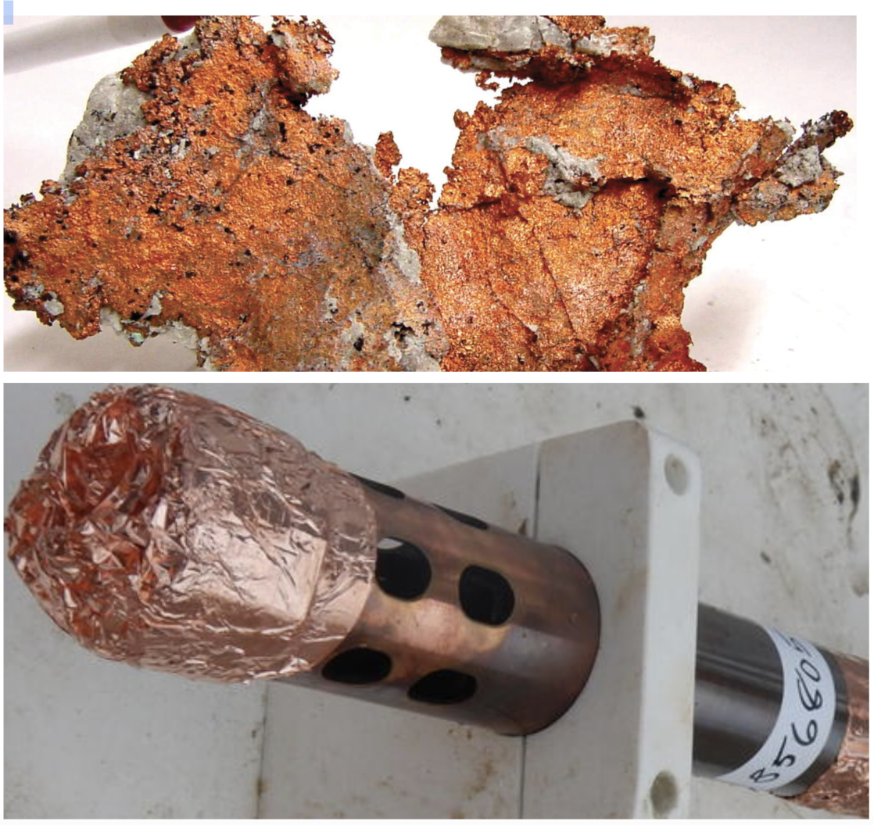
Malleable
Lesson 3
Ore and Mineral Vocabulary | Student Slides
Copper can be turned into foil and so can other substances, like aluminum and gold.
How does the copper become foil-shaped?
Platform with oceanographic sensors that collect oceanographic data courtesy of the U.S. Geological Survey, https://www.usgs.gov/media/images/platform-oceanographic-sensors-collect-oceanographic-data
Copper Image Courtesy of the U.S. Geological Survey, https://www.usgs.gov/media/images/copper

Slide 11
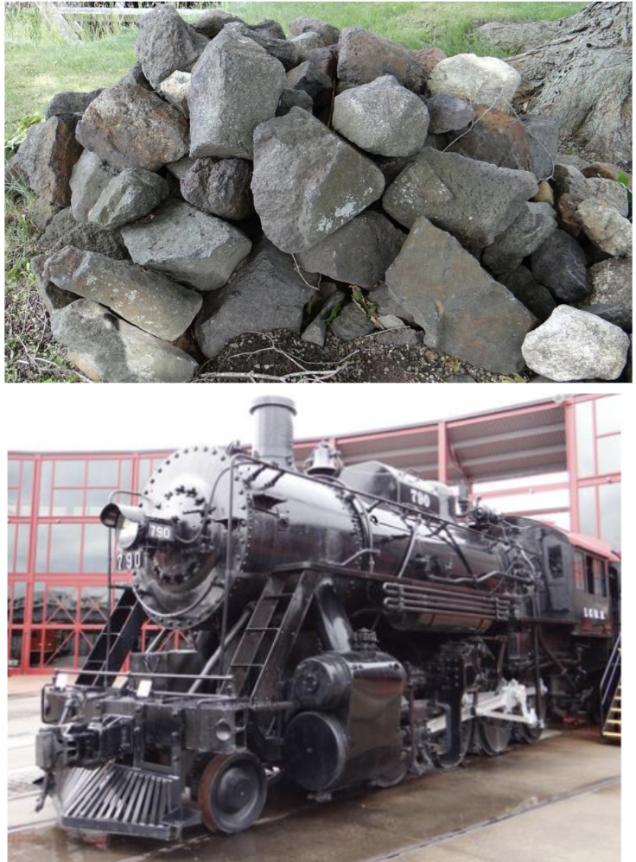
Ore
Lesson 3
Ore and Mineral Vocabulary | Student Slides
Limonite is processed in a factory to obtain iron for making important materials, like steel.
How is the limonite obtained, and what form is it in?
Limonite Pile at Saugus Iron Works Courtesy of the U.S. Geological Survey. https://www.usgs.gov/media/images/limonite-pile-saugus-iron-works
Steam Engine at Steamtown ourtesy of the U.S. Geological Survey. https://www.usgs.gov/media/images/steam-engine-steamtown

Slide 12
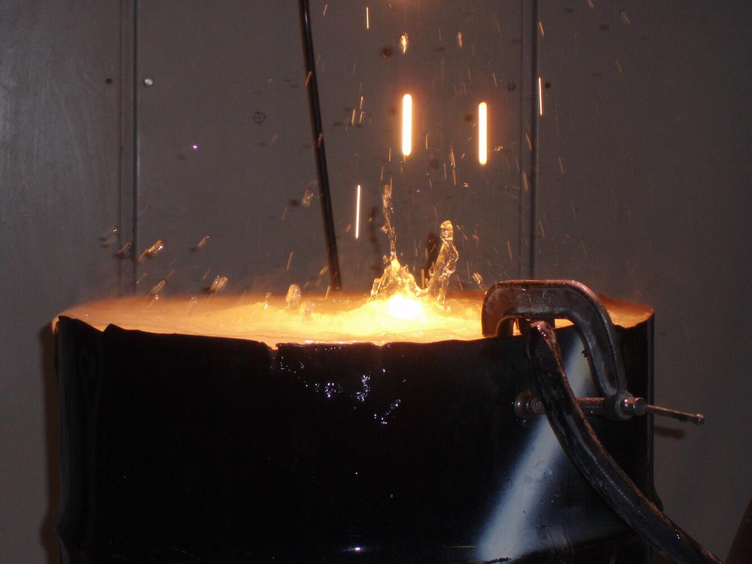
Refine
Lesson 3
Ore and Mineral Vocabulary | Student Slides
Raw ore is often crushed and heated in factories.
What is the purpose of crushing and heating the ore?
Molten Rock Streaming into Water Image Courtesy of the U.S. Geological Survey. https://www.usgs.gov/media/images/molten-rock-streaming-water-0

Slide 13
What To Do
Lesson 3
Ore and Mineral Vocabulary | Student Slides
Complete the Student Worksheet - Vocabulary Graphic Organizer with your teacher.

Slide 14
Up Next
Lesson 3
Ore and Mineral Vocabulary | Student Slides
In the next lesson, you will discover how the different properties of minerals are useful for people.

