Slide 1


USGS Ores to Minerals
Lesson 5
Cookie Mining | Student Slides

Slide 2

Guiding Questions
Lesson 5
Cookie Mining | Student Slides
How are minerals obtained?
What are some challenges with obtaining useful minerals?
What happens to a mining site or quarry after the minerals have been obtained?

Slide 3
How are minerals obtained?
Lesson 5
Cookie Mining | Student Slides
The desired mineral must be located and the land must be leased or purchased.
To obtain minerals, miners must extract rocks from a mine. This is called ore. Ore can be accessed from underground or from the surface. The cookie mining activity models surface mining.
Surface mining can be strip mining, open-pit mining, mountain-top removal, or dredging.

Slide 4
What are some challenges with obtaining useful minerals?
Lesson 5
Cookie Mining | Student Slides
Finding the minerals that you need to mine and obtaining a lease or purchasing the land.
Workers can be exposed to harmful chemicals, dust, and loud noises.
Water runoff can threaten local water sources.
The quality of minerals in the ore can be unpredictable.
Equipment must be maintained and updated.
Compliance with laws and permitting is required.
The ground can be unstable and could also require water removal.
Digging for ore requires physical stamina, technical skills, and safety awareness.

Slide 5
What happens to a mining site or quarry after the minerals have been obtained?
Lesson 5
Cookie Mining | Student Slides
After mining operations are over, the environmental harm is minimized and mined lands are returned to beneficial use.
Reclamation of land is expensive.
Mining companies generally must have a reclamation plan before beginning operations.

Slide 6
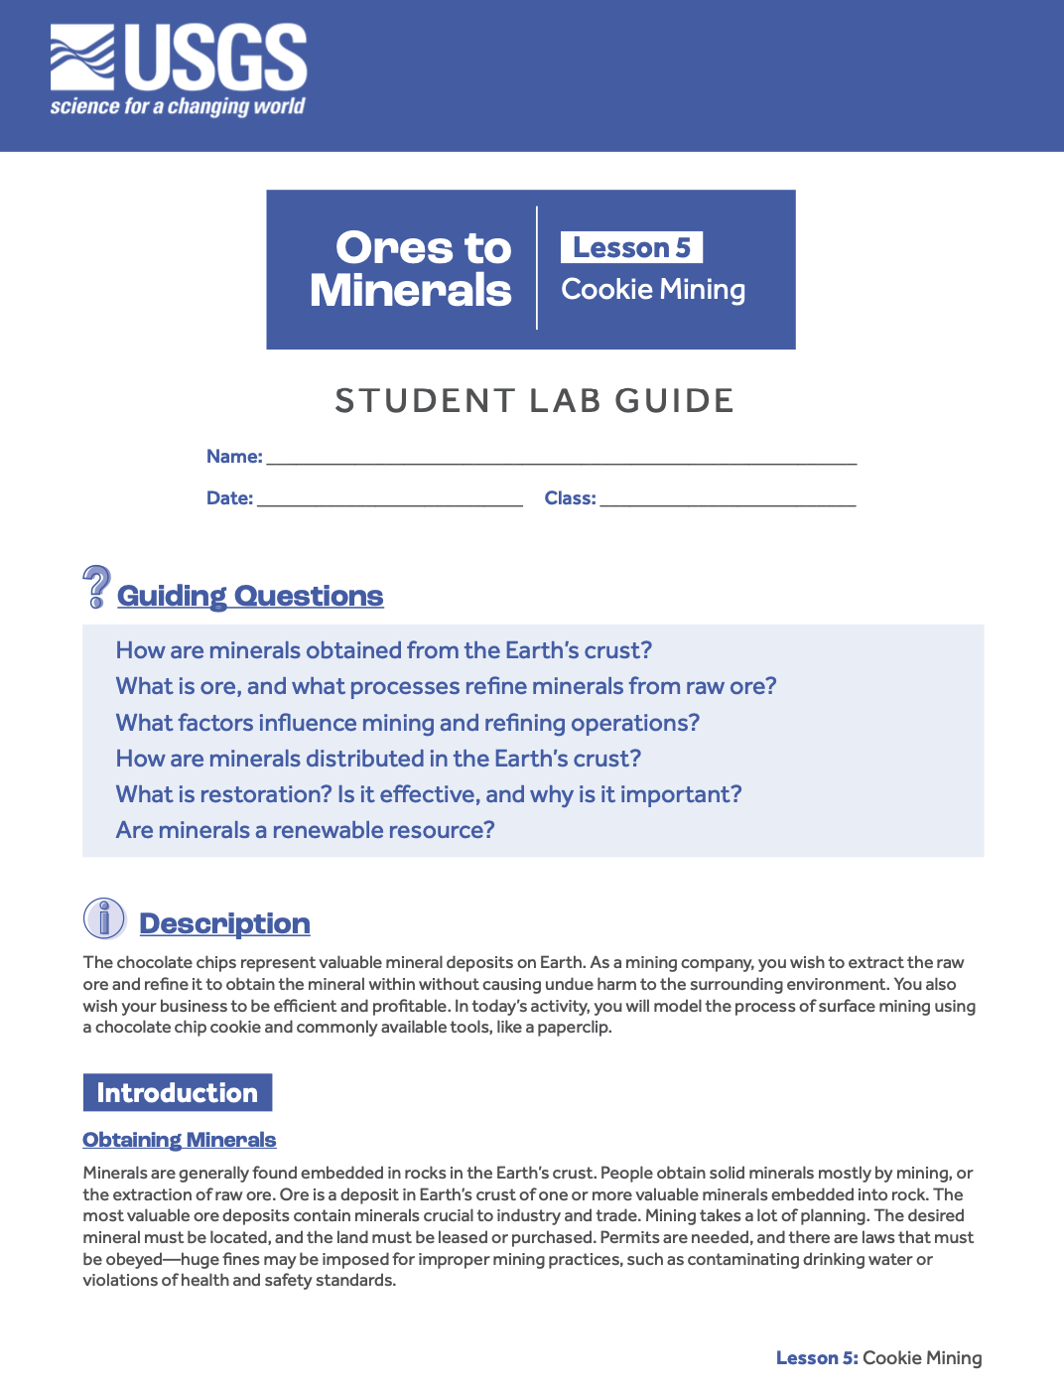
Instructions
Lesson 5
Cookie Mining | Student Slides
Use the materials to complete the Student Worksheet as you mine your cookie for chocolate chips.
Follow the instructions in the Lab Guide.

Slide 7

Materials
Lesson 5
Cookie Mining | Student Slides
Ruler with centimeters
Chocolate chip cookie
Extraction tools
Timer
Student Worksheet
Lab Guide
Renee Comet. (2013). Chocolate chip cookie [Photograph]. Wikimedia Commons.
https://upload.wikimedia.org/wikipedia/commons/a/ab/Chocolate_chip_cookie.jpg

Slide 8
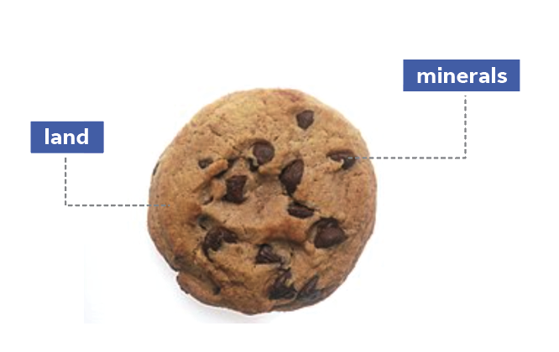
Model
Lesson 5
Cookie Mining | Student Slides
You represent a mining company that wishes to extract and refine minerals from the ore to sell.
Cookie = land
Chocolate chips = minerals

Slide 9
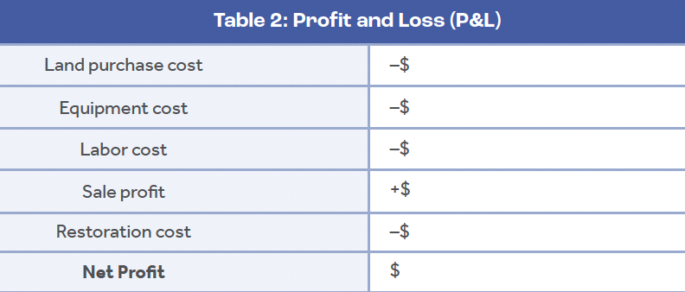
Requirements
Lesson 5
Cookie Mining | Student Slides
Purchase or lease the land.
Pay the workers.
Use tools you have purchased.
Measure the area of the land.
Keep track of labor costs, purchases, and overall profits.
Restore the land.

Slide 10
Review of Guiding Questions
Lesson 5
Cookie Mining | Student Slides
✔
How are minerals obtained?
What are some challenges with obtaining useful minerals?
What happens to a mining site or quarry after the minerals have been obtained?
✔
✔

Slide 11

Takeaway
Lesson 5
Cookie Mining | Student Slides
Mines have a life cycle beginning with their natural state and ending with reclamation. The process of mining comes with many responsibilities and requires careful management of resources.
Mine Life Cycle Image Courtesy of U.S. Geological Survey: https://www.usgs.gov/media/images/mineral-production-lifecycle-exploration-through-reclamation

Slide 12
Get Started
Lesson 5
Cookie Mining | Student Slides
Use the materials to mine your cookie. Be sure to follow the instructions in the Lab Guide and fill out the Student Worksheet.
You also have an Exit Ticket as a formative assessment for this lesson.

Slide 13
Up Next
Lesson 5
Cookie Mining | Student Slides
In the next lesson, you will learn how minerals came to be in Earth’s crust and how those minerals are used in everyday objects, like cell phones.

