Slide 1


USGS Ores to Minerals
Ores and Minerals Instruction | Student Slides
Lesson 6

Slide 2

Guiding Questions
Lesson 6
Ores and Minerals Instruction | Student Slides
Why are minerals unevenly distributed in Earth’s crust?
What are the properties of minerals that make them important?
Why is it important to assess what minerals are available and what minerals are critical?

Slide 3
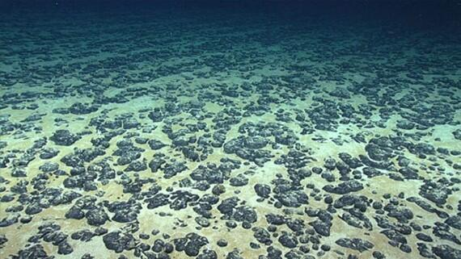
Mineral Distribution (1)
Lesson 6
Ores and Minerals Instruction | Student Slides
Minerals accumulate in systems in Earth’s crust.
Some minerals are terrestrial and some are marine. Terrestrial minerals are land-based, while marine minerals are extracted from the seabed.
Manganese nodules covering the seafloor courtesy of the U.S. Geological Survey, https://www.usgs.gov/media/images/ manganese-nodules-covering-seafloor

Slide 4
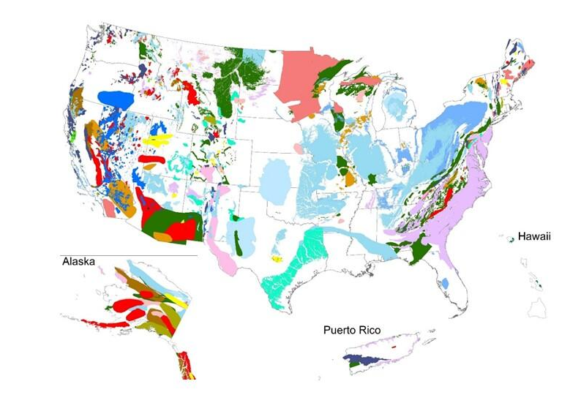
Mineral Distribution (2)
Lesson 6
Ores and Minerals Instruction | Student Slides
Minerals are unevenly distributed. Mapping mineral systems can help locate areas where certain types of minerals can be found.
Mapping Mineral Systems courtesy of USGS https://www.usgs.gov/media/images/mineral-systems-map-united-states

Slide 5
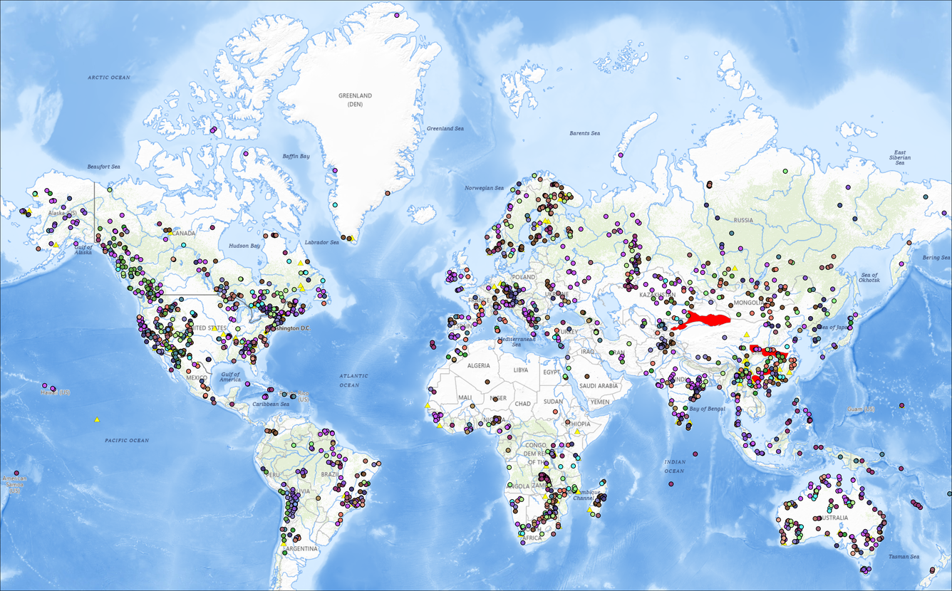
Mineral Distribution (3)
Lesson 6
Ores and Minerals Instruction | Student Slides
Minerals are unevenly distributed because their formation is directly tied to specific geological processes, like:
Tectonic plate motion
Volcanic eruptions
Sedimentation
Global Distribution of Selected Mines, Deposits, and Districts of Critical Minerals courtesy of USGS
https://www.sciencebase.gov/catalog/item/594d3c8ee4b062508e39b332

Slide 6
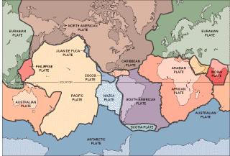
Plate Tectonics
Lesson 6
Ores and Minerals Instruction | Student Slides
Earth’s crust is divided into tectonic plates that are able to move around. Plates can also go under one another, pushing minerals down. Magma can well up through cracks in plates or between plates, pulling minerals up.
So, tectonic plates move minerals all around and through Earth’s crust.
Plate Tectonics Map courtesy of the U.S. Geological Survey, https://www.usgs.gov/media/images/platetectonicsgif

Slide 7
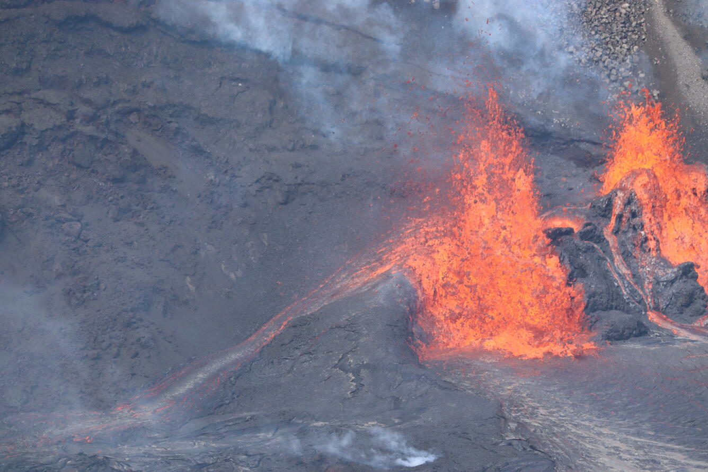
Volcanic Eruptions
Lesson 6
Ores and Minerals Instruction | Student Slides
Magma, the molten rock that erupts into lava, contains dissolved minerals. At or near the surface, it cools and solidifies, creating new mineral-rich rock formations.
December 29, 2024 — Spatter-fed lava flow in Halemaʻumaʻu courtesy of the U.S. Geological Survey, https://www.usgs.gov/media/images/ december-29-2024-spatter-fed-lava-flow-halemaumau

Slide 8

Sedimentation
Lesson 6
Ores and Minerals Instruction | Student Slides
Sedimentation moves minerals by the process of erosion, where weathered rock fragments, called sediments, are transported, often by water, and then deposited in a new location. This moves the minerals along with the sediment.
Lake Accotink Sediment Flow courtesy of the U.S. Geological Survey, https://www.usgs.gov/media/images/lake-accotink-sediment-flow

Slide 9
Guiding Questions (2)
Lesson 6
Ores and Minerals Instruction | Student Slides
Why are minerals unevenly distributed in Earth’s crust?
What are the properties of minerals that make them important?
Why is it important to assess what minerals are available and what minerals are critical?

Slide 10
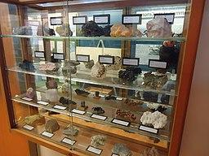
Mineral Properties
Lesson 6
Ores and Minerals Instruction | Student Slides
Mineral properties include:
Color
Luster
Streak
Cleavage or Fracture
Hardness
Density
Magnetism
Refraction
Radioactivity
Tomwsulcer. (2014). Rutgers University Geology museum minerals on display in cabinet [Photograph]. Wikimedia Commons. https://commons.wikimedia.org/wiki/File:Rutgers_University_Geology_museum_minerals_on_display_in_cabinet.JPG

Slide 11
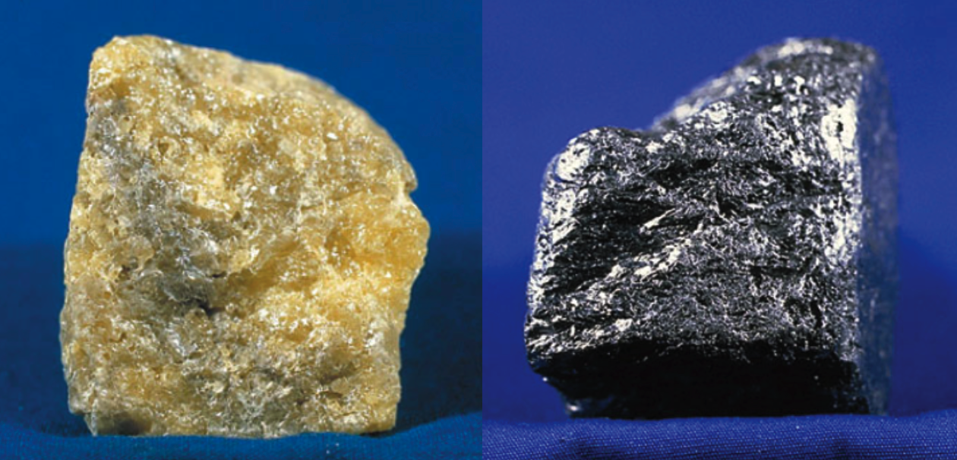
Color
Lesson 6
Ores and Minerals Instruction | Student Slides
MIneral color allows us to differentiate between minerals using only visual perception. For example, sulfur is bright yellow while graphite is black. Mineral colors make them attractive to people. Often, a bright color is caused by the inclusion of metal atoms to a crystal structure, which is really an impurity.
U.S. Geological Survey. (2005). SulfurUSGOV [Photograph]. Wikimedia Commons. https://commons.wikimedia.org/wiki/File:SulfurUSGOV.jpg
U.S. Geological Survey. (2005). GraphiteUSGOV [Photograph]. Wikimedia Commons. https://commons.wikimedia.org/wiki/File:GraphiteUSGOV.jpg

Slide 12
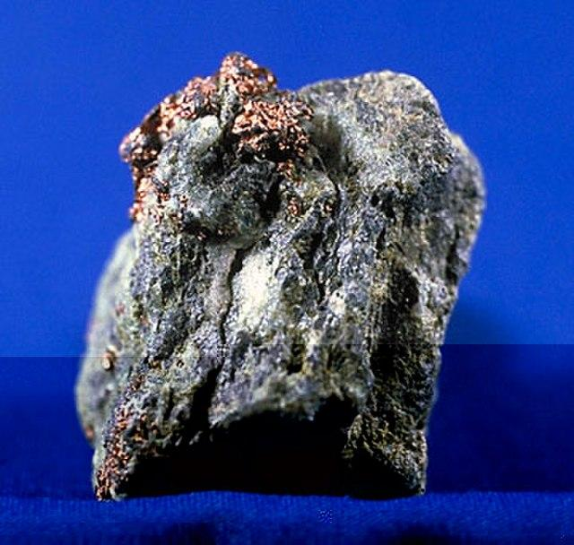
Luster
Lesson 6
Ores and Minerals Instruction | Student Slides
Many minerals, like native copper, are prized for their shininess, or luster. The way they reflect light is aesthetically pleasing, which makes them valuable as gemstones.
Lustrous minerals also include native gold and silver, pyrite, and galena.
Many lustrous metals—like gold, silver, nickel, and copper—are used for coinage and for jewelry.
U.S. Geological Survey. (2005). CopperMineralUSGOV [Photograph]. Wikimedia Commons. https://commons.wikimedia.org/wiki/ File:CopperMineralUSGOV.jpg

Slide 13
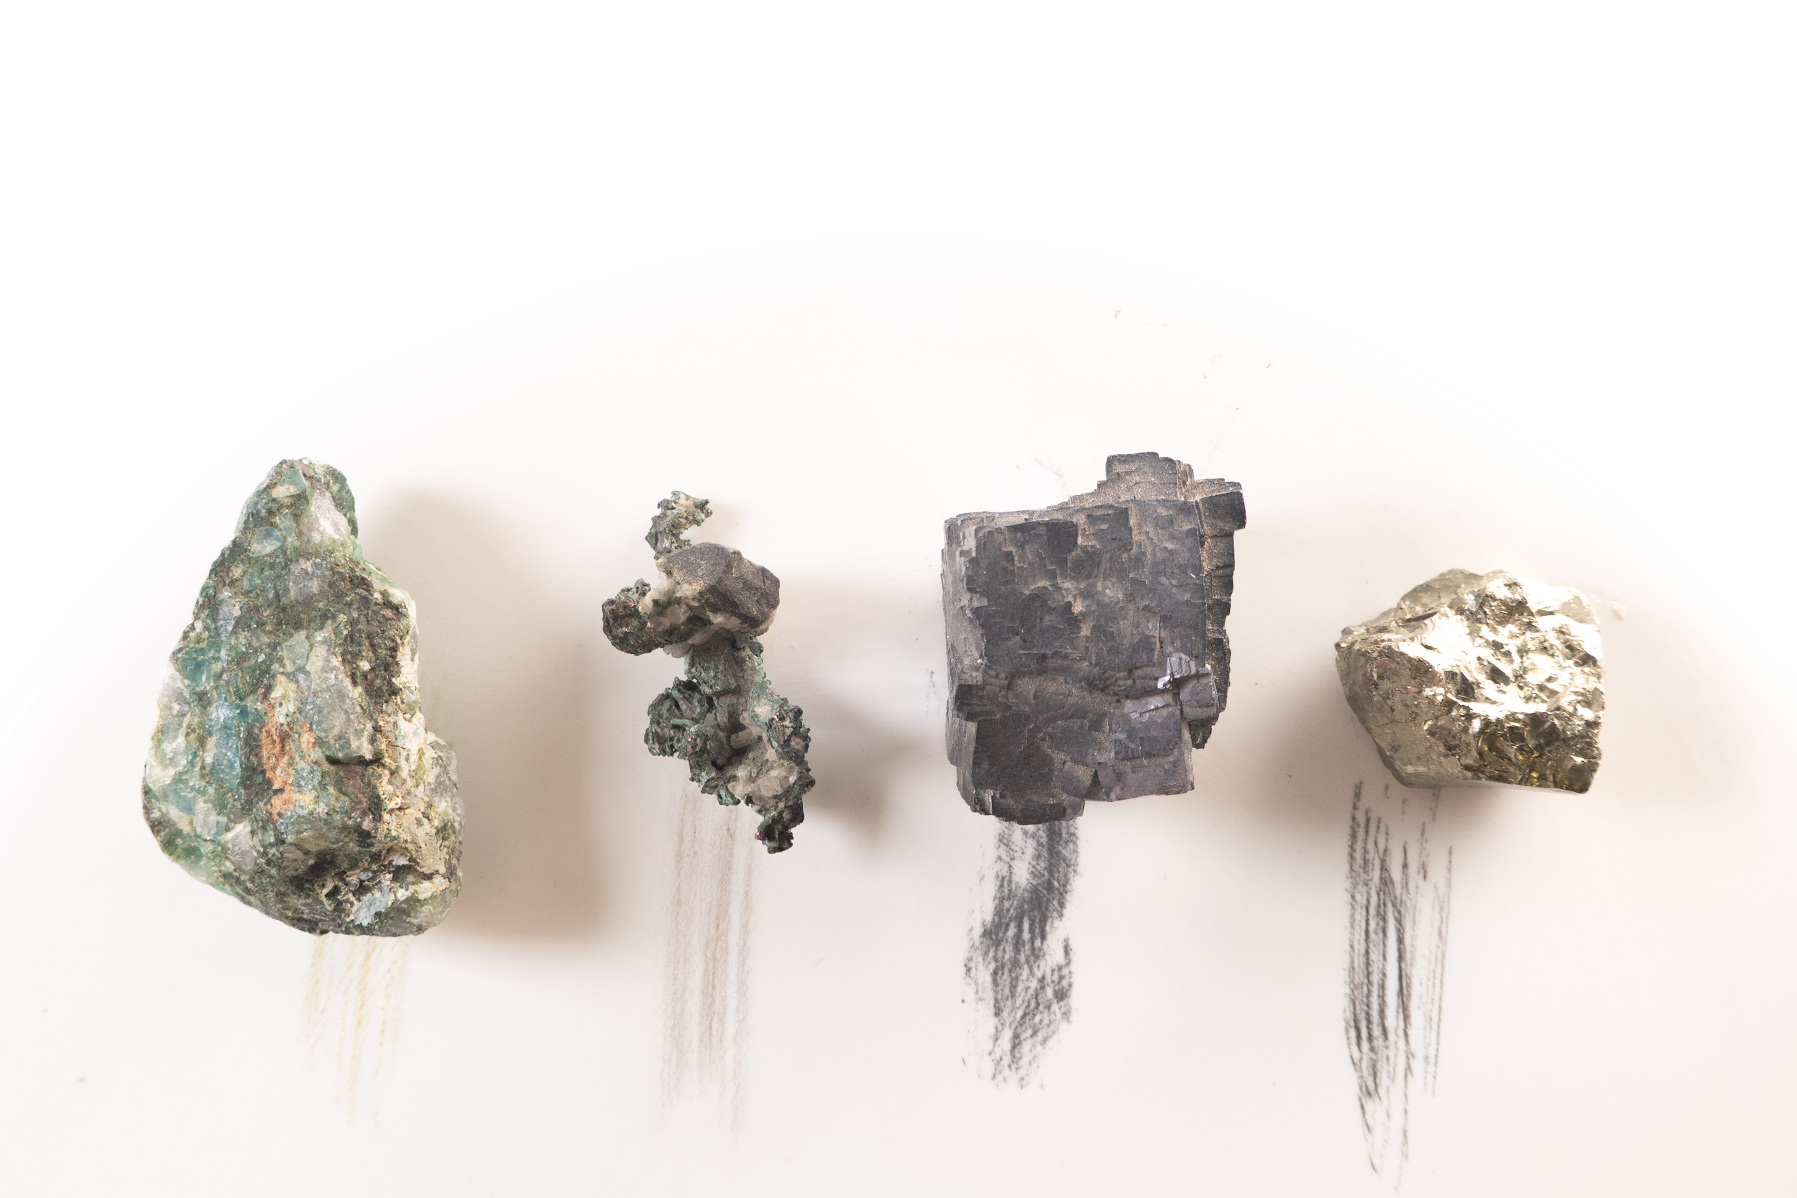
Lesson 6
Ores and Minerals Instruction | Student Slides
Streak
Streak is a more reliable property of minerals than color for identification. It shows the true color of the mineral, because small impurities are generally not visible as color when you perform a streak test. To test a mineral’s streak, rub the mineral on a ceramic tile and observe the color.
U.S. Geological Survey. (2025). Streak Test [Photograph].

Slide 14

Cleavage or Fracture
Lesson 6
Ores and Minerals Instruction | Student Slides
Minerals can be brittle, which means they can break. Cleavage is when a mineral breaks along smooth planes. Fracture is when a mineral breaks in an uneven pattern.
For example, mica is widely used in electronics as an insulator in electronics because its perfect cleavage allows it to be broken into thin sheets (shown right).
Retired electrician. (2023). MT-100 transistor (Sanken 2SC3519) and matching mica sheet 01 [Photograph]. Wikimedia Commons. https://commons.wikimedia.org/wiki/File:MT-100_transistor_(Sanken_2SC3519)_and_matching_mica_sheet_01.jpg

Slide 15
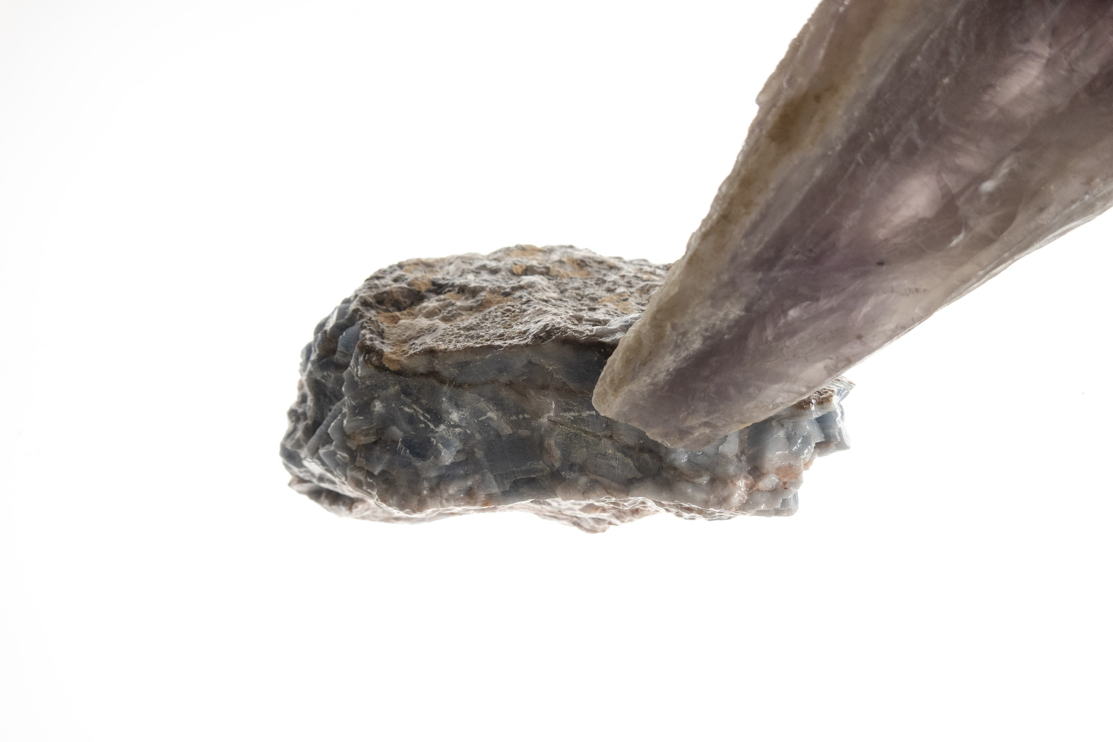
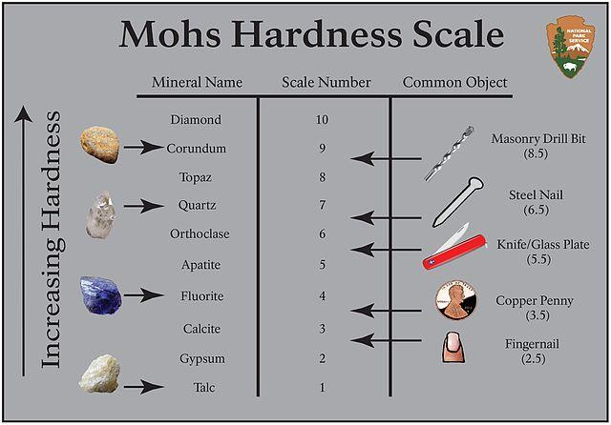
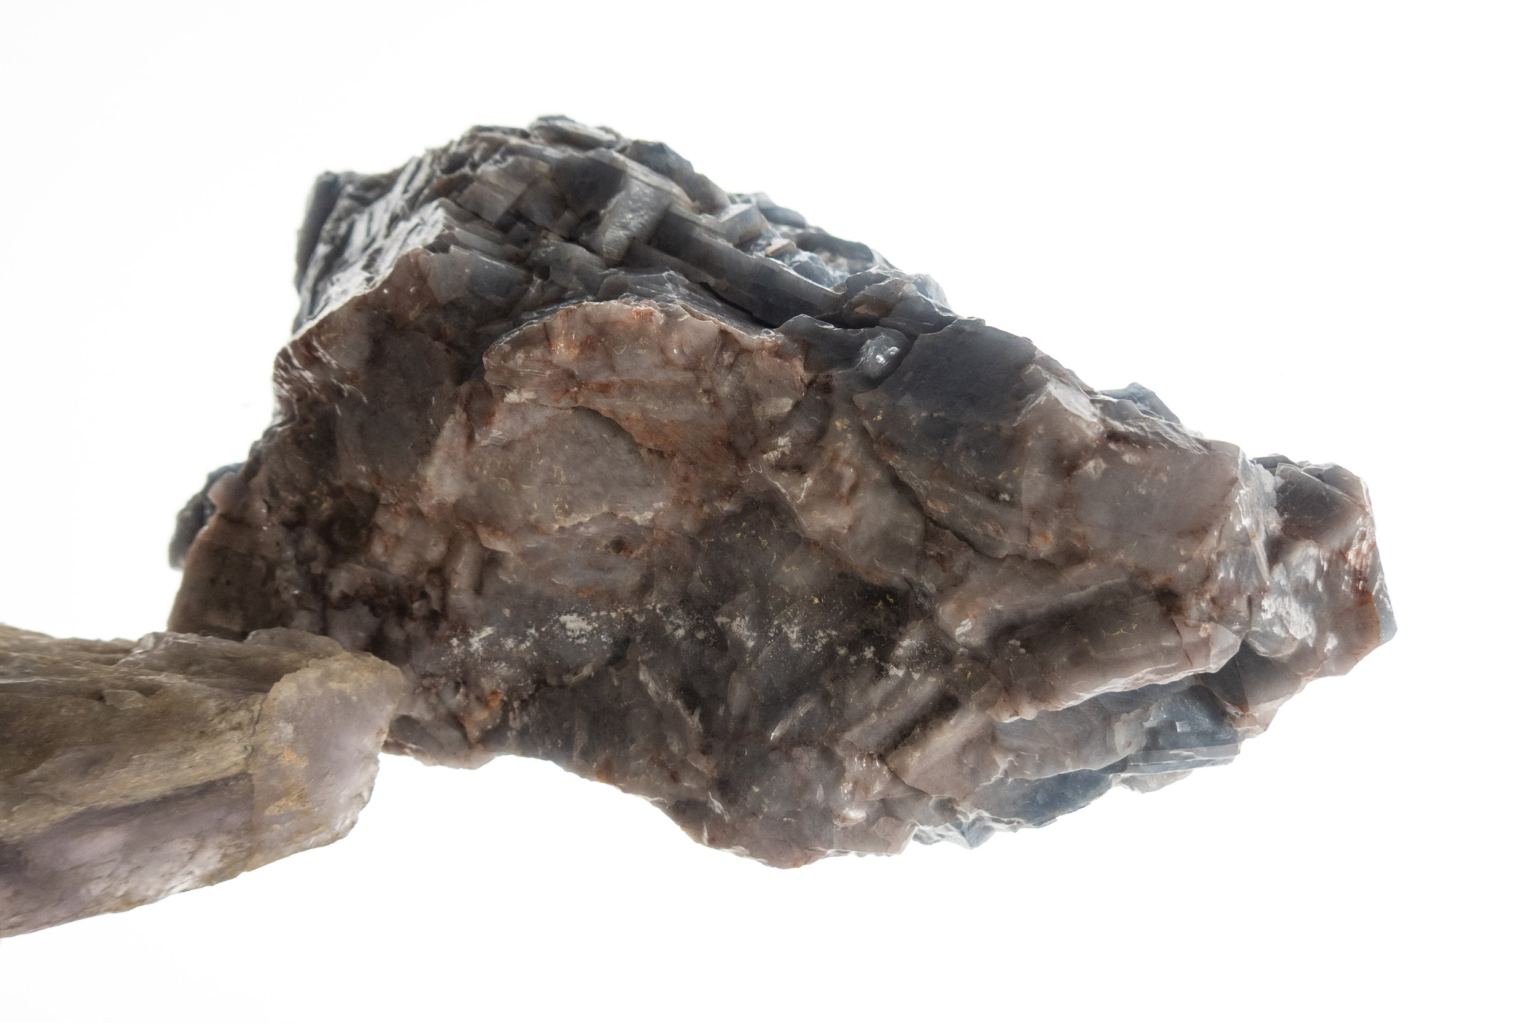
Hardness
Lesson 6
Ores and Minerals Instruction | Student Slides
A harder mineral will scratch a softer mineral. The Mohs Hardness Scale shows the hardest mineral as 10 and the softest as 1.
National Park Service. (2016). Mohs [Diagram]. Wikimedia Commons. https://commons.wikimedia.org/wiki/File:Mohs.jpg
(right top)U.S. Geological Survey. (2025). Scratch test 1 [Photograph]
(right bottom) U.S. Geological Survey. (2025). Scratch test 2 [Photograph]

Slide 16
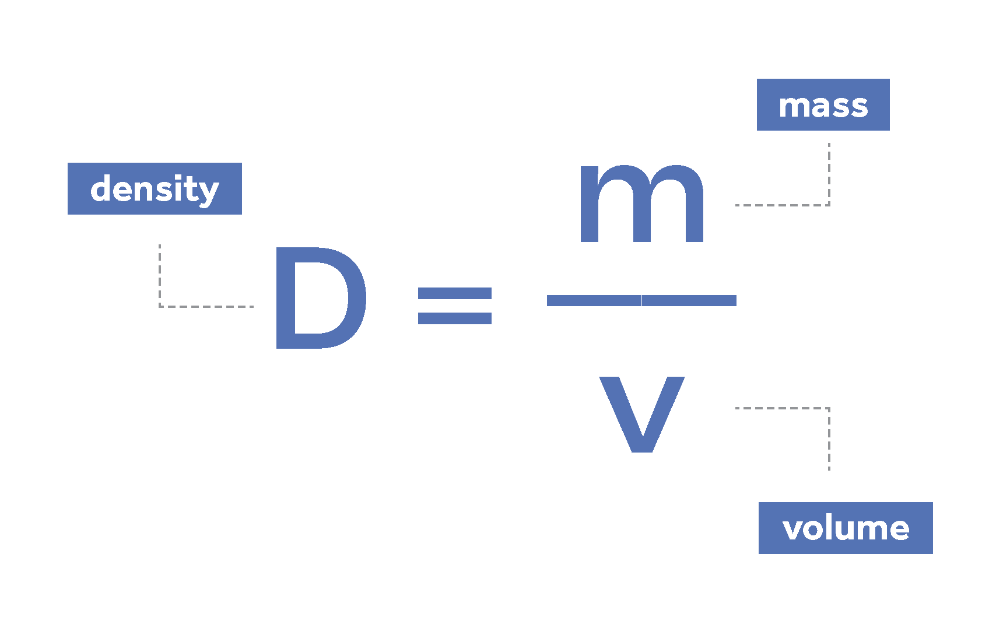
Density
Lesson 6
Ores and Minerals Instruction | Student Slides
The density of a mineral is the ratio of its mass to its volume.
Density can help identify a mineral, because they all have different density values.
When atoms are packed closer together in a dense material, it will be resistant to compression and external forces, insulate from sound, and block radiation. Low-density minerals are good for making lightweight planes, bikes, and cars.

Slide 17
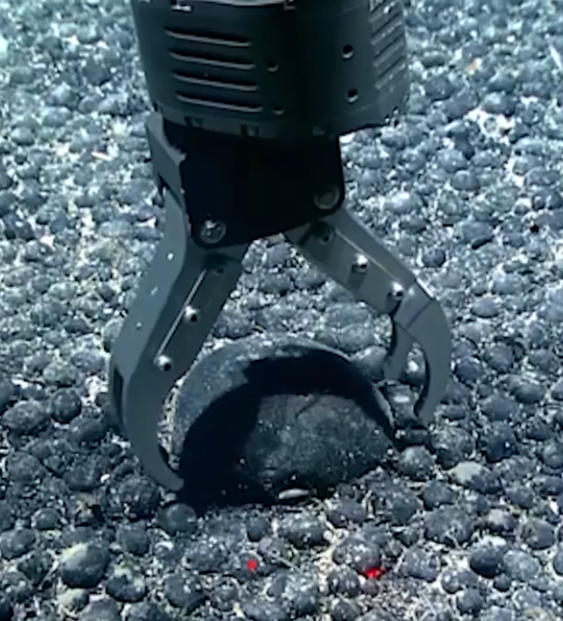
Magnetism
Lesson 6
Ores and Minerals Instruction | Student Slides
Magnetic minerals are useful for removing iron ore from other minerals, separating impurities from clay to make ceramics, and separating recyclable metals from other waste materials.
The seafloor is a possible source of useful magnetic and ferromagnetic minerals.
Screenshot from Marine Minerals b-roll - Manganese Nodules courtesy of the U.S. Geological Survey, https://www.usgs.gov/media/videos/ marine-minerals-b-roll-manganese-nodules

Slide 18
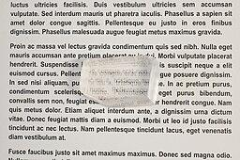
Refraction
Lesson 6
Ores and Minerals Instruction | Student Slides
Transparent minerals will bend the light that passes through them. The amount of bend depends on the refractive index of the mineral. As shown on right, a calcite crystal will bend the light reaching your eyes, causing the letters to look like they have shifted. Refraction is a necessary property for crystals used in lasers.
Danpl. (2018). Calcite-refraction-property [Photograph]. Wikimedia Commons. https://commons.wikimedia.org/wiki/ File:Calcite-refraction-property.jpg

Slide 19
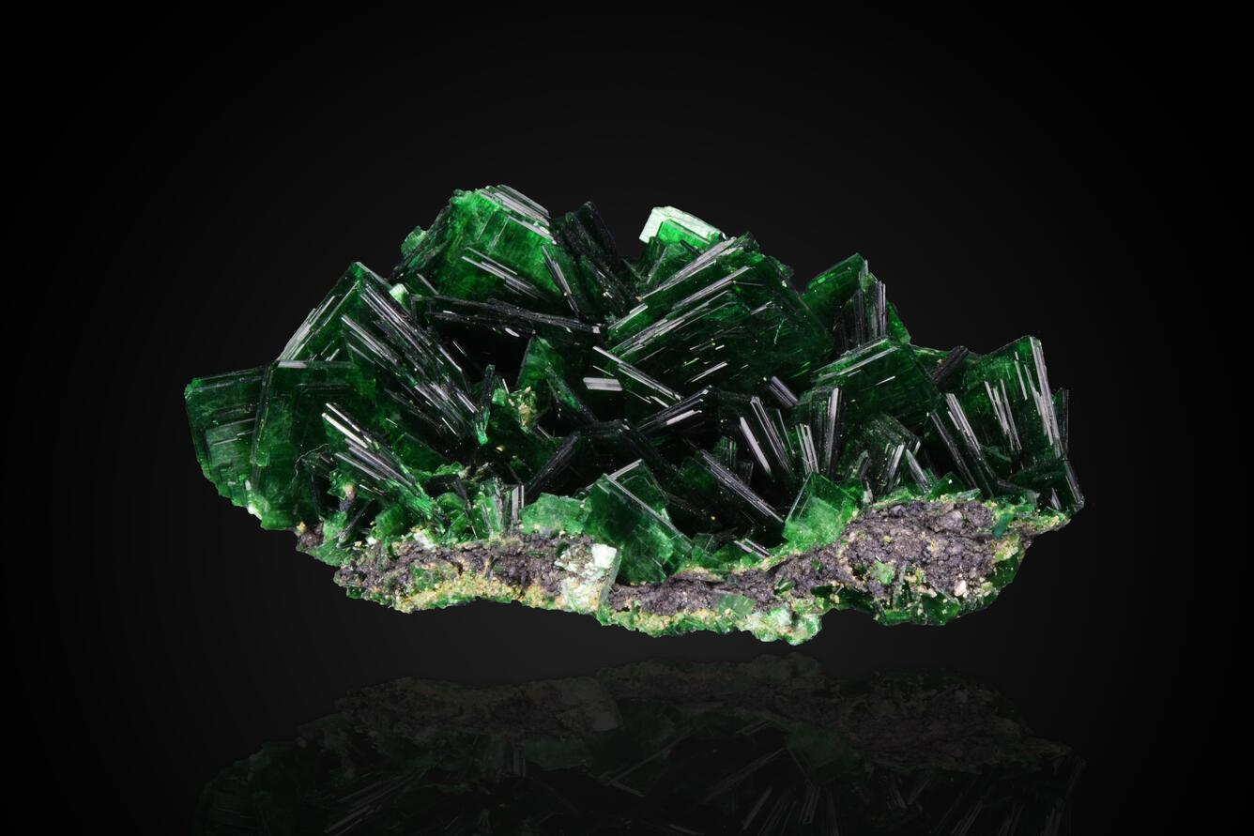
Radioactivity
Lesson 6
Ores and Minerals Instruction | Student Slides
Radium, uranium, and thorium—three radioactive elements—are found in minerals such as uraninite, monazite, pitchblende, and torbernite (shown right). Radioactive minerals are useful for medical imaging, cancer treatment, and smoke detectors because they emit radiation, or particles and/or energy with a very high frequency.
Torbernite courtesy of the U.S. Geological Survey, https://www.usgs.gov/ media/images/torbernite

Slide 20
Guiding Questions (3)
Lesson 6
Ores and Minerals Instruction | Student Slides
Why are minerals unevenly distributed in Earth’s crust?
What are the properties of minerals that make them important?
Why is it important to assess what minerals are available and what minerals are critical?

Slide 21
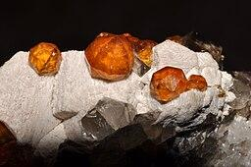
Availability
Lesson 6
Ores and Minerals Instruction | Student Slides
Some minerals are comprised of elements that are not commonly found together which makes them rare. Some minerals are hard to find because they require very specific conditions to form. Garnets, for example, only form from extreme pressure and temperature deep in Earth’s crust.
Géry PARENT. (2010). Garnet, quartz, feldspar 1 [Photograph]. Wikimedia Commons. https://commons.wikimedia.org/wiki/ File:Garnet,_quartz,_feldspar_1.jpg

Slide 22
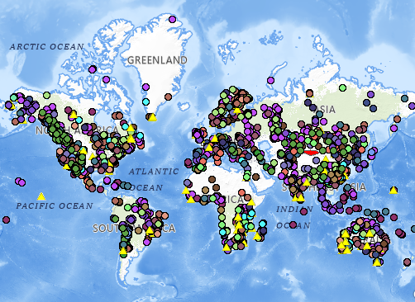
Studying
Lesson 6
Ores and Minerals Instruction | Student Slides
Studying mineral distribution is crucial. It allows us to find out where different minerals are located, which is vital for responsible resource management, mining operations, economic planning, industrial development, conservation, and global trade agreements.
Global Distribution of Selected Mines, Deposits, and Districts of Critical Minerals courtesy of the U.S. Geological Survey, https://colorado-river-portal.usgs.gov/maps/729127ed3aa44991a7dad2a775aa3988/about

Slide 23
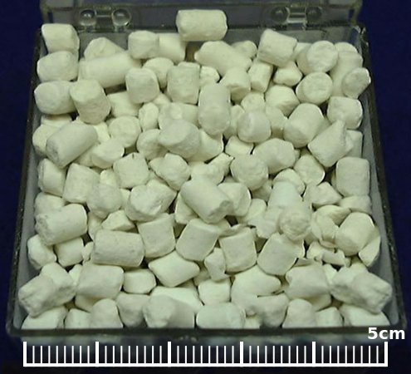
Critical Minerals (1)
Lesson 6
Ores and Minerals Instruction | Student Slides
Critical minerals are designated as such because they are at risk of becoming unavailable due to high demand, difficulties with extraction and refinement, scarcity, and world politics. One example is lithium used for batteries, which is sourced mainly from Chile and Argentina.
U.S. Geological Survey. (2010). LithiumPelletsUSGOV [Photograph]. Wikimedia Commons. https://commons.wikimedia.org/wiki/ File:LithiumPelletsUSGOV.jpg

Slide 24
Critical Minerals (2)
Lesson 6
Ores and Minerals Instruction | Student Slides
As with many minerals, the refinement of lithium is a complex and environmentally sensitive process. Strict regulations are necessary to ensure it won’t contaminate groundwater or soil. Difficulties and regulations include:
Plentiful water source
Building evaporation ponds
Long time to extract
Lengthy process for permits
U.S. Geological Survey. (2010). LithiumPelletsUSGOV [Photograph]. Wikimedia Commons. https://commons.wikimedia.org/wiki/ File:LithiumPelletsUSGOV.jpg

Slide 25
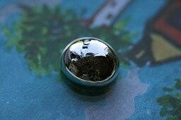
Critical Minerals (3)
Lesson 6
Ores and Minerals Instruction | Student Slides
Critical minerals are essential to our economy, industry, and national security. Critical minerals are necessary for the production of key products.
The United States needs to ensure access to supplies of these materials because they are so important to our lives.
Pixelmaniac pictures. (2011). Gallium surface tension [Photograph]. Wikimedia Commons. https://commons.wikimedia.org/wiki/ File:Gallium_surface_tension.jpg

Slide 26
Critical Minerals (4)
Lesson 6
Ores and Minerals Instruction | Student Slides
The USGS studies the uses of critical minerals, their supply, and mining locations. Gallium (shown right), for example, is currently on the 2025 critical minerals list from the USGS in part because its export to the U.S. was banned by China and also because gallium occurs in very small concentrations in ores of other metals, making it hard to obtain in a pure state.
Pixelmaniac pictures. (2011). Gallium surface tension [Photograph]. Wikimedia Commons. https://commons.wikimedia.org/wiki/ File:Gallium_surface_tension.jpg

Slide 27
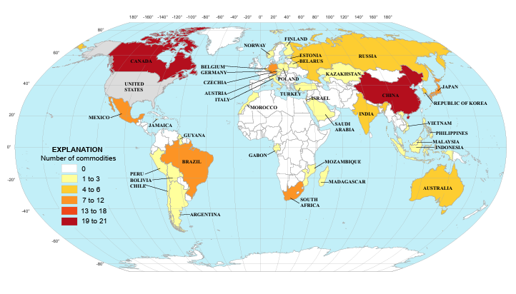
USGS Report
Lesson 6
Ores and Minerals Instruction | Student Slides
You can learn more about the USGS list of critical minerals at:
www.usgs.gov/science/science-explorer/minerals/critical-minerals
And check out the Mineral Commodity Summaries 2025 at:
https://pubs.usgs.gov/periodicals/mcs2025/mcs2025.pdf
U.S. Geological Survey, 2025, Mineral commodity summaries 2025: U.S. Geological Survey, 212 p., https://doi.org/10.3133/mcs2025, Figure 3.—Leading Import Sources* (2020–23) of Nonfuel Mineral Commodities for Which the United States Was Greater Than 50% Net Import Reliant, p. 8.

Slide 28
Review of Guiding Questions
Lesson 6
Ores and Minerals Instruction | Student Slides
✔
Why are minerals unevenly distributed in Earth’s crust?
What are the properties of minerals that make them important?
Why is it important to assess what minerals are available and what minerals are critical?
✔
✔

Slide 29
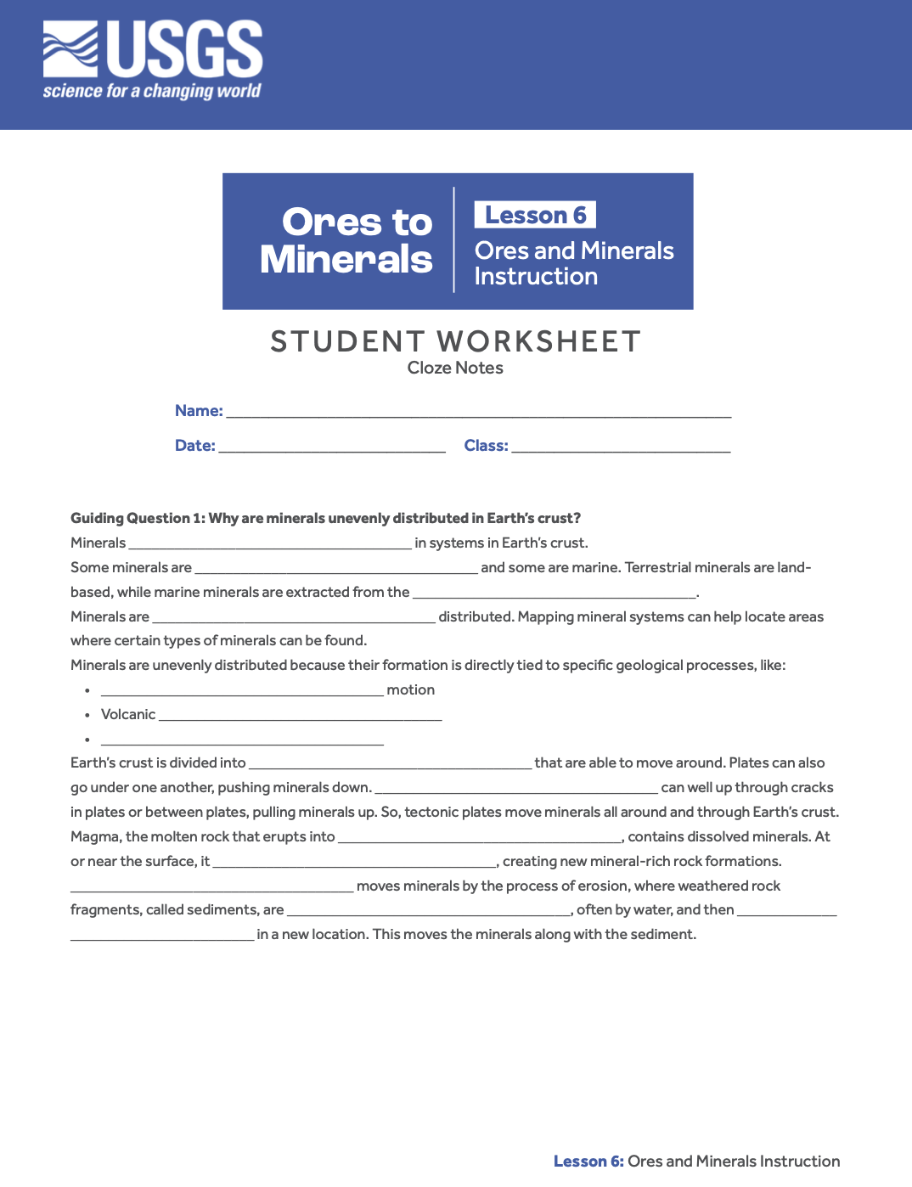
Student Worksheet
Lesson 6
Ores and Minerals Instruction | Student Slides
Did you complete the cloze notes on your Student Worksheet during this slide presentation?
Great work!

Slide 30
Up Next
Lesson 6
Ores and Minerals Instruction | Student Slides
You’ll tackle a research project to find out more about minerals. Get your thinking cap on!

