Slide 1

Preparing for your RGE-EDGE Review
Steve Hilburger and Mark Miller
RGE-EDGE Senior Scientists
Office of Science Quality and Integrity (OSQI)
2026 Summer Review Cycle (June 15 Submission)
RGE mailbox rge-edge@usgs.gov
RGE website www.usgs.gov/rge-edge

Slide 2
RGE and EDGE Definitions
RGE: Research Grade Evaluation
Research Scientists
~900 RGE scientists
OPM RGE Guide (2006)
EDGE: Equipment Development Grade Evaluation
Development Scientists
~50 EDGE scientists
OPM EDGE Guide (1968)

Slide 3
RGE-EDGE Review
Mandatory and periodic classification review of Permanent scientists
Administered by OSQI in collaboration with the Office of Human Resources
Reviewed by panels of scientific peers who meet, discuss, and reach consensus
Sum of scores from factors 1–4 maps to a grade

Slide 4
Review Schedule and Frequency
Frequency and current assignment period varies with grade
GS-9 (EDGE) or GS-11 (RGE) to GS-13: every 4 years
GS-14: 6 years
GS-15: 7 years
All schedule changes require CD approval:
Early reviews scheduled with CD approval
Delayed reviews possible, typically limited to:
Personal / health issues, or
Temporary assignments away from typical research work
Not provided for convenience or to allow a better package

Slide 5
Annual Calendar
Two RGE-EDGE “cycles” per year, each with
~100+ scientists reviewed; ~15+ panels held
Summer Cycle
May 15 Intent to Submit Deadline (for all early review and conversion additions)
June 15 submission date
Panels meet ~September through ~December
Winter Cycle
November 15 Intent to Submit Deadline (for all early review and conversion additions)
December 15 submission date
Panels meet ~March through ~June
These dates changed late 2025.

Slide 6
What is in an RGE-EDGE package?
Five files are required:
1. Research or Development Scientist Record
2. Significant Contribution 1 (as PDF attachment, or URL if needed)
3. Significant Contribution 2 (as PDF attachment, or URL if needed)
4. Significant Contribution 3 (as PDF attachment, or URL if needed)
5. Approval Sheet signed by CD, supervisor, and scientist
Optional:
Letter(s) of Support from supervisor and/or center director
External Impact Statements
Templates and guidance on www.usgs.gov/rge-edge

Slide 7
Planning for your RGE-EDGE review
Review Planning for your Submission document
Read carefully the relevant scoring criteria
OPM RGE Guide
OPM EDGE Guide (pages 42–60) and EDGE checklist
If you’re a GS-15, the Degree G Criteria
Give yourself time
Write clearly and concisely; use plain language
Have colleagues, supervisor, Center Director review

Slide 8
Use of Generative AI
Must comply with existing DOI and USGS policies
Not to be used to author research or development scientist records.
Can be used as a writing improvement tool.
Human authors are responsible for the scientist record and for any modifications introduced by the use of AI tools.
Generative AI is not to be used to perform peer reviews.
Relevant USGS Policies
Generative AI and Authorship
Restrictions on Using Generative AI
Ensuring Reliability and Accuracy of AI
Safeguarding Information Using AI

Slide 9
Scientist Record – Outline
Scientist Background
Written Narratives (length limits)
Research Environment
Four Factor Narratives
Three Significant Contributions
Supporting Information (no length limit)
Bibliography, Presentations, Service, Awards, etc.
Reference List
Please don’t change the headings

Slide 10
Scientist Background
Name (pronouns, optional)
Classification Title, Series, and Grade
Center Name
Duty Station
Date of Entrance to Federal Service
Date of Last Promotion
Review Cycle Submitted
Up to 5 descriptive phrases that characterize your research and specialties
(e.g., aquatic trophic interactions, heavy metal isotopes, earthquake wave propagation…Avoid general terms such as hydrology, ecology, and geology.)

Slide 11
Research or Development Environment
An abstract to your position
Very high-level summary
Scope of research/development
Primary collaborators
Major sources of funding
Not scored, offers context
Do not include:
Lengthy lists with a lot of detail

Slide 12
Factor Narratives - Overview
Allows you to directly address each of the four factors.
Focus factors 1, 2, and 3 on current assignment (varies by grade; see guidance document).
Factor 4 can cover full career but recency matters.
Focus on clear descriptions of your work and your role.
Claims made in the narrative must be substantiated in the record.
Tips:
Become familiar with OPM Guide criteria but avoid relying on aspirational phrases from the Guide.
Show, don’t tell.
Describe specific evidence; avoid making a general statement followed by numerous citations.
Do not include images, diagrams, pictures, or illustrations.

Slide 13
Factor I: Research Assignment
Focus on:
Scope and complexity
General types of methods used
Importance of expected results
Scientific leadership – team, supervisory, and administrative responsibilities
Discuss your specific role
Tips:
Keep to current assignment: work done in perm position, in last ~4, ~6, or ~7 years; or since last promotion, if shorter
Discuss the norm of the assignments rather than atypical projects

Slide 14
Factor II: Supervisory Controls
Focus on:
Degree of personal responsibility
Authority to act independently
Level of approval required
Technical supervision required
Tips:
Keep to current assignment: work done in perm position, in last ~4, ~6, or ~7 years; or since last promotion, if shorter
Does not evaluate administrative supervision that you provide
Panel will consider guidance and supervision from all sources, not only from your direct supervisor
At higher levels, the scientist has the autonomy to influence high-level (DOI) scientific directions

Slide 15
Factor III: Guidelines and Originality
Focus on:
Preexisting knowledge available
How you demonstrated originality
Novelty of methods, approaches, and frameworks used in products
Tips:
Keep to current assignment: work done in perm position, in last ~4, ~6, or ~7 years; or since last promotion, if shorter
Explain how your work is original
Specific examples are highly useful to panels

Slide 16
Factor IV: Contributions, Impact, Stature
Focus on:
Scientific contributions – publications, datasets, tools, code, presentations, testimony, strategic planning, special assignments…
Impact to society, agency, or science
Stature and standing
Invitations, elected positions, awards, recognitions, selection to lead teams…
Who is inviting, recognizing, selecting...
Tips:
Includes your entire career; recency is important to receive full credit
Discuss how your work is:
Changing the way people think or act
Advancing scientific understanding
Advancing the USGS and DOI Mission
Protecting and advancing the health, safety, economic vitality, or ecological integrity of society

Slide 17
Focus on Impacts
Former tendency for panels to over-rely on numbers of publications and reputation of outlets
Panels consider all scoring criteria, not just publications
Panels consider both impact and outputs

Slide 18
Three Significant Contributions
Select three specific products that demonstrate your recent research and major career achievements
May be publications, datasets, scientific tools, patents, code, presentations, testimony, strategic planning, and special assignments.
Include these products with your submission
Include PDFs as separate files (URLs if needed)
Narrative: Background, Role, Results, Impact
Some products may be limiting:
Very recent and in-press (impact is uncertain)
Pre-USGS publications (does not describe USGS assignment)

Slide 19
Length Limits for Narrative Sections
Including spaces
These are LIMITS, not targets
RSR/DSR Section | Characters Allowed | Page Length
Res./Dev. Env.: | 2,500 | (~3/4 page)
Factor 1: | 7,000 | (~2 pages)
Factor 2: | 3,500 | (~1 page)
Factor 3: | 7,000 | (~2 pages)
Factor 4: | 14,000 | (~4 pages)
Contributions: | 10,500 | (~3 pages)
Total: | 44,500 | (~12–13 pages)

Slide 20
Supporting Information (slide 1)
A. Current and Recent Projects (brief descriptions)
B. Bibliography
Published products
Products approved for publication (have BAO approval)
Unpublished technical reports
Submitted manuscripts
include data releases; see Guidance
include relative % contributions for Concept, Data, Interpretation, Writing; see Guidance
C. Presentations
Invited or noteworthy (entire career)
Contributed presentations (last 10 years)
D. Professional and Scientific Service
E. Academic Service

Slide 21
Supporting Information (slide 2)
F. Technical Training Provided
G. Awards and Recognition (research- or development-related awards)
H. Special Assignments
I. Inventions and Patents**
J. Outreach and Media Coverage
K. Previous Professional Positions
L. Education**
** these sections differ between RGE and EDGE

Slide 22
References
Supervisor & Center Director (required)
Panelists will contact at least 4
CD, Supervisor, and 2+ others
List at least 6 references and their specific professional relationship to you.
“Collaborator on wormhole project”
“End user of SPYDER model”
Supervisor / CD turnover?
Feel free to list both current and former with notes
Consider including a range of collaborators, cooperators, partners and people who have been impacted by your science.
Recommend that you contact references prior to listing them. Consider sharing your documentation with them.
Panelists may contact people other than your references in certain situations.

Slide 23
External Impact Statements
Optional
External (non-USGS) authors only
Written letters that supplement the reference discussions
A way to ensure a certain viewpoint is included in your package
You collect and include letter as part of package
See guidance document online
Includes information useful to potential authors
Authors may be contacted by panelists for follow up
Please list Impact Statement Authors among your references

Slide 24
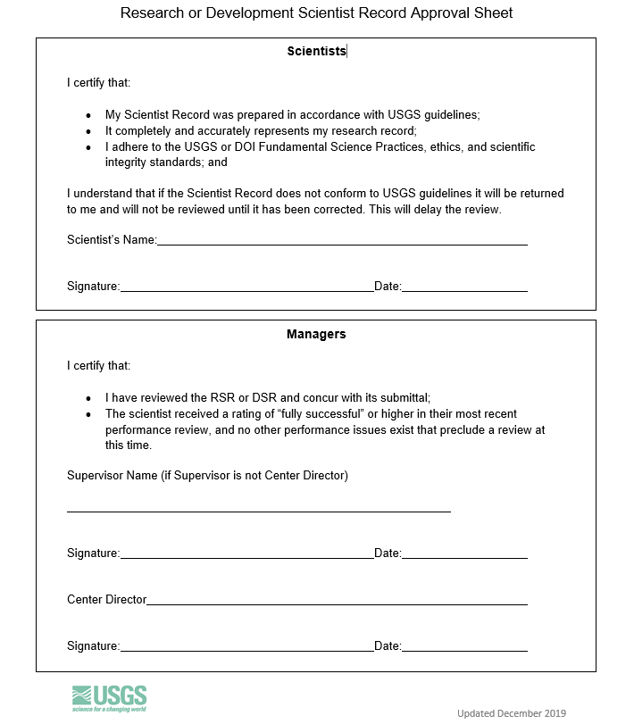
Approval Sheet and Signature
Your supervisor AND Center Director will review and verify
Accuracy
Use of clear language
Section length limits
Use of IPDS numbers
BAO approval dates
Electronic/pen signatures OK
Multiple copies OK

Slide 25
Ready to submit?
Refer to Planning for your Submission document
When package is complete
Email to submit_rge-edge@usgs.gov
You will receive confirmation of receipt
Submit all files by email, if possible
Break into multiple emails if needed
Contact us for extreme file size issues
If prompted, decline Outlook’s suggestion to submit OneDrive “links” instead; please actually attach the files
Use rge-edge@usgs.gov for general questions

Slide 26
Dynamic Peer Groups
Scientists do not pre-select peer group
Panels formed based on expertise of the scientists to be reviewed in each cycle
A computer program clusters packages into groups with similar expertise, which is followed by human curation
Results in better panel composition
Allows more efficient panel development

Slide 27
Panel Findings
Written description of the score (typically 3-5 pages)
How each factor score was determined
Framed in terms of OPM Guide criteria
Why the higher score was not awarded
“The panel did not see evidence of [guide criteria]”
“The factor fully meets but does not exceed level C”
Goal to be more explicit, less subtle
No prescriptive statements ("you should focus more on....")

Slide 28
When will you receive your results?
It varies!
Planning to evaluate ~100 scientists over 15+ panels.
Panels held through ~December.
Individual results sent to Center Directors after each panel.
Specific timing depends on the overall schedule of panels.

Slide 29
Disagree with your results?
You have options.
Discuss with your supervisor / Center Director
Engage with RGE-EDGE Coordinators at OSQI
Request early review (requires CD approval)
Request Classification Review by Human Resources

Slide 30

Resources – www.usgs.gov/rge-edge
Planning for your Submission document
OPM’s RGE Guide and EDGE Guide
EDGE checklist and Degree G criteria
Training materials (these slides)
Current Scientist Record templates (Mar 2023) and associated guidance (July 2025)
External Impact Statement guidance
Approval Sheet (Feb 2026)

Slide 31
Contacts
RGE-EDGE Coordinators
Steve Hilburger shilburger@usgs.gov
Mark Miller mpmiller@usgs.gov
Shared RGE-EDGE mailbox rge-edge@usgs.gov
Human Resources related to RGE-EDGE
Servicing Personnel Office

