Slide 1
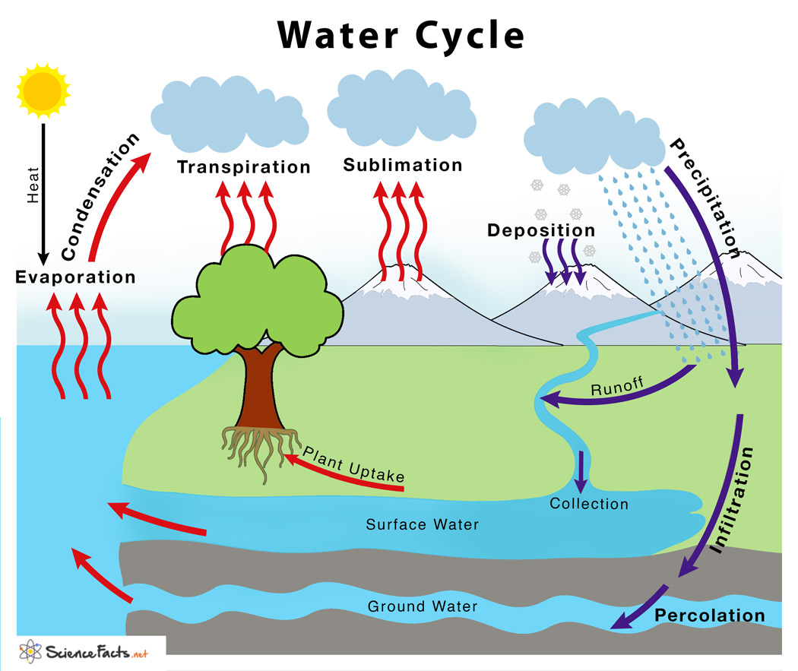
Water Cycle Exploration
Explore
Pair
Share

Slide 2

This class is being recorded for learning purposes!
BE KIND
Take Risks!
Don’t be afraid to try!
Make Mistakes!
Show Respect!
Use Manners!
Participate!
Complete today’s assignment in class!

Slide 3
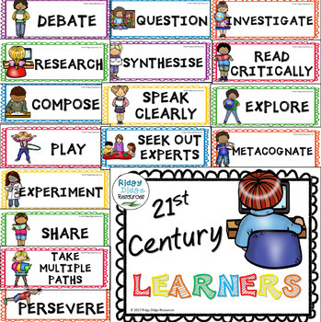
Objectives and State Standards
Objective/s: Students explore different activities regarding the water cycle to discuss their findings with a partner to earn a 100% on today’s assignment.
Indiana State Standards: S-ESS2-4 Develop a model to describe the cycling of water through Earth's systems driven by energy from the sun and the force of gravity.

Slide 4
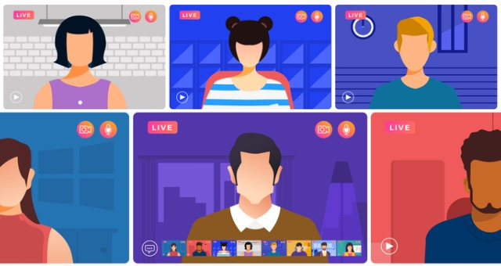
You may…
1. Work alone by downloading the PPT under content in your D2
2. Work in at a table with 2 or 3 friends
3. Work individually in Nearpod

Slide 5
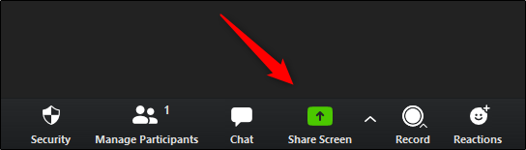
You Must Screen Share or Else! Dun Dun Dun Dun

Slide 6

Expectations
Download the PPT to write on it or work in NearPod
Raise hand immediately if someone is MIA or not participating at the table. Teacher will contact LC.
Collaborate not compete!
Read and complete the prompts on each slide.
Complete today’s Exit Ticket.
Raise your hand for the teacher to check when finished.

Slide 7
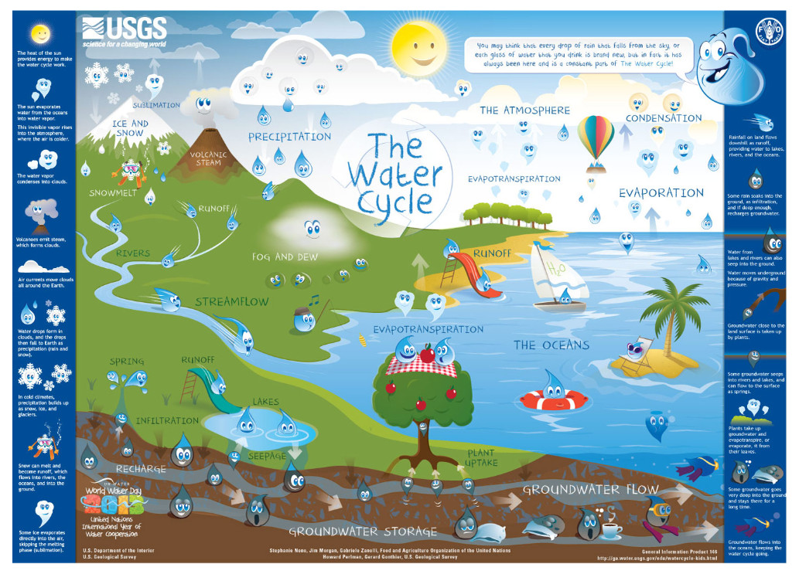
Place circles on the diagram where or when you have seen or experienced any of the terms. Explain in chat.
Example: I circled rivers because I use them to kayak!
I circled ground water storage because we draw water from our well.

Slide 8
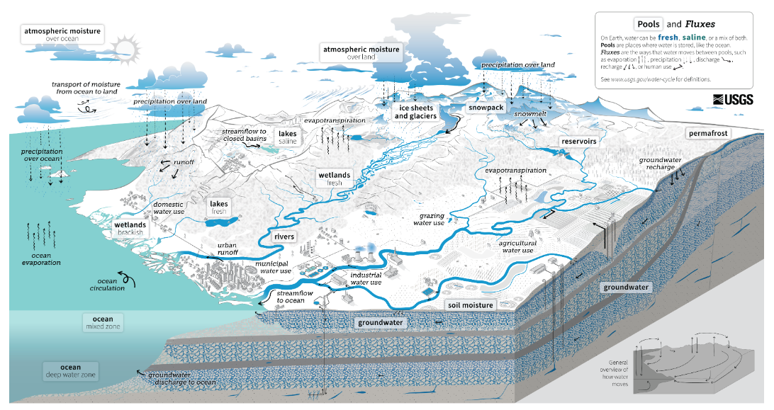
This is an example of what geologist view when they study water cycle diagrams!
Discuss: How is this diagram different from the one we just viewed?

Slide 9
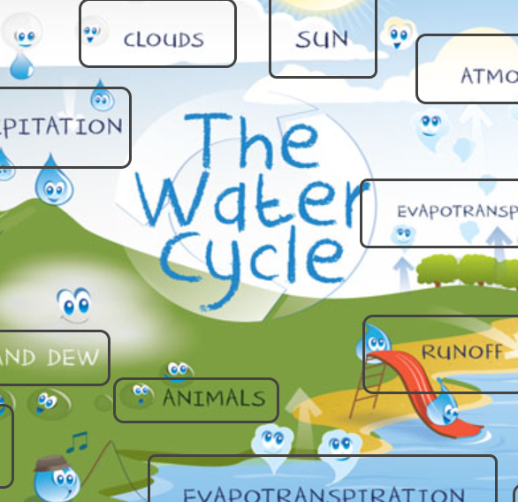
Scavenger Hunt: Visit the website and click on the interactive titles to solve the riddles below.
https://water.usgs.gov/edu/watercycle-kids-adv.html
Who is the boss of the water cycle?
Name a place where sublimation occurs.
What is the superhighway of the sky?
Who does not play a large roll in the water cycle?
Why can’t a water droplet get tan?
What part of the water cycle is like spilling a drink on the carpet?

Slide 10
Scavenger Hunt: Visit the website and click on the interactive titles to solve the riddles below.
https://water.usgs.gov/edu/watercycle-kids-adv.html
What process of the water cycle works against gravity drawing up water?
What forms from building a dam or a reservoir?
Where would you vacation if you wanted to see Bow River Falls?
Who “blows off” steam?

Slide 11

Choice Board: Visit the link. Each person chooses one article to read silently to themselves. Complete the activity on the next slide!
Make sure you choose an article from the list and that they are different from one another!
Hydrologic Cycle
Cloud
Hydrosphere
Condensation
Types of Precipitation
Water Tables and Aquifers
From Toilet to Tap
Water Cycle
Evaporation
Precipitation
Surface Water
Watershed
Link: https://education.nationalgeographic.org/resource/resource-library-the-water-cycle/

Slide 12
Partner 1: Inform your partner of the title and 3 facts from the article you read. Partner 2 record the information below. Repeat, switching roles.
Partner 2 learned… from Partner 1
Partner 2 knows…
Partner 1 learned… from Partner 2
Partner 2 records what they learned from partner 1!
Partner 1 records what they learned from partner 2!

Slide 13


Sign your name below when you ACE your ET! Call the teacher when finished!

Slide 14

Resources
USGS: https://water.usgs.gov/edu/watercycle-kids-adv.html
National Geographic Education – The Water Cycle: https://education.nationalgeographic.org/resource/resource-library-the-water-cycle/

